Slide 1
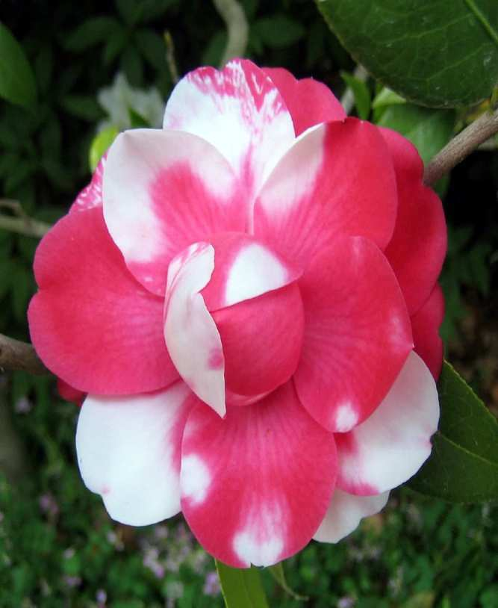

Genetics Review Game
Part 5
Lesson 11

Slide 2
Part V Genetics Review Game
MEN DULL | TYPO | HOT LOTTO | THINK INSIDE THE BOX | -Bonus- FAMILY TIES
1 | 6 | 11 | 16 | *21
2 | 7 | 12 | 17 | *22
3 | 8 | 13 | 18 | *23
4 | 9 | 14 | 19 | *24
5 | 10 | 15 | 20 | *25

Slide 3
How to play…
  Don’t play like Jeo_ _ _ _ y.
  Class should be divided into several small groups.
  Groups should use science journal (red slide notes), homework, and other available materials to assist you.
  Groups can communicate quietly with each other but no sharing answers between groups.
    Practice quietly communicating right now?
    Practice Communication Question:
    Your group gets to order one pizza and you can have two toppings. What does your group want?

Slide 4

Questions 1-20 = 5pts Each
Final Category (Bonus) = 1pt Each
Final Questions = 5 pt wager
If you wager 5 on the last question and get it wrong you lose 5 pts. Wager 5 and get it right you get 5 pts.
Find the Owl =
Secretly write “Owl” in the correct box worth 1pt.
“I’ll be about this big.”

Slide 5
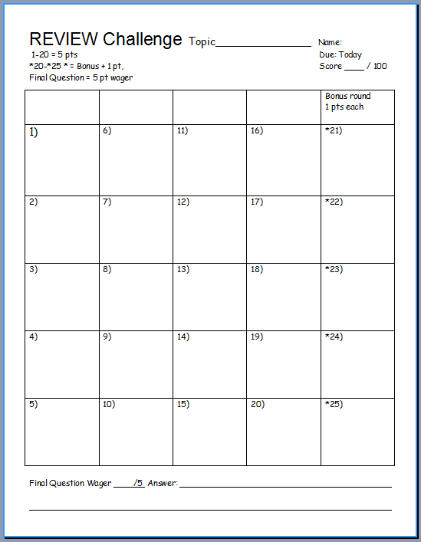
Is your name on the review sheet?
Name

Slide 6
Is your name on the review sheet?
Add the categories
along the top
on the next slide.

Slide 7
Part V Genetics Review Game
MEN DULL | TYPO | HOT LOTTO | THINK INSIDE THE BOX | -Bonus- FAMILY TIES
1 | 6 | 11 | 16 | *21
2 | 7 | 12 | 17 | *22
3 | 8 | 13 | 18 | *23
4 | 9 | 14 | 19 | *24
5 | 10 | 15 | 20 | *25

Slide 8
Part V Genetics Review Game
MEN DULL | TYPO | HOT LOTTO | THINK INSIDE THE BOX | -Bonus- FAMILY TIES
1 | 6 | 11 | 16 | *21
2 | 7 | 12 | 17 | *22
3 | 8 | 13 | 18 | *23
4 | 9 | 14 | 19 | *24
5 | 10 | 15 | 20 | *25

Slide 9
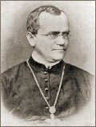
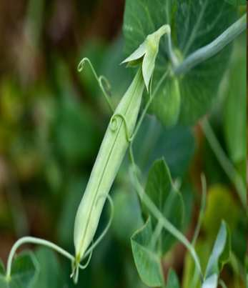
This Monk is known as the father of modern genetics for his work with pea plants.
1
Copyright © 2024 SlideSpark .LLC

Slide 10
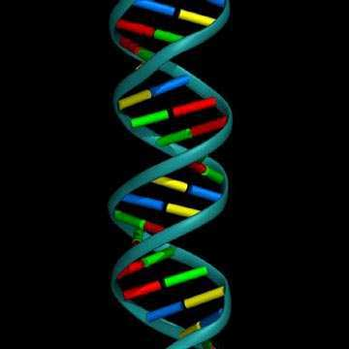
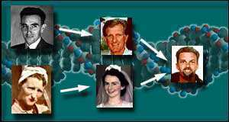
This is the term for when organisms pass traits from parents to offspring.
  A.) Genetics
  B.) Punnett Squares
  C.) Alleles
  D.) Heredity
  E.) Homozygous
2
Copyright © 2024 SlideSpark .LLC

Slide 11
This is the term for when organisms pass traits from parents to offspring.
  A.) Genetics
  B.) Punnett Squares
  C.) Alleles
  D.) Heredity
  E.) Homozygous
2
Copyright © 2024 SlideSpark .LLC

Slide 12
This is the term for when organisms pass traits from parents to offspring.
  A.) Genetics
  B.) Punnett Squares
  C.) Alleles
  D.) Heredity
  E.) Homozygous
2
Copyright © 2024 SlideSpark .LLC

Slide 13
This is the term for when organisms pass traits from parents to offspring.
  A.) Genetics
  B.) Punnett Squares
  C.) Alleles
  D.) Heredity
  E.) Homozygous
2
Copyright © 2024 SlideSpark .LLC

Slide 14
This is the term for when organisms pass traits from parents to offspring.
  A.) Genetics
  B.) Punnett Squares
  C.) Alleles
  D.) Heredity
  E.) Homozygous
2
Copyright © 2024 SlideSpark .LLC

Slide 15
This is the term for when organisms pass traits from parents to offspring.
  A.) Genetics
  B.) Punnett Squares
  C.) Alleles
  D.) Heredity
  E.) Homozygous
2
Copyright © 2024 SlideSpark .LLC

Slide 16
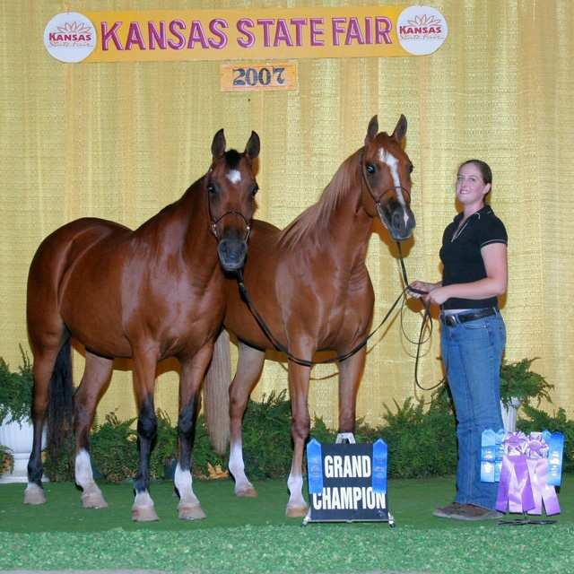
When two purebreds mate, they always produce…
  A.) Offspring with different traits as the parent.
  B.) Offspring with the same traits as the parent.
  C.) Offspring without any traits.
  D.) Purebreds cannot produce offspring.
3
Copyright © 2024 SlideSpark .LLC

Slide 17
When two purebreds mate, they always produce…
  A.) Offspring with different traits as the parent.
  B.) Offspring with the same traits as the parent.
  C.) Offspring without any traits.
  D.) Purebreds cannot produce offspring.
3
Copyright © 2024 SlideSpark .LLC

Slide 18
When two purebreds mate, they always produce…
  A.) Offspring with different traits as the parent.
  B.) Offspring with the same traits as the parent.
  C.) Offspring without any traits.
  D.) Purebreds cannot produce offspring.
3
Copyright © 2024 SlideSpark .LLC

Slide 19
When two purebreds mate, they always produce…
  A.) Offspring with different traits as the parent.
  B.) Offspring with the same traits as the parent.
  C.) Offspring without any traits.
  D.) Purebreds cannot produce offspring.
3
Copyright © 2024 SlideSpark .LLC

Slide 20
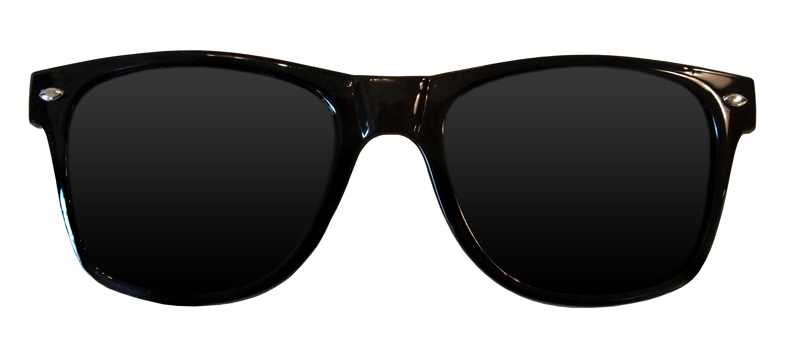
When two purebreds mate, they always produce…
  A.) Offspring with different traits as the parent.
  B.) Offspring with the same traits as the parent.
  C.) Offspring without any traits.
  D.) Purebreds cannot produce offspring.
3
Copyright © 2024 SlideSpark .LLC

Slide 21
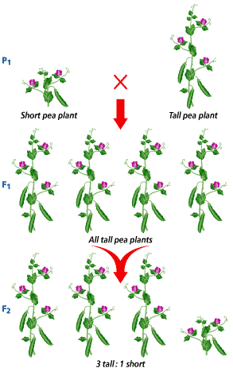
4
What were Mendel’s results in the F2 Generation?
?
?
?
?
Copyright © 2024 SlideSpark .LLC

Slide 22
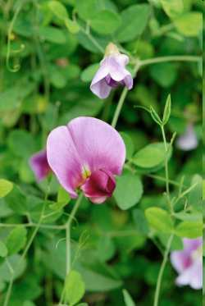
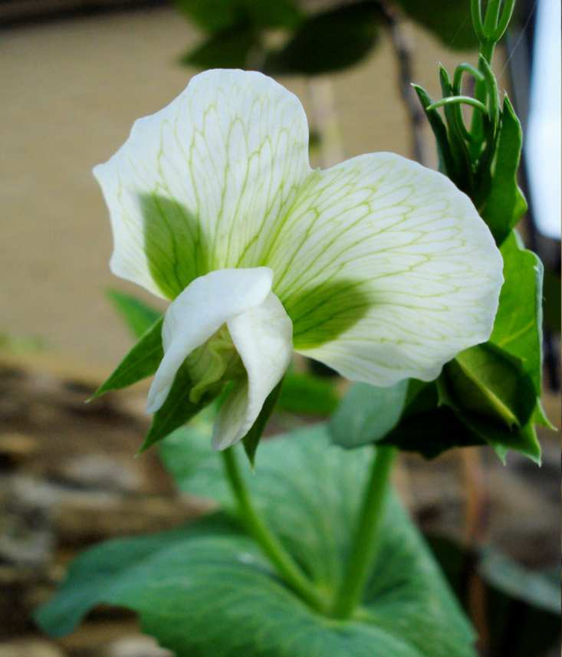
This is the name for an organism’s physical appearance or its visible traits.
5

Slide 23
Part V Genetics Review Game
MEN DULL | TYPO | HOT LOTTO | THINK INSIDE THE BOX | -Bonus- FAMILY TIES
1 | 6 | 11 | 16 | *21
2 | 7 | 12 | 17 | *22
3 | 8 | 13 | 18 | *23
4 | 9 | 14 | 19 | *24
5 | 10 | 15 | 20 | *25

Slide 24
Part V Genetics Review Game
MEN DULL | TYPO | HOT LOTTO | THINK INSIDE THE BOX | -Bonus- FAMILY TIES
1 | 6 | 11 | 16 | *21
2 | 7 | 12 | 17 | *22
3 | 8 | 13 | 18 | *23
4 | 9 | 14 | 19 | *24
5 | 10 | 15 | 20 | *25

Slide 25
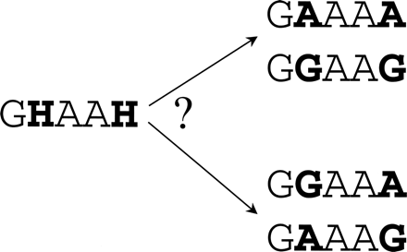
This is the name for an organism’s genetic makeup, or allele combinations
6
Copyright © 2024 SlideSpark .LLC

Slide 26
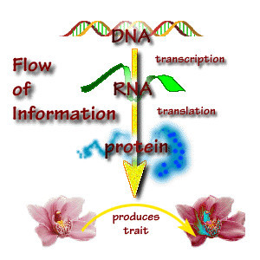
7

Slide 27
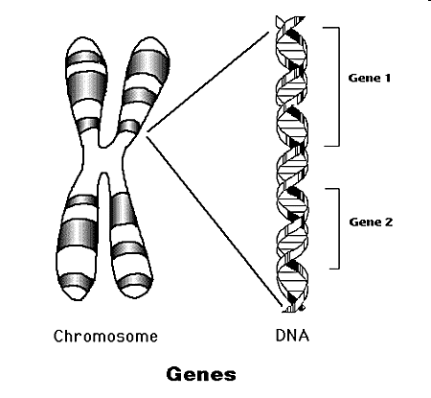
Geneticists call the factors that control traits genes .
8
Copyright © 2024 SlideSpark .LLC

Slide 28
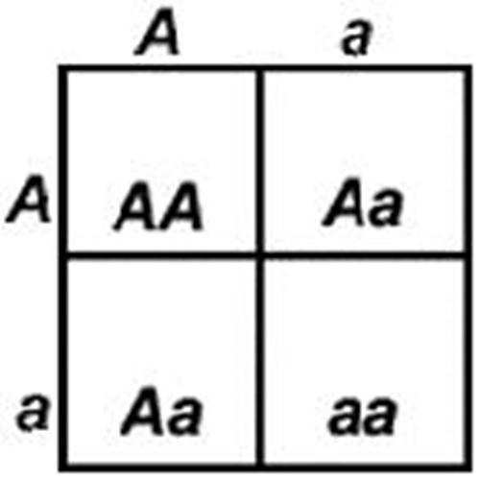
This type of allele always shows up in the organism when the allele is present.
  A.) Recessive
  B.) Dominant
  C.) Heterozygous
  D.) Incomplete
  E.) Mendellion Allele
9
Copyright © 2024 SlideSpark .LLC

Slide 29
This type of allele always shows up in the organism when the allele is present.
  A.) Recessive
  B.) Dominant
  C.) Heterozygous
  D.) Incomplete
  E.) Mendellion Allele
9
Copyright © 2024 SlideSpark .LLC

Slide 30
This type of allele always shows up in the organism when the allele is present.
  A.) Recessive
  B.) Dominant
  C.) Heterozygous
  D.) Incomplete
  E.) Mendellion Allele
9
Copyright © 2024 SlideSpark .LLC

Slide 31
This type of allele always shows up in the organism when the allele is present.
  A.) Recessive
  B.) Dominant
  C.) Heterozygous
  D.) Incomplete
  E.) Mendellion Allele
9
Copyright © 2024 SlideSpark .LLC

Slide 32
This type of allele always shows up in the organism when the allele is present.
  A.) Recessive
  B.) Dominant
  C.) Heterozygous
  D.) Incomplete
  E.) Mendellion Allele
9
Copyright © 2024 SlideSpark .LLC

Slide 33
This type of allele always shows up in the organism when the allele is present.
  A.) Recessive
  B.) Dominant
  C.) Heterozygous
  D.) Incomplete
  E.) Mendellion Allele
9
Copyright © 2024 SlideSpark .LLC

Slide 34
This type of allele is covered up when the dominant allele is with it?
10
Copyright © 2024 SlideSpark .LLC

Slide 35
Part V Genetics Review Game
MEN DULL | TYPO | HOT LOTTO | THINK INSIDE THE BOX | -Bonus- FAMILY TIES
1 | 6 | 11 | 16 | *21
2 | 7 | 12 | 17 | *22
3 | 8 | 13 | 18 | *23
4 | 9 | 14 | 19 | *24
5 | 10 | 15 | 20 | *25

Slide 36
Part V Genetics Review Game
MEN DULL | TYPO | HOT LOTTO | THINK INSIDE THE BOX | -Bonus- FAMILY TIES
1 | 6 | 11 | 16 | *21
2 | 7 | 12 | 17 | *22
3 | 8 | 13 | 18 | *23
4 | 9 | 14 | 19 | *24
5 | 10 | 15 | 20 | *25

Slide 37
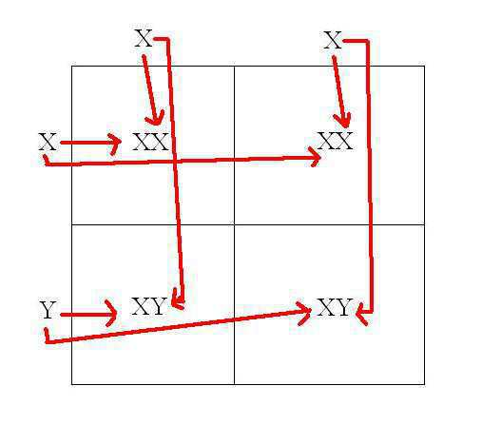
This is the name for a diagram that is used to predict the outcome of a particular cross
11
Copyright © 2024 SlideSpark .LLC

Slide 38
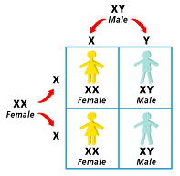
Which gender decides the childs gender?
Use the Punnett Square below to help you.
  XX=Female XY=Male
12
Copyright © 2024 SlideSpark .LLC

Slide 39
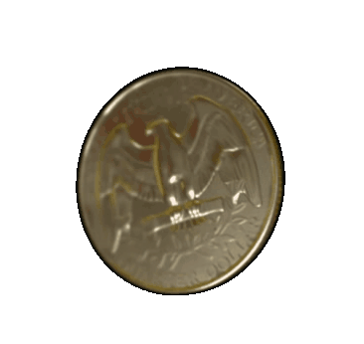
Genetics deals heavily with probability, or the likelihood that a particular event will occur.
13
Copyright © 2024 SlideSpark .LLC

Slide 40
14
The letters below represent…
  A.) Both are Heterozygous Dominant
  B.) Homozygous recessive and Homozygous Dominant
  C.) Heterozygous and Heterozygous
  D.) Both are Heterozygous Recessive
  E.) Homozygous Dominant and Heterozygous
ZZHh
Copyright © 2024 SlideSpark .LLC

Slide 41
14
The letters below represent…
  A.) Both are Heterozygous Dominant
  B.) Homozygous recessive and Homozygous Dominant
  C.) Heterozygous and Heterozygous
  D.) Both are Heterozygous Recessive
  E.) Homozygous Dominant and Heterozygous
ZZHh
Copyright © 2024 SlideSpark .LLC

Slide 42
14
The letters below represent…
  A.) Both are Heterozygous Dominant
  B.) Homozygous recessive and Homozygous Dominant
  C.) Heterozygous and Heterozygous
  D.) Both are Heterozygous Recessive
  E.) Homozygous Dominant and Heterozygous
ZZHh
Copyright © 2024 SlideSpark .LLC

Slide 43
14
The letters below represent…
  A.) Both are Heterozygous Dominant
  B.) Homozygous recessive and Homozygous Dominant
  C.) Heterozygous and Heterozygous
  D.) Both are Heterozygous Recessive
  E.) Homozygous Dominant and Heterozygous
ZZHh
Copyright © 2024 SlideSpark .LLC

Slide 44
14
The letters below represent…
  A.) Both are Heterozygous Dominant
  B.) Homozygous recessive and Homozygous Dominant
  C.) Heterozygous and Heterozygous
  D.) Both are Heterozygous Recessive
  E.) Homozygous Dominant and Heterozygous
ZZHh
Copyright © 2024 SlideSpark .LLC

Slide 45
14
The letters below represent…
  A.) Both are Heterozygous Dominant
  B.) Homozygous recessive and Homozygous Dominant
  C.) Heterozygous and Heterozygous
  D.) Both are Heterozygous Recessive
  E.) Homozygous Dominant and Heterozygous
ZZHh
Copyright © 2024 SlideSpark .LLC

Slide 46
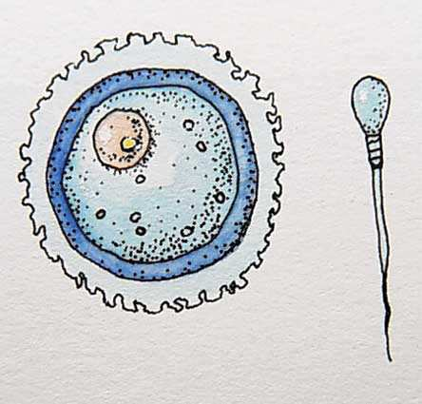
From all of Mendel’s’ results, he reasoned that individual factors must control the inheritance of traits in peas.
  Mendel knew that the female contributes one factor, while the male contributes the other factor in sexual reproduction.
15
Copyright © 2024 SlideSpark .LLC

Slide 47
Part V Genetics Review Game
MEN DULL | TYPO | HOT LOTTO | THINK INSIDE THE BOX | -Bonus- FAMILY TIES
1 | 6 | 11 | 16 | *21
2 | 7 | 12 | 17 | *22
3 | 8 | 13 | 18 | *23
4 | 9 | 14 | 19 | *24
5 | 10 | 15 | 20 | *25

Slide 48
Part V Genetics Review Game
MEN DULL | TYPO | HOT LOTTO | THINK INSIDE THE BOX | -Bonus- FAMILY TIES
1 | 6 | 11 | 16 | *21
2 | 7 | 12 | 17 | *22
3 | 8 | 13 | 18 | *23
4 | 9 | 14 | 19 | *24
5 | 10 | 15 | 20 | *25

Slide 49

16
Please complete the Punnett Square,
Tt and Tt
  T = Tall
  tt = Short
Both parents are heterozygous
How many will be tall, and how many will be short ___ : ___
Copyright © 2024 SlideSpark .LLC

Slide 50
16
Please complete the Punnett Square,
Tt and Tt
  T = Tall
  tt = Short
T t
T
t
Both parents are heterozygous
How many will be tall, and how many will be short ___ : ___
Copyright © 2024 SlideSpark .LLC

Slide 51
New
Question

Slide 52
17
Please complete the Punnett Square,
Tt and tt
  T = Tall
  tt = Short
One parent heterozygous and one homozygous recessive.
How many will be tall, and how many will be short ___ : ___
Copyright © 2024 SlideSpark .LLC

Slide 53
17
Please complete the Punnett Square,
Tt and tt
  T = Tall
  tt = Short
T t
t
t
One parent heterozygous and one homozygous recessive.
How many will be tall, and how many will be short ___ : ___
Copyright © 2024 SlideSpark .LLC

Slide 54
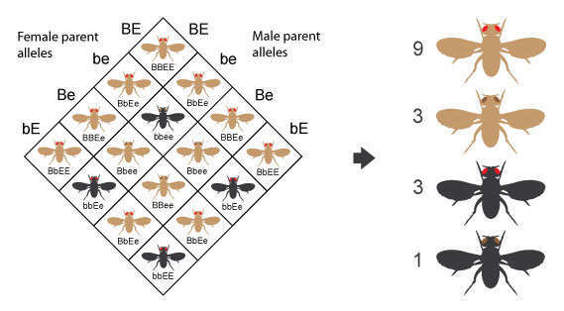
What color body and eye type will the fly be for A, B, C, and D?
B=Brown, b=black, E=Red, e=brown
18
A
B
C
D

Slide 55
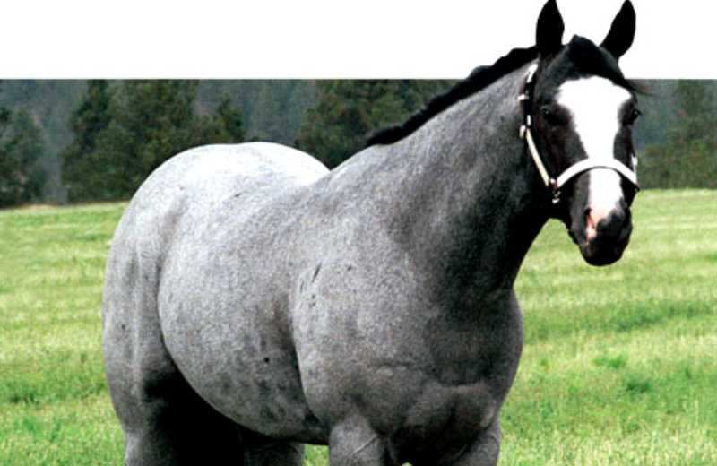
Codominance is a relationship among alleles where both alleles contribute to the phenotype of the heterozygote.
19
Copyright © 2024 SlideSpark .LLC

Slide 56
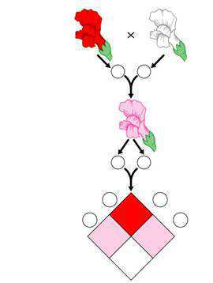
This is an example of...
  A.) Homozygous Dominant
  B.) Heterozygous Dominant
  C.) Incomplete Dominance
  D.) Recessive Alleles
  E.) Pure Breeding
20
Copyright © 2024 SlideSpark .LLC

Slide 57
This is an example of...
  A.) Homozygous Dominant
  B.) Heterozygous Dominant
  C.) Incomplete Dominance
  D.) Recessive Alleles
  E.) Pure Breeding
20
Copyright © 2024 SlideSpark .LLC

Slide 58
This is an example of...
  A.) Homozygous Dominant
  B.) Heterozygous Dominant
  C.) Incomplete Dominance
  D.) Recessive Alleles
  E.) Pure Breeding
20
Copyright © 2024 SlideSpark .LLC

Slide 59
This is an example of...
  A.) Homozygous Dominant
  B.) Heterozygous Dominant
  C.) Incomplete Dominance
  D.) Recessive Alleles
  E.) Pure Breeding
20
Copyright © 2024 SlideSpark .LLC

Slide 60
This is an example of...
  A.) Homozygous Dominant
  B.) Heterozygous Dominant
  C.) Incomplete Dominance
  D.) Recessive Alleles
  E.) Pure Breeding
20
Copyright © 2024 SlideSpark .LLC

Slide 61
This is an example of...
  A.) Homozygous Dominant
  B.) Heterozygous Dominant
  C.) Incomplete Dominance
  D.) Recessive Alleles
  E.) Pure Breeding
20
Copyright © 2024 SlideSpark .LLC

Slide 62
Part V Genetics Review Game
MEN DULL | TYPO | HOT LOTTO | THINK INSIDE THE BOX | -Bonus- FAMILY TIES
1 | 6 | 11 | 16 | *21
2 | 7 | 12 | 17 | *22
3 | 8 | 13 | 18 | *23
4 | 9 | 14 | 19 | *24
5 | 10 | 15 | 20 | *25

Slide 63
Part V Genetics Review Game
MEN DULL | TYPO | HOT LOTTO | THINK INSIDE THE BOX | -Bonus- FAMILY TIES
1 | 6 | 11 | 16 | *21
2 | 7 | 12 | 17 | *22
3 | 8 | 13 | 18 | *23
4 | 9 | 14 | 19 | *24
5 | 10 | 15 | 20 | *25

Slide 64
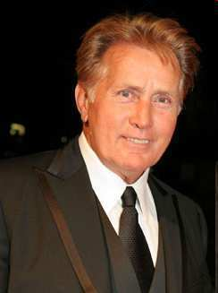
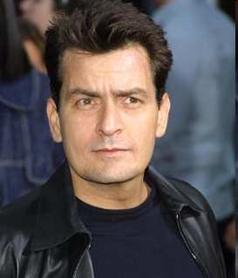

“Who are we?”
Copyright © 2024 SlideSpark .LLC

Slide 65
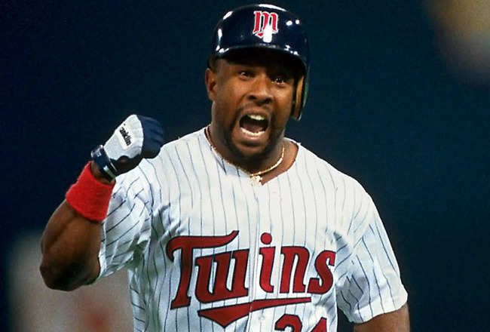

Name this MLB Team?
*22

Slide 66

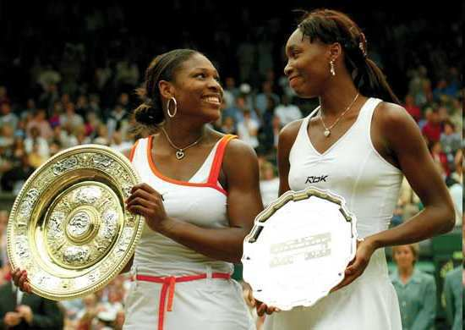
Who are these Grand Slam sisters?
Copyright © 2024 SlideSpark .LLC

Slide 67
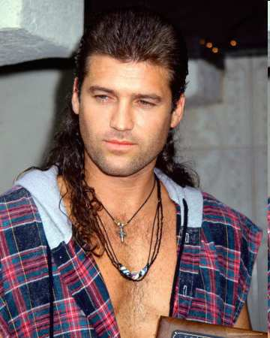

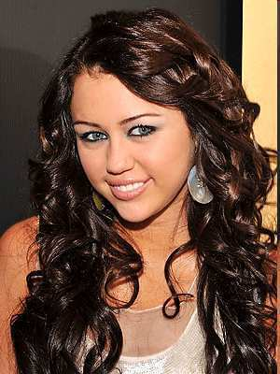
“What’s my dads name?”
Copyright © 2024 SlideSpark .LLC

Slide 68
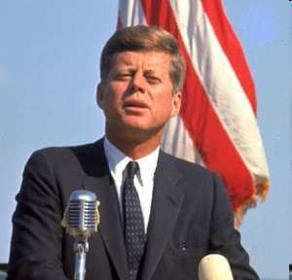
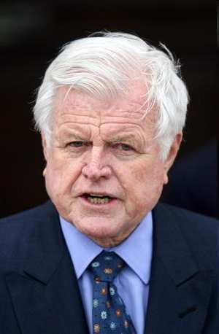

Who are these two?
Copyright © 2024 SlideSpark .LLC

Slide 69
Part V Genetics Review Game
MEN DULL | TYPO | HOT LOTTO | THINK INSIDE THE BOX | -Bonus- FAMILY TIES
1 | 6 | 11 | 16 | *21
2 | 7 | 12 | 17 | *22
3 | 8 | 13 | 18 | *23
4 | 9 | 14 | 19 | *24
5 | 10 | 15 | 20 | *25
Final Question

Slide 70
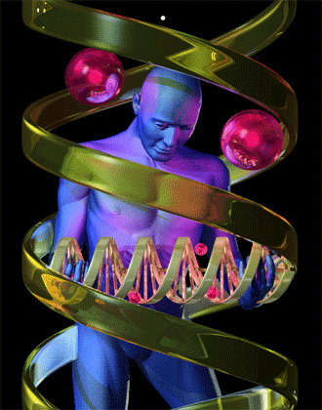
5 Wager Question

Slide 71
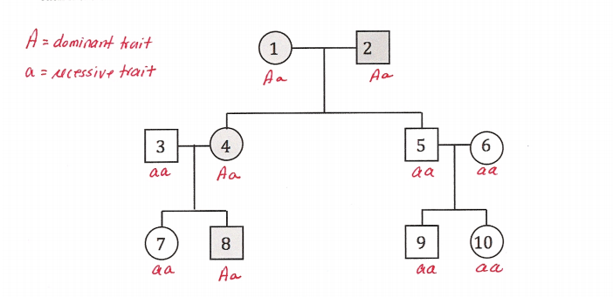
The shaded circles and squares is a dominant allelle. Shaded = Dominant
  What’s the probable genotypes of the two below?
Aa
Aa
aa
Aa

Slide 72
Genetics Review Game
Part 5
Lesson 11

Slide 73

Genetics Review Game
Part 5
Lesson 12

Slide 74
Part V Genetics Review Game
MEN DULL | TYPO | HOT LOTTO | THINK INSIDE THE BOX | -Bonus- FAMILY TIES
1 | 6 | 11 | 16 | *21
2 | 7 | 12 | 17 | *22
3 | 8 | 13 | 18 | *23
4 | 9 | 14 | 19 | *24
5 | 10 | 15 | 20 | *25

Slide 75
Part V Genetics Review Game
MEN DULL | TYPO | HOT LOTTO | THINK INSIDE THE BOX | -Bonus- FAMILY TIES
1 | 6 | 11 | 16 | *21
2 | 7 | 12 | 17 | *22
3 | 8 | 13 | 18 | *23
4 | 9 | 14 | 19 | *24
5 | 10 | 15 | 20 | *25

Slide 76
This Monk is known as the father of modern genetics for his work with pea plants.
1
Copyright © 2010 Ryan P. Murphy

Slide 77
This Monk is known as the father of modern genetics for his work with pea plants.
1
and the answer is…
Copyright © 2010 Ryan P. Murphy

Slide 78
This Monk is known as the father of modern genetics for his work with pea plants.
1
Gregor Mendel
and the answer is…
Copyright © 2010 Ryan P. Murphy

Slide 79
This is the term for when organisms pass traits from parents to offspring.
  A.) Genetics
  B.) Punnett Squares
  C.) Alleles
  D.) Heredity
  E.) Homozygous
2
Copyright © 2024 SlideSpark .LLC

Slide 80
This is the term for when organisms pass traits from parents to offspring.
  A.) Genetics
  B.) Punnett Squares
  C.) Alleles
  D.) Heredity
  E.) Homozygous
2
Copyright © 2024 SlideSpark .LLC

Slide 81
This is the term for when organisms pass traits from parents to offspring.
  A.) Genetics
  B.) Punnett Squares
  C.) Alleles
  D.) Heredity
  E.) Homozygous
2
Copyright © 2024 SlideSpark .LLC

Slide 82
This is the term for when organisms pass traits from parents to offspring.
  A.) Genetics
  B.) Punnett Squares
  C.) Alleles
  D.) Heredity
  E.) Homozygous
2
Copyright © 2024 SlideSpark .LLC

Slide 83
This is the term for when organisms pass traits from parents to offspring.
  A.) Genetics
  B.) Punnett Squares
  C.) Alleles
  D.) Heredity
  E.) Homozygous
2
Copyright © 2024 SlideSpark .LLC

Slide 84
This is the term for when organisms pass traits from parents to offspring.
  A.) Genetics
  B.) Punnett Squares
  C.) Alleles
  D.) Heredity
  E.) Homozygous
2
Copyright © 2024 SlideSpark .LLC

Slide 85
This is the term for when organisms pass traits from parents to offspring.
  A.) Genetics
  B.) Punnett Squares
  C.) Alleles
  D.) Heredity
  E.) Homozygous
2
and the answer is…
Copyright © 2024 SlideSpark .LLC

Slide 86
This is the term for when organisms pass traits from parents to offspring.
  A.) Genetics
  B.) Punnett Squares
  C.) Alleles
  D.) Heredity
  E.) Homozygous
2
and the answer is…
Copyright © 2024 SlideSpark .LLC

Slide 87
When two purebreds mate, they always produce…
  A.) Offspring with different traits as the parent.
  B.) Offspring with the same traits as the parent.
  C.) Offspring without any traits.
  D.) Purebreds cannot produce offspring.
3
Copyright © 2024 SlideSpark .LLC

Slide 88
When two purebreds mate, they always produce…
  A.) Offspring with different traits as the parent.
  B.) Offspring with the same traits as the parent.
  C.) Offspring without any traits.
  D.) Purebreds cannot produce offspring.
3
Copyright © 2024 SlideSpark .LLC

Slide 89
When two purebreds mate, they always produce…
  A.) Offspring with different traits as the parent.
  B.) Offspring with the same traits as the parent.
  C.) Offspring without any traits.
  D.) Purebreds cannot produce offspring.
3
Copyright © 2024 SlideSpark .LLC

Slide 90
When two purebreds mate, they always produce…
  A.) Offspring with different traits as the parent.
  B.) Offspring with the same traits as the parent.
  C.) Offspring without any traits.
  D.) Purebreds cannot produce offspring.
3
Copyright © 2024 SlideSpark .LLC

Slide 91
When two purebreds mate, they always produce…
  A.) Offspring with different traits as the parent.
  B.) Offspring with the same traits as the parent.
  C.) Offspring without any traits.
  D.) Purebreds cannot produce offspring.
3
Copyright © 2024 SlideSpark .LLC

Slide 92
When two purebreds mate, they always produce…
  A.) Offspring with different traits as the parent.
  B.) Offspring with the same traits as the parent.
  C.) Offspring without any traits.
  D.) Purebreds cannot produce offspring.
3
and the answer is…
Copyright © 2024 SlideSpark .LLC

Slide 93
When two purebreds mate, they always produce…
  A.) Offspring with different traits as the parent.
  B.) Offspring with the same traits as the parent.
  C.) Offspring without any traits.
  D.) Purebreds cannot produce offspring.
3
and the answer is…
Copyright © 2024 SlideSpark .LLC

Slide 94

When two purebreds mate, they always produce…
  A.) Offspring with different traits as the parent.
  B.) Offspring with the same traits as the parent.
  C.) Offspring without any traits.
  D.) Purebreds cannot produce offspring.
3
and the answer is…
Copyright © 2024 SlideSpark .LLC

Slide 95
4
What were Mendel’s results in the F2 Generation?
?
?
?
?
Copyright © 2024 SlideSpark .LLC

Slide 96
4
What were Mendel’s results in the F2 Generation?
?
?
?
?
Copyright © 2024 SlideSpark .LLC

Slide 97
4
What were Mendel’s results in the F2 Generation?
3 Tall : 1 Short
Copyright © 2024 SlideSpark .LLC

Slide 98
4
What were Mendel’s results in the F2 Generation?
  In the next F2 generation, ¼ of the pea plants were short, ¾ were tall.
3 Tall : 1 Short
Copyright © 2024 SlideSpark .LLC

Slide 99
This is the name for an organism’s physical appearance or its visible traits.
5

Slide 100
This is the name for an organism’s physical appearance or its visible traits.
5
and the answer is…

Slide 101
This is the name for an organism’s physical appearance or its visible traits.
5
Phenotype
Phenotype
and the answer is…

Slide 102
Part V Genetics Review Game
MEN DULL | TYPO | HOT LOTTO | THINK INSIDE THE BOX | -Bonus- FAMILY TIES
1 | 6 | 11 | 16 | *21
2 | 7 | 12 | 17 | *22
3 | 8 | 13 | 18 | *23
4 | 9 | 14 | 19 | *24
5 | 10 | 15 | 20 | *25

Slide 103
Part V Genetics Review Game
MEN DULL | TYPO | HOT LOTTO | THINK INSIDE THE BOX | -Bonus- FAMILY TIES
1 | 6 | 11 | 16 | *21
2 | 7 | 12 | 17 | *22
3 | 8 | 13 | 18 | *23
4 | 9 | 14 | 19 | *24
5 | 10 | 15 | 20 | *25

Slide 104
This is the name for an organism’s genetic makeup, or allele combinations
6
Copyright © 2024 SlideSpark .LLC

Slide 105
This is the name for an organism’s genetic makeup, or allele combinations
6
Answer is…
Copyright © 2024 SlideSpark .LLC

Slide 106
This is the name for an organism’s genetic makeup, or allele combinations
6
Genotype
Answer is…
Copyright © 2024 SlideSpark .LLC

Slide 107
This is the name for an organism’s genetic makeup, or allele combinations
6
Genotype
codes for…
Answer is…
Copyright © 2024 SlideSpark .LLC

Slide 108
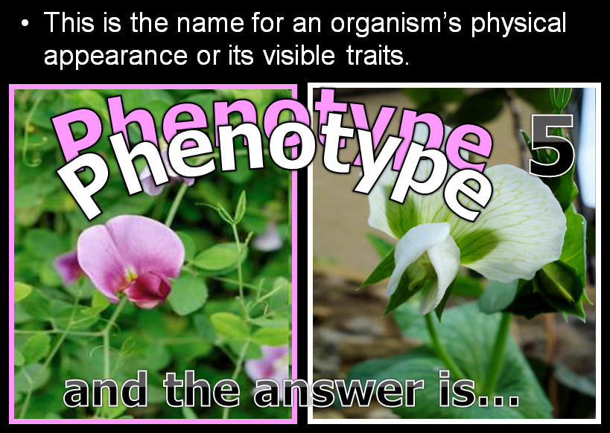
This is the name for an organism’s genetic makeup, or allele combinations
6
Genotype
codes for…
Answer is…
Copyright © 2024 SlideSpark .LLC

Slide 109
7

Slide 110
7

Slide 111
7

Slide 112
7

Slide 113
7

Slide 114
7

Slide 115
7

Slide 116
Geneticists call the factors that control traits genes .
8
Copyright © 2024 SlideSpark .LLC

Slide 117
Geneticists call the factors that control traits genes .
8
Copyright © 2024 SlideSpark .LLC

Slide 118

Geneticists call the factors that control traits genes .
8
Copyright © 2024 SlideSpark .LLC

Slide 119
This type of allele always shows up in the organism when the allele is present.
  A.) Recessive
  B.) Dominant
  C.) Heterozygous
  D.) Incomplete
  E.) Mendellion Allele
9
Copyright © 2024 SlideSpark .LLC

Slide 120
This type of allele always shows up in the organism when the allele is present.
  A.) Recessive
  B.) Dominant
  C.) Heterozygous
  D.) Incomplete
  E.) Mendellion Allele
9
Copyright © 2024 SlideSpark .LLC

Slide 121
This type of allele always shows up in the organism when the allele is present.
  A.) Recessive
  B.) Dominant
  C.) Heterozygous
  D.) Incomplete
  E.) Mendellion Allele
9
Copyright © 2024 SlideSpark .LLC

Slide 122
This type of allele always shows up in the organism when the allele is present.
  A.) Recessive
  B.) Dominant
  C.) Heterozygous
  D.) Incomplete
  E.) Mendellion Allele
9
Copyright © 2024 SlideSpark .LLC

Slide 123
This type of allele always shows up in the organism when the allele is present.
  A.) Recessive
  B.) Dominant
  C.) Heterozygous
  D.) Incomplete
  E.) Mendellion Allele
9
Copyright © 2024 SlideSpark .LLC

Slide 124
This type of allele always shows up in the organism when the allele is present.
  A.) Recessive
  B.) Dominant
  C.) Heterozygous
  D.) Incomplete
  E.) Mendellion Allele
9
Copyright © 2024 SlideSpark .LLC

Slide 125
This type of allele always shows up in the organism when the allele is present.
  A.) Recessive
  B.) Dominant
  C.) Heterozygous
  D.) Incomplete
  E.) Mendellion Allele
Answer is…
9
Copyright © 2024 SlideSpark .LLC

Slide 126
This type of allele always shows up in the organism when the allele is present.
  A.) Recessive
  B.) Dominant
  C.) Heterozygous
  D.) Incomplete
  E.) Mendellion Allele
Answer is…
9
Copyright © 2024 SlideSpark .LLC

Slide 127
This type of allele always shows up in the organism when the allele is present.
  A.) Recessive
  B.) Dominant
  C.) Heterozygous
  D.) Incomplete
  E.) Mendellion Allele
Answer is…
9
Copyright © 2024 SlideSpark .LLC

Slide 128
This type of allele is covered up when the dominant allele is with it?
10
Copyright © 2024 SlideSpark .LLC

Slide 129
This type of allele is covered up when the dominant allele is with it?
10
and the answer is…
Copyright © 2024 SlideSpark .LLC

Slide 130
This type of allele is covered up when the dominant allele is with it?
10
Recessive Allele
and the answer is…
Copyright © 2024 SlideSpark .LLC

Slide 131
This type of allele is covered up when the dominant allele is with it?
10
Recessive Allele
and the answer is…
Copyright © 2024 SlideSpark .LLC

Slide 132
Part V Genetics Review Game
MEN DULL | TYPO | HOT LOTTO | THINK INSIDE THE BOX | -Bonus- FAMILY TIES
1 | 6 | 11 | 16 | *21
2 | 7 | 12 | 17 | *22
3 | 8 | 13 | 18 | *23
4 | 9 | 14 | 19 | *24
5 | 10 | 15 | 20 | *25

Slide 133
Part V Genetics Review Game
MEN DULL | TYPO | HOT LOTTO | THINK INSIDE THE BOX | -Bonus- FAMILY TIES
1 | 6 | 11 | 16 | *21
2 | 7 | 12 | 17 | *22
3 | 8 | 13 | 18 | *23
4 | 9 | 14 | 19 | *24
5 | 10 | 15 | 20 | *25

Slide 134
This is the name for a diagram that is used to predict the outcome of a particular cross
11
Copyright © 2024 SlideSpark .LLC

Slide 135
This is the name for a diagram that is used to predict the outcome of a particular cross
Meiosis
11
M
E
I
O
S
I
s
and the answer is…
Copyright © 2024 SlideSpark .LLC

Slide 136
This is the name for a diagram that is used to predict the outcome of a particular cross
Meiosis
11
M
E
I
O
S
I
s
Punnett Square
Copyright © 2024 SlideSpark .LLC

Slide 137
Which gender decides the childs gender?
Use the Punnett Square below to help you.
  XX=Female XY=Male
12
Copyright © 2024 SlideSpark .LLC

Slide 138
Which gender decides the childs gender?
Use the Punnett Square below to help you.
  XX=Female XY=Male
12
Copyright © 2024 SlideSpark .LLC

Slide 139
Which gender decides the childs gender?
Use the Punnett Square below to help you.
  XX=Female XY=Male
12
answer is…
Copyright © 2024 SlideSpark .LLC

Slide 140
Which gender decides the childs gender?
Use the Punnett Square below to help you.
  XX=Female XY=Male
12
answer is…
Copyright © 2024 SlideSpark .LLC

Slide 141
Which gender decides the childs gender?
Use the Punnett Square below to help you.
  XX=Female XY=Male
12
Only men can give
the Y chromosome
answer is…
Copyright © 2024 SlideSpark .LLC

Slide 142
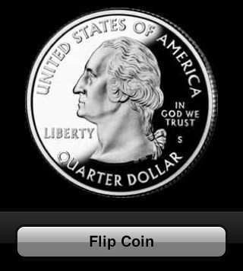
Genetics deals heavily with probability, or the likelihood that a particular event will occur.
13
Copyright © 2024 SlideSpark .LLC

Slide 143
Genetics deals heavily with probability, or the likelihood that a particular event will occur.
13
Copyright © 2024 SlideSpark .LLC

Slide 144
Genetics deals heavily with probability, or the likelihood that a particular event will occur.
13
Copyright © 2024 SlideSpark .LLC

Slide 145
14
The letters below represent…
  A.) Both are Heterozygous Dominant
  B.) Homozygous recessive and Homozygous Dominant
  C.) Heterozygous and Heterozygous
  D.) Both are Heterozygous Recessive
  E.) Homozygous Dominant and Heterozygous
ZZHh
Copyright © 2024 SlideSpark .LLC

Slide 146
14
The letters below represent…
  A.) Both are Heterozygous Dominant
  B.) Homozygous recessive and Homozygous Dominant
  C.) Heterozygous and Heterozygous
  D.) Both are Heterozygous Recessive
  E.) Homozygous Dominant and Heterozygous
ZZHh
Copyright © 2024 SlideSpark .LLC

Slide 147
14
The letters below represent…
  A.) Both are Heterozygous Dominant
  B.) Homozygous recessive and Homozygous Dominant
  C.) Heterozygous and Heterozygous
  D.) Both are Heterozygous Recessive
  E.) Homozygous Dominant and Heterozygous
ZZHh
Copyright © 2024 SlideSpark .LLC

Slide 148
14
The letters below represent…
  A.) Both are Heterozygous Dominant
  B.) Homozygous recessive and Homozygous Dominant
  C.) Heterozygous and Heterozygous
  D.) Both are Heterozygous Recessive
  E.) Homozygous Dominant and Heterozygous
ZZHh
Copyright © 2024 SlideSpark .LLC

Slide 149
14
The letters below represent…
  A.) Both are Heterozygous Dominant
  B.) Homozygous recessive and Homozygous Dominant
  C.) Heterozygous and Heterozygous
  D.) Both are Heterozygous Recessive
  E.) Homozygous Dominant and Heterozygous
ZZHh
Copyright © 2024 SlideSpark .LLC

Slide 150
14
The letters below represent…
  A.) Both are Heterozygous Dominant
  B.) Homozygous recessive and Homozygous Dominant
  C.) Heterozygous and Heterozygous
  D.) Both are Heterozygous Recessive
  E.) Homozygous Dominant and Heterozygous
ZZHh
Copyright © 2024 SlideSpark .LLC

Slide 151
14
The letters below represent…
  A.) Both are Heterozygous Dominant
  B.) Homozygous recessive and Homozygous Dominant
  C.) Heterozygous and Heterozygous
  D.) Both are Heterozygous Recessive
  E.) Homozygous Dominant and Heterozygous
ZZHh
Answer is…
Copyright © 2024 SlideSpark .LLC

Slide 152
14
The letters below represent…
  A.) Both are Heterozygous Dominant
  B.) Homozygous recessive and Homozygous Dominant
  C.) Heterozygous and Heterozygous
  D.) Both are Heterozygous Recessive
  E.) Homozygous Dominant and Heterozygous
ZZHh
Answer is…
Copyright © 2024 SlideSpark .LLC

Slide 153
From all of Mendel’s’ results, he reasoned that individual factors must control the inheritance of traits in peas.
  Mendel knew that the female contributes one factor, while the male contributes the other factor in sexual reproduction.
15
Copyright © 2024 SlideSpark .LLC

Slide 154
From all of Mendel’s’ results, he reasoned that individual factors must control the inheritance of traits in peas.
  Mendel knew that the female contributes one factor, while the male contributes the other factor in sexual reproduction.
15
Copyright © 2024 SlideSpark .LLC

Slide 155
From all of Mendel’s’ results, he reasoned that individual factors must control the inheritance of traits in peas.
  Mendel knew that the female contributes one factor, while the male contributes the other factor in sexual reproduction.
15
Copyright © 2024 SlideSpark .LLC

Slide 156
Part V Genetics Review Game
MEN DULL | TYPO | HOT LOTTO | THINK INSIDE THE BOX | -Bonus- FAMILY TIES
1 | 6 | 11 | 16 | *21
2 | 7 | 12 | 17 | *22
3 | 8 | 13 | 18 | *23
4 | 9 | 14 | 19 | *24
5 | 10 | 15 | 20 | *25

Slide 157
Part V Genetics Review Game
MEN DULL | TYPO | HOT LOTTO | THINK INSIDE THE BOX | -Bonus- FAMILY TIES
1 | 6 | 11 | 16 | *21
2 | 7 | 12 | 17 | *22
3 | 8 | 13 | 18 | *23
4 | 9 | 14 | 19 | *24
5 | 10 | 15 | 20 | *25

Slide 158
16
Please complete the Punnett Square,
Tt and Tt
  T = Tall
  tt = Short
Both parents are heterozygous
How many will be tall, and how many will be short ___ : ___
Copyright © 2024 SlideSpark .LLC

Slide 159
16
Please complete the Punnett Square,
Tt and Tt
  T = Tall
  tt = Short
T t
T
t
Both parents are heterozygous
How many will be tall, and how many will be short ___ : ___
Copyright © 2024 SlideSpark .LLC

Slide 160
16
Please complete the Punnett Square,
Tt and Tt
  T = Tall
  tt = Short
T t
T
t
TT
Tt
Tt
tt
Both parents are heterozygous
How many will be tall, and how many will be short ___ : ___
Copyright © 2024 SlideSpark .LLC

Slide 161
16
Please complete the Punnett Square,
Tt and Tt
  T = Tall
  tt = Short
T t
T
t
TT
Tt
Tall
Tall
Tt
tt
Tall
Short
Both parents are heterozygous
How many will be tall, and how many will be short ___ : ___
Copyright © 2024 SlideSpark .LLC

Slide 162
16
Please complete the Punnett Square,
Tt and Tt
  T = Tall
  tt = Short
T t
T
t
TT
Tt
Tall
Tall
Tt
tt
Tall
Short
Both parents are heterozygous
How many will be tall, and how many will be short ___ : ___
3
1
Copyright © 2024 SlideSpark .LLC

Slide 163
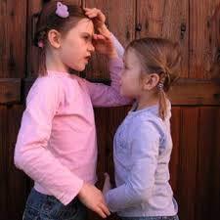
16
Please complete the Punnett Square,
Tt and Tt
  T = Tall
  tt = Short
T t
All probability
T
t
TT
Tt
Tall
Tall
Tt
tt
Tall
Short
Both parents are heterozygous
How many will be tall, and how many will be short ___ : ___
3
1
Copyright © 2024 SlideSpark .LLC

Slide 164
New
Question

Slide 165
17
Please complete the Punnett Square,
Tt and tt
  T = Tall
  tt = Short
One parent heterozygous and one homozygous recessive.
How many will be tall, and how many will be short ___ : ___
Copyright © 2024 SlideSpark .LLC

Slide 166
17
Please complete the Punnett Square,
Tt and tt
  T = Tall
  tt = Short
T t
t
t
One parent heterozygous and one homozygous recessive.
How many will be tall, and how many will be short ___ : ___
Copyright © 2024 SlideSpark .LLC

Slide 167
17
Please complete the Punnett Square,
Tt and tt
  T = Tall
  tt = Short
T t
Tt
tt
t
t
Tt
tt
One parent heterozygous and one homozygous recessive.
How many will be tall, and how many will be short ___ : ___
Copyright © 2024 SlideSpark .LLC

Slide 168
17
Please complete the Punnett Square,
Tt and tt
  T = Tall
  tt = Short
T t
Tt
tt
t
t
Tall
Short
Tt
tt
Tall
Short
One parent heterozygous and one homozygous recessive.
How many will be tall, and how many will be short ___ : ___
Copyright © 2024 SlideSpark .LLC

Slide 169
17
Please complete the Punnett Square,
Tt and tt
  T = Tall
  tt = Short
T t
Tt
tt
t
t
Tall
Short
Tt
tt
Tall
Short
One parent heterozygous and one homozygous recessive.
How many will be tall, and how many will be short ___ : ___
Copyright © 2024 SlideSpark .LLC

Slide 170
17
Please complete the Punnett Square,
Tt and tt
  T = Tall
  tt = Short
T t
Tt
tt
t
t
Tall
Short
Tt
tt
Tall
Short
One parent heterozygous and one homozygous recessive.
How many will be tall, and how many will be short ___ : ___
2
2
Copyright © 2024 SlideSpark .LLC

Slide 171
17
Please complete the Punnett Square,
Tt and tt
  T = Tall
  tt = Short
All Probability
T t
Tt
tt
t
t
Tall
Short
Tt
tt
Tall
Short
One parent heterozygous and one homozygous recessive.
How many will be tall, and how many will be short ___ : ___
2
2
Copyright © 2024 SlideSpark .LLC

Slide 172
What color body and eye type will the fly be for A, B, C, and D?
B=Brown, b=black, E=Red, e=brown
18
A
B
C
D

Slide 173
What color body and eye type will the fly be for A, B, C, and D?
B=Brown, b=black, E=Red, e=brown
18
A
B
C
D

Slide 174
What color body and eye type will the fly be for A, B, C, and D?
B=Brown, b=black, E=Red, e=brown
18
B
C
D
A

Slide 175
What color body and eye type will the fly be for A, B, C, and D?
B=Brown, b=black, E=Red, e=brown
18
B
C
D
A

Slide 176
What color body and eye type will the fly be for A, B, C, and D?
B=Brown, b=black, E=Red, e=brown
18
B
C
D
A

Slide 177
What color body and eye type will the fly be for A, B, C, and D?
B=Brown, b=black, E=Red, e=brown
18
B
C
D
A

Slide 178
What color body and eye type will the fly be for A, B, C, and D?
B=Brown, b=black, E=Red, e=brown
18
C
B
D
A

Slide 179
What color body and eye type will the fly be for A, B, C, and D?
B=Brown, b=black, E=Red, e=brown
18
C
B
D
A

Slide 180
What color body and eye type will the fly be for A, B, C, and D?
B=Brown, b=black, E=Red, e=brown
18
C
B
D
A

Slide 181
What color body and eye type will the fly be for A, B, C, and D?
B=Brown, b=black, E=Red, e=brown
18
C
B
D
A

Slide 182
What color body and eye type will the fly be for A, B, C, and D?
B=Brown, b=black, E=Red, e=brown
18
C
B
D
A

Slide 183
Codominance is a relationship among alleles where both alleles contribute to the phenotype of the heterozygote.
19
Copyright © 2010 Ryan P. Murphy

Slide 184
Codominance is a relationship among alleles where both alleles contribute to the phenotype of the heterozygote.
19
Copyright © 2010 Ryan P. Murphy

Slide 185
Codominance is a relationship among alleles where both alleles contribute to the phenotype of the heterozygote.
19
Copyright © 2010 Ryan P. Murphy

Slide 186
This is an example of...
  A.) Homozygous Dominant
  B.) Heterozygous Dominant
  C.) Incomplete Dominance
  D.) Recessive Alleles
  E.) Pure Breeding
20
Copyright © 2010 Ryan P. Murphy

Slide 187
This is an example of...
  A.) Homozygous Dominant
  B.) Heterozygous Dominant
  C.) Incomplete Dominance
  D.) Recessive Alleles
  E.) Pure Breeding
20
Copyright © 2010 Ryan P. Murphy

Slide 188
This is an example of...
  A.) Homozygous Dominant
  B.) Heterozygous Dominant
  C.) Incomplete Dominance
  D.) Recessive Alleles
  E.) Pure Breeding
20
Copyright © 2010 Ryan P. Murphy

Slide 189
This is an example of...
  A.) Homozygous Dominant
  B.) Heterozygous Dominant
  C.) Incomplete Dominance
  D.) Recessive Alleles
  E.) Pure Breeding
20
Copyright © 2010 Ryan P. Murphy

Slide 190
This is an example of...
  A.) Homozygous Dominant
  B.) Heterozygous Dominant
  C.) Incomplete Dominance
  D.) Recessive Alleles
  E.) Pure Breeding
20
Copyright © 2010 Ryan P. Murphy

Slide 191
This is an example of...
  A.) Homozygous Dominant
  B.) Heterozygous Dominant
  C.) Incomplete Dominance
  D.) Recessive Alleles
  E.) Pure Breeding
20
Copyright © 2010 Ryan P. Murphy

Slide 192
This is an example of...
  A.) Homozygous Dominant
  B.) Heterozygous Dominant
  C.) Incomplete Dominance
  D.) Recessive Alleles
  E.) Pure Breeding
answer is…
20
Copyright © 2010 Ryan P. Murphy

Slide 193
This is an example of...
  A.) Homozygous Dominant
  B.) Heterozygous Dominant
  C.) Incomplete Dominance
  D.) Recessive Alleles
  E.) Pure Breeding
answer is…
20
Copyright © 2010 Ryan P. Murphy

Slide 194
Part V Genetics Review Game
MEN DULL | TYPO | HOT LOTTO | THINK INSIDE THE BOX | -Bonus- FAMILY TIES
1 | 6 | 11 | 16 | *21
2 | 7 | 12 | 17 | *22
3 | 8 | 13 | 18 | *23
4 | 9 | 14 | 19 | *24
5 | 10 | 15 | 20 | *25

Slide 195
Part V Genetics Review Game
MEN DULL | TYPO | HOT LOTTO | THINK INSIDE THE BOX | -Bonus- FAMILY TIES
1 | 6 | 11 | 16 | *21
2 | 7 | 12 | 17 | *22
3 | 8 | 13 | 18 | *23
4 | 9 | 14 | 19 | *24
5 | 10 | 15 | 20 | *25

Slide 196
“Who are we?”
Copyright © 2010 Ryan P. Murphy

Slide 197
“My name is Charlie Sheen?”
Copyright © 2010 Ryan P. Murphy

Slide 198
“I’m Martin
Sheen?”
Copyright © 2010 Ryan P. Murphy

Slide 199
Name this MLB Team?
*22

Slide 200
Name this MLB Team?
*22

Slide 201

Name this MLB Team?
*22

Slide 202
Who are these Grand Slam sisters?
Copyright © 2010 Ryan P. Murphy

Slide 203
The Williams sisters, Serena and Venus.
Copyright © 2010 Ryan P. Murphy

Slide 204
“What’s my dads name?”
Copyright © 2010 Ryan P. Murphy

Slide 205
“That’s my dad, Billy Ray Cyrus.”
Copyright © 2010 Ryan P. Murphy

Slide 206
Who are these two?
Copyright © 2010 Ryan P. Murphy

Slide 207
John Fitzgerald Kennedy Ted Kennedy
Copyright © 2010 Ryan P. Murphy

Slide 208
Part V Genetics Review Game
MEN DULL | TYPO | HOT LOTTO | THINK INSIDE THE BOX | -Bonus- FAMILY TIES
1 | 6 | 11 | 16 | *21
2 | 7 | 12 | 17 | *22
3 | 8 | 13 | 18 | *23
4 | 9 | 14 | 19 | *24
5 | 10 | 15 | 20 | *25
Final Question

Slide 209
5 Wager Question

Slide 210
The shaded circles and squares is a dominant allelle. Shaded = Dominant
  What’s the probable genotypes of the two below?
Aa
Aa
aa
Aa

Slide 211
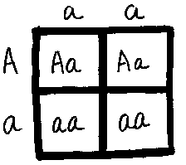
The shaded circles and squares is a dominant allelle. Shaded = Dominant
  What’s the probable genotypes of the two below?
Aa
Aa
aa
Aa

Slide 212
The shaded circles and squares is a dominant allelle. Shaded = Dominant
  What’s the probable genotypes of the two below?
Aa
Aa
aa
Aa

Slide 213
The shaded circles and squares is a dominant allelle. Shaded = Dominant
  What’s the probable genotypes of the two below?
Aa
Aa
aa
Aa
aa
Aa
2:2

Slide 214

Genetics Unit Review Game
1-20 = 5 points each
20-25 = Bonus (1 point each)
Final Question = 5 point wager
Find the Owl = 1 point

Slide 215
Genetics Review Game
Part 5
Lesson 12

Slide 216



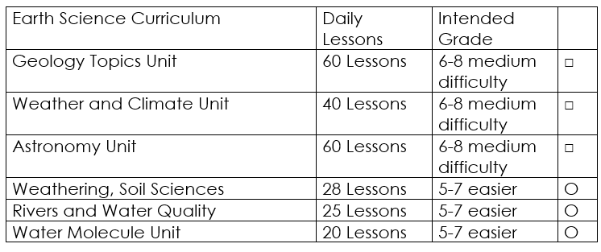

Curriculum Guide
Number of Lessons in each unit (50 min, daily lessons) and difficult rating scale / intended grade level.
=Easier, = More difficult, =Most difficult
Earth Science Units

Slide 217


Life Science Units

Slide 218

Physical Science

Slide 219
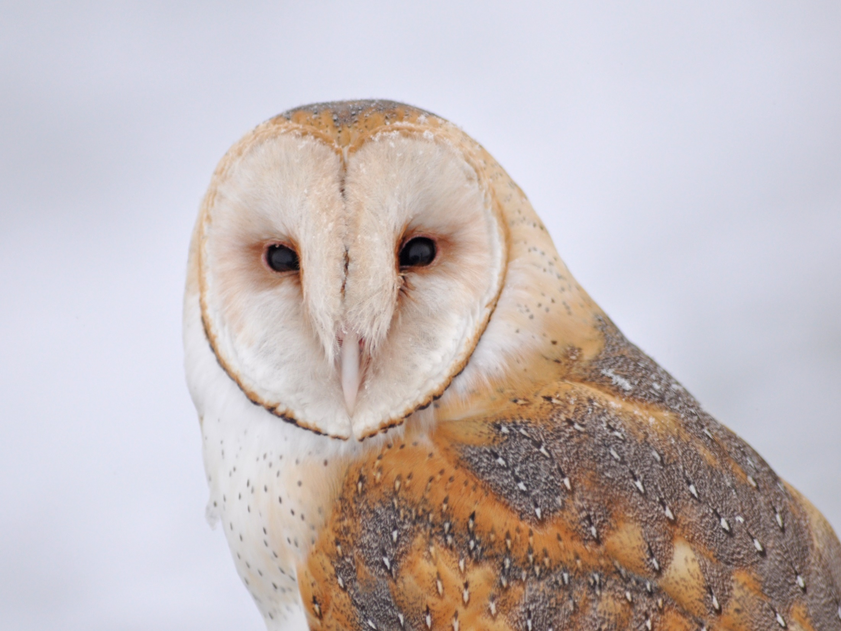
Dear Valued Educator,
Our fully editable .pptx and .doc resources are perfect for educators looking to bring enthusiasm and creativity to their lessons. We encourage you to make changes to fit your needs and style. As science educators, we’re committed to providing students with the tools they need to succeed in the classroom and beyond. Each unit in the curriculum includes a range of resources that have been developed through extensive research and use in a busy classroom. Our teaching approach is designed to make science education engaging and exciting for learners of all ages. We offer a one-of-a-kind science curriculum that will challenge, inspire, and educate students to become tomorrow's scientists and leaders. Join us today and learn more about how our program can help you achieve your classroom goals.
With appreciation,
Support@SlideSpark.net

Slide 220





Thank you for your time and interest in our Science curriculum. We strive to provide students with engaging and informative lessons that will spark their curiosity and encourage scientific exploration. Should you have any questions or concerns, please do not hesitate to contact us. Thank you again for considering our curriculum, and we wish you all the best in your educational journey.
Sincerely,
Support@slidespark.net
SlideSpark Science on TpT

