Slide 1

Subscripts and Equations
Review Game
2 H2 + O2 2 H2O
Part 4
Lesson 6

Slide 2
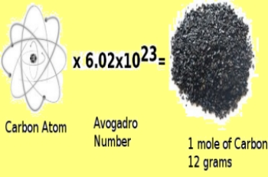
This is the standard scientific unit for measuring large quantities of very small entities such as atoms. What is the number, and who is it named after?
1

Slide 3
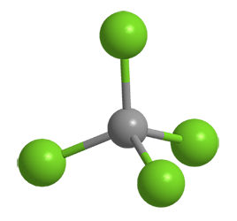
2
What is the Molar Mass of Carbon Tetrachloride?

Slide 4
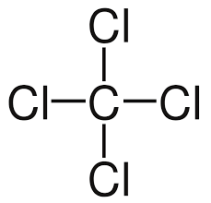
2
What is the Molar Mass of Carbon Tetrachloride?

Slide 5
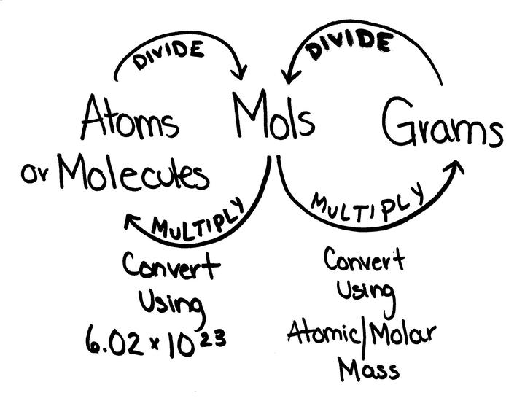
To Convert from moles to atoms, multiply the molar amount by Avogadro's number.
To Convert from atoms to moles, divide the atom amount by Avogadro's number
3

Slide 6
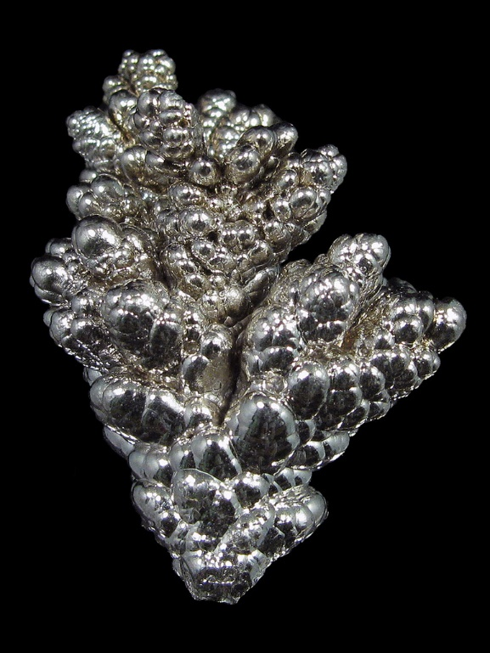
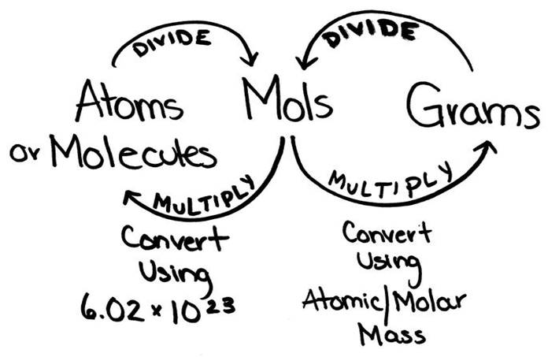
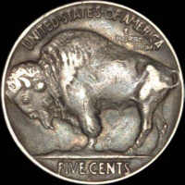
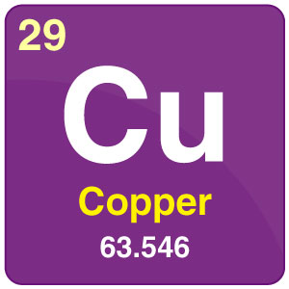
What is the g/mol of Nickel?
Ni = 58.69 g/mol
How many mols are in 10 grams of Copper?
4

Slide 7
Which color is the subscript and which color is the Coefficient?
2 H2 + O2 2 H2O
5

Slide 8
Subscripts and Equations Review Game
THE SCRIPT KEEPER | THE MORE YOU KNOW | BALANCING ACT | BLANK STARE | -BONUS- NAME THE COMPOUD
1 | 6 | 11 | 16 | *21
2 | 7 | 12 | 17 | *22
3 | 8 | 13 | 18 | *23
4 | 9 | 14 | 19 | *24
5 | 10 | 15 | 20 | *25
Final Question:________________
Copyright © 2024 SlideSpark .LLC

Slide 9
Subscripts and Equations Review Game
THE SCRIPT KEEPER | THE MORE YOU KNOW | BALANCING ACT | BLANK STARE | -BONUS- NAME THE COMPOUD
1 | 6 | 11 | 16 | *21
2 | 7 | 12 | 17 | *22
3 | 8 | 13 | 18 | *23
4 | 9 | 14 | 19 | *24
5 | 10 | 15 | 20 | *25
Final Question:________________
Copyright © 2024 SlideSpark .LLC

Slide 10
What are the elements found in 4H2SO4, and how many of each element?
4H2SO4
6

Slide 11
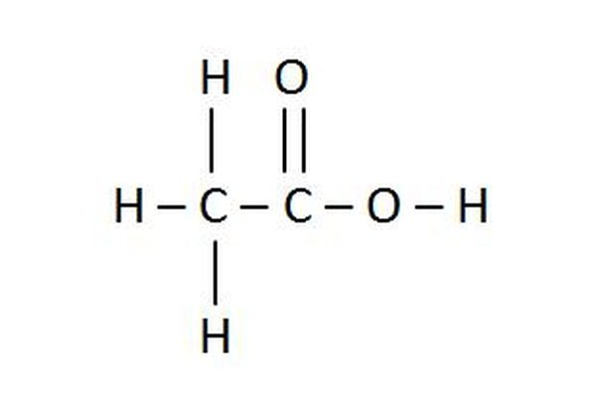
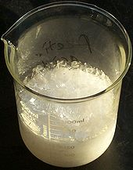
Which one is the correct formula for acetic acid?
A.) C2OH4
B.) 3HCO
C.) CH3COOH
D.) NH4C2O2
E.) 2C(OH)4
7

Slide 12

NEW
QUESTION

Slide 13
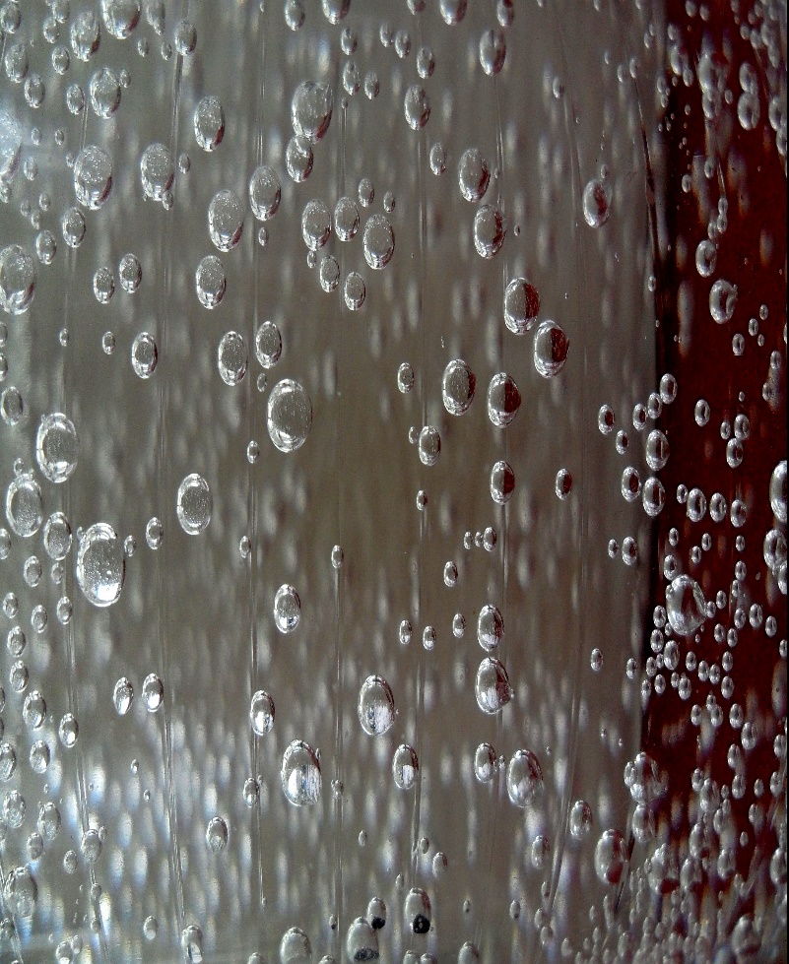
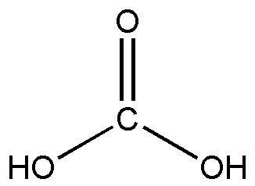
Which one is the correct formula for carbonic acid?
A.) C2OH2
B.) H2CO3
C.) OOHC
D.) COOOOH
E.) 2C(OH)4
8

Slide 14
How many total atoms are in?
Ni(CH3CO2)2
9

Slide 15
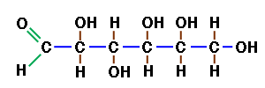
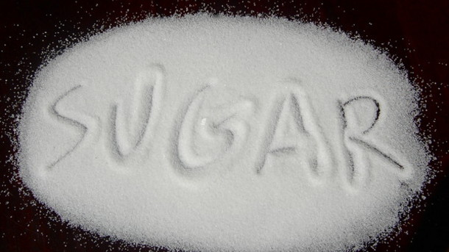
What is the empirical formula for glucose?
A.) C6H12O6
B.) 6CH2O3
C.) 3C2OH6
D.) CO(CH)4
E.) Undefined
F.) Defined
10

Slide 16
Subscripts and Equations Review Game
THE SCRIPT KEEPER | THE MORE YOU KNOW | BALANCING ACT | BLANK STARE | -BONUS- NAME THE COMPOUD
1 | 6 | 11 | 16 | *21
2 | 7 | 12 | 17 | *22
3 | 8 | 13 | 18 | *23
4 | 9 | 14 | 19 | *24
5 | 10 | 15 | 20 | *25
Final Question:________________
Copyright © 2024 SlideSpark .LLC

Slide 17
Subscripts and Equations Review Game
THE SCRIPT KEEPER | THE MORE YOU KNOW | BALANCING ACT | BLANK STARE | -BONUS- NAME THE COMPOUD
1 | 6 | 11 | 16 | *21
2 | 7 | 12 | 17 | *22
3 | 8 | 13 | 18 | *23
4 | 9 | 14 | 19 | *24
5 | 10 | 15 | 20 | *25
Final Question:________________
Copyright © 2024 SlideSpark .LLC

Slide 18
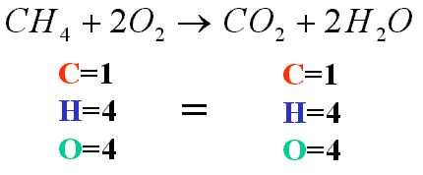
Balancing Chemical Equations helps describe all of the following except...
  A.) Telling us what happens in a chemical reaction.
  B.) It describes what you started with…and ended with.
  C.) Shows the increasing amount of products compared to reactants.
  D.) It also describes the phases of each (s) (l) (g)
  E.) Describes the amount of each element in reaction.
11

Slide 19
Balancing Chemical Equations helps describe all of the following except...
  A.) Telling us what happens in a chemical reaction.
  B.) It describes what you started with…and ended with.
  C.) Shows the increasing amount of products compared to reactants.
  D.) It also describes the phases of each (s) (l) (g)
  E.) Describes the amount of each element in reaction.
11

Slide 20
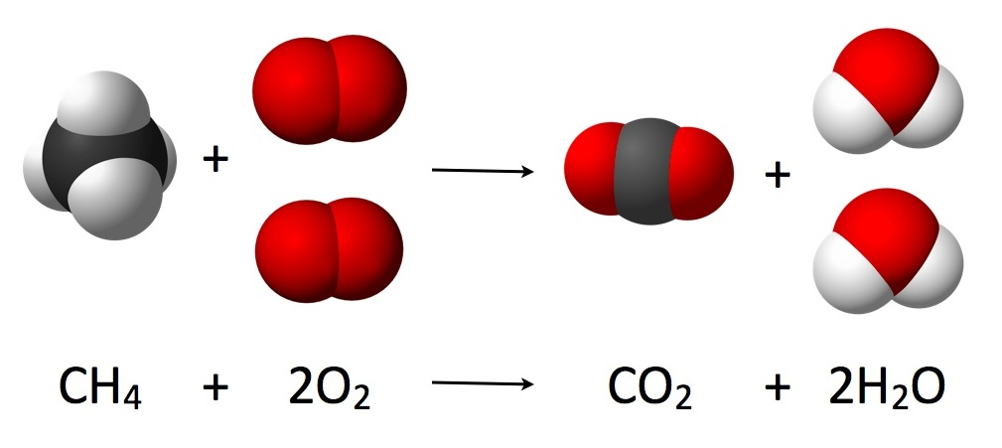
Which letter is the products and which letter is the reactants?
A
B
12

Slide 21
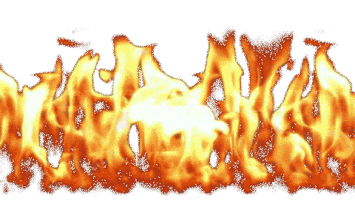
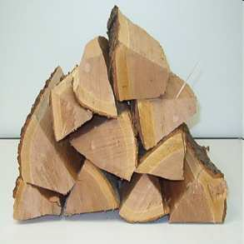
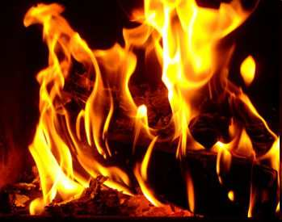
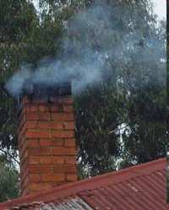

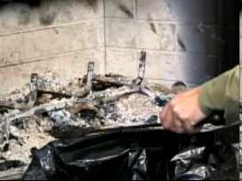
13
In any physical or chemical change, matter is neither created nor destroyed
  Matter can be changed from one form to another.
=
Copyright © 2024 SlideSpark .LLC

Slide 22
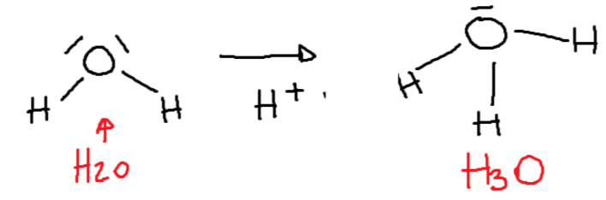
True or False? It is okay to change the subscript when balancing a chemical equation.
  Example… H2O becomes H3O
14
Copyright © 2024 SlideSpark .LLC

Slide 23
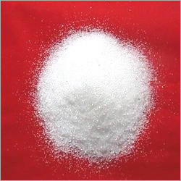
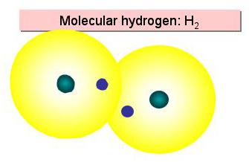
Please balance the equation below.
__As + __ NaOH -> __Na3AsO3 + __H2
15

Slide 24
Subscripts and Equations Review Game
THE SCRIPT KEEPER | THE MORE YOU KNOW | BALANCING ACT | BLANK STARE | -BONUS- NAME THE COMPOUD
1 | 6 | 11 | 16 | *21
2 | 7 | 12 | 17 | *22
3 | 8 | 13 | 18 | *23
4 | 9 | 14 | 19 | *24
5 | 10 | 15 | 20 | *25
Final Question:________________
Copyright © 2024 SlideSpark .LLC

Slide 25
Subscripts and Equations Review Game
THE SCRIPT KEEPER | THE MORE YOU KNOW | BALANCING ACT | BLANK STARE | -BONUS- NAME THE COMPOUD
1 | 6 | 11 | 16 | *21
2 | 7 | 12 | 17 | *22
3 | 8 | 13 | 18 | *23
4 | 9 | 14 | 19 | *24
5 | 10 | 15 | 20 | *25
Final Question:________________
Copyright © 2024 SlideSpark .LLC

Slide 26
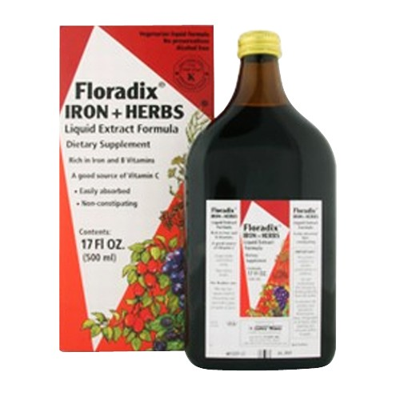

Please balance the equation below.
___Fe2O3(s) + __CO(g) → __Fe(l) + ___CO2(g)
16

Slide 27

NEW QUESTION

Slide 28
Please balance the equation below.
__NH4NO3 → __N2 + __O2 + __H2O
17

Slide 29

NEW
QUESTION

Slide 30
Please balance the equation below.
__SiO2 + __HF → __SiF4 + __H2O
18

Slide 31

NEW
QUESTION

Slide 32
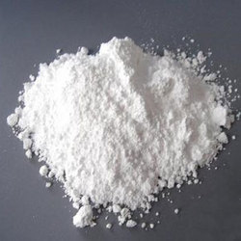
Please balance the equation below.
__H2SO4 +__Pb(OH)4 →__Pb(SO4)2 +__H2O
19
answer is…

Slide 33

NEW QUESTION

Slide 34
Please balance the equation below.
__N2(g) + __O2(g) + __H2O →__HNO3 (aq)
20

Slide 35
Subscripts and Equations Review Game
THE SCRIPT KEEPER | THE MORE YOU KNOW | BALANCING ACT | BLANK STARE | -BONUS- NAME THE COMPOUD
1 | 6 | 11 | 16 | *21
2 | 7 | 12 | 17 | *22
3 | 8 | 13 | 18 | *23
4 | 9 | 14 | 19 | *24
5 | 10 | 15 | 20 | *25
Final Question:________________
Copyright © 2024 SlideSpark .LLC

Slide 36
Subscripts and Equations Review Game
THE SCRIPT KEEPER | THE MORE YOU KNOW | BALANCING ACT | BLANK STARE | -BONUS- NAME THE COMPOUD
1 | 6 | 11 | 16 | *21
2 | 7 | 12 | 17 | *22
3 | 8 | 13 | 18 | *23
4 | 9 | 14 | 19 | *24
5 | 10 | 15 | 20 | *25
Final Question:________________
Copyright © 2024 SlideSpark .LLC

Slide 37
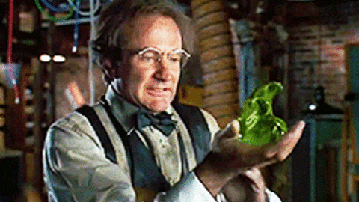
*21
What’s this?

Slide 38
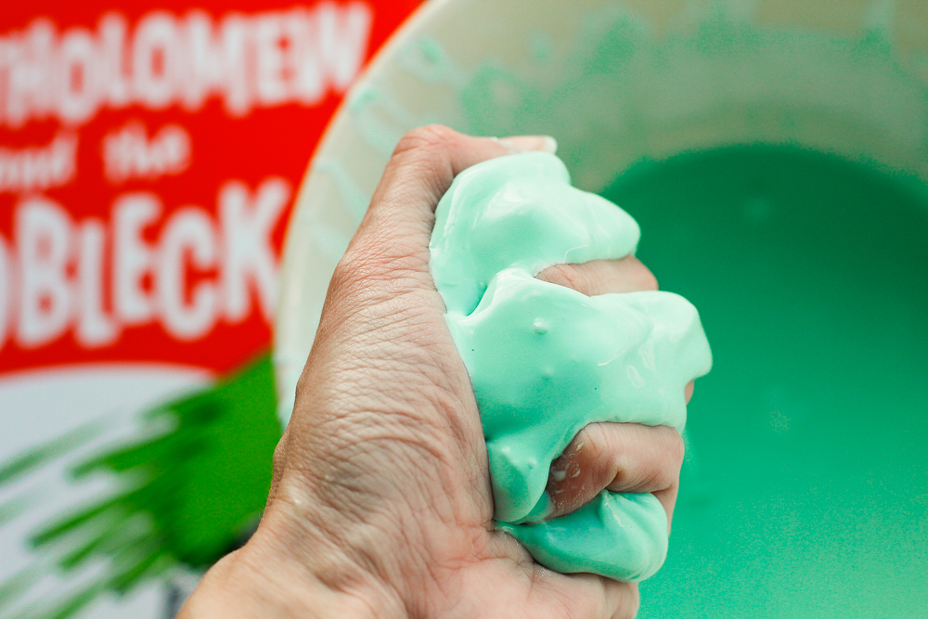
What’s this?
*22

Slide 39
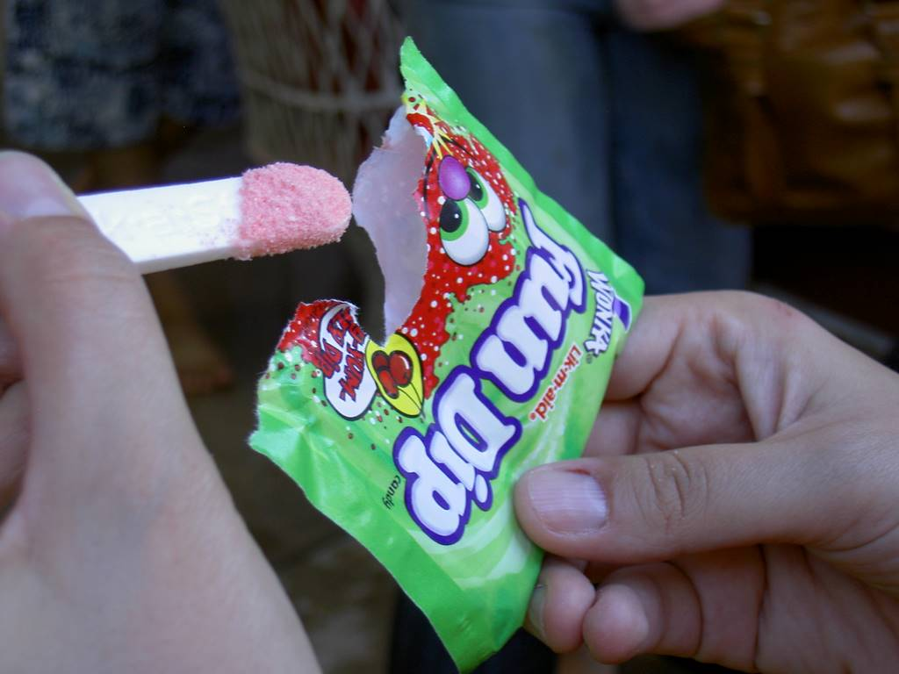
*23
What’s this?

Slide 40
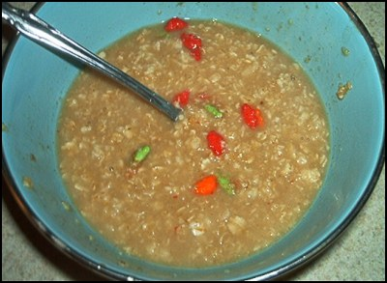
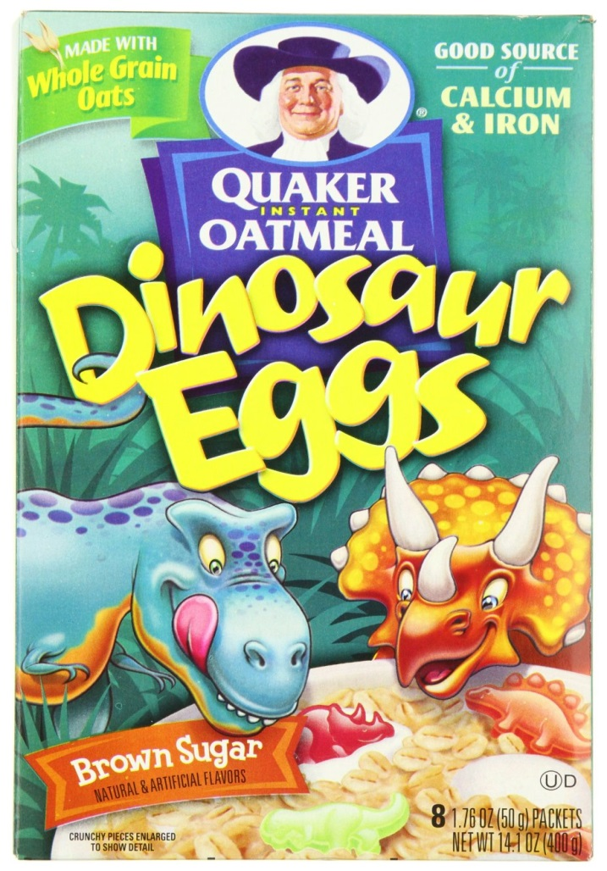
*24

Slide 41
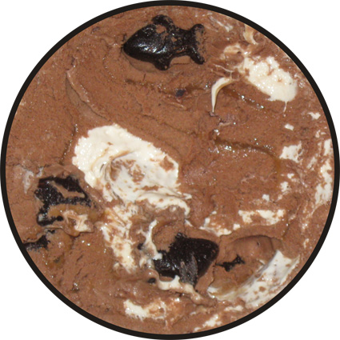
*25
Name the Flavor

Slide 42
Subscripts and Equations Review Game
THE SCRIPT KEEPER | THE MORE YOU KNOW | BALANCING ACT | BLANK STARE | -BONUS- NAME THE COMPOUD
1 | 6 | 11 | 16 | *21
2 | 7 | 12 | 17 | *22
3 | 8 | 13 | 18 | *23
4 | 9 | 14 | 19 | *24
5 | 10 | 15 | 20 | *25
Final Question:________________
Copyright © 2024 SlideSpark .LLC

Slide 43
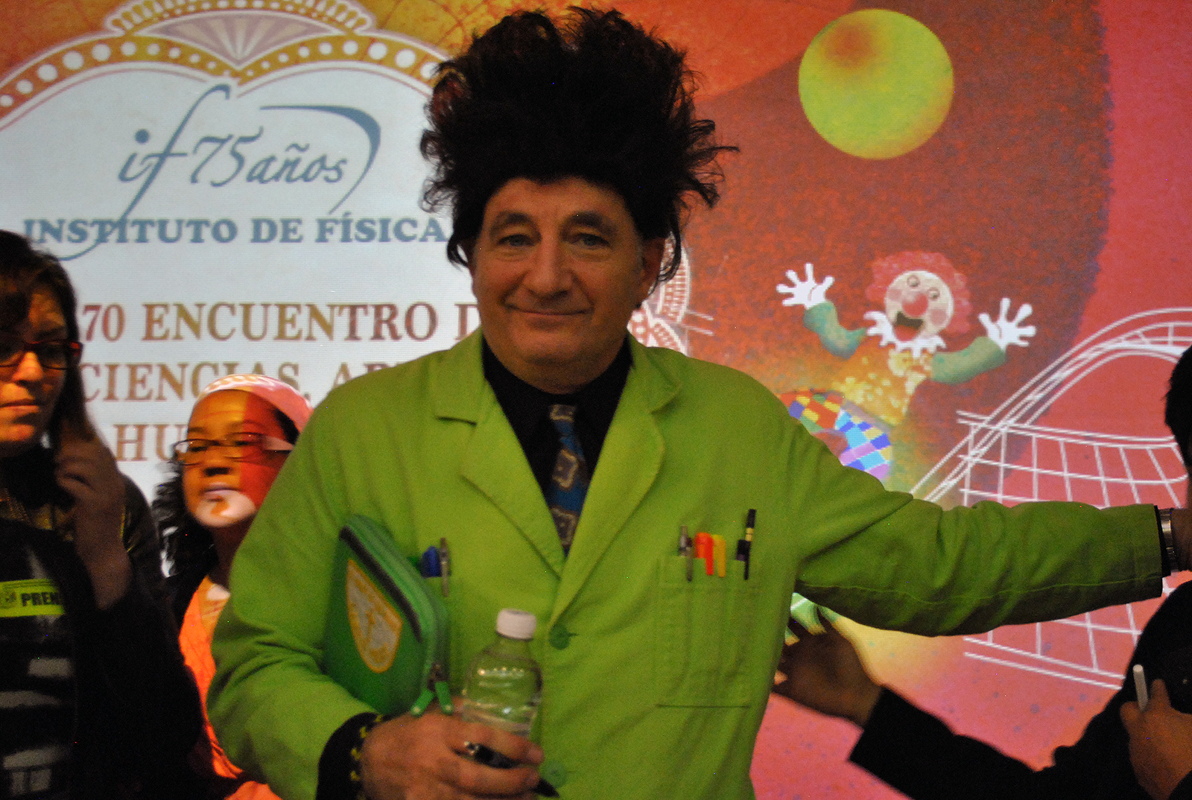
5 Point Wager Question

Slide 44
Please balance the equation below.
__Hg(OH)2 + __H3PO4 →__Hg3(PO4)2 + __H2O
FINAL QUESTION

Slide 45

Subscripts and Equations Review Game
1-20 = 5 points each
20-25 = Bonus (1 point each)
Final Question = 5 point wager
Find the Owl = 1 point
Answer Key is provided in PowerPoint Form after Final Question
Copyright © 2024 SlideSpark .LLC

Slide 46
Subscripts and Equations
Review Game
2 H2 + O2 2 H2O
Part 4
Lesson 6

Slide 47

Subscripts and Equations
Review Game
2 H2 + O2 2 H2O
Part 4
Lesson 7

Slide 48
This is the standard scientific unit for measuring large quantities of very small entities such as atoms. What is the number, and who is it named after?
1

Slide 49
This is the standard scientific unit for measuring large quantities of very small entities such as atoms. What is the number, and who is it named after? 1 mol = 6.02 × 10²³
  The number of atoms determined to be found in 12 grams of carbon-12.
1

Slide 50
This is the standard scientific unit for measuring large quantities of very small entities such as atoms. What is the number, and who is it named after? 1 mol = 6.02 × 10²³
  The number of atoms determined to be found in 12 grams of carbon-12.
1

Slide 51
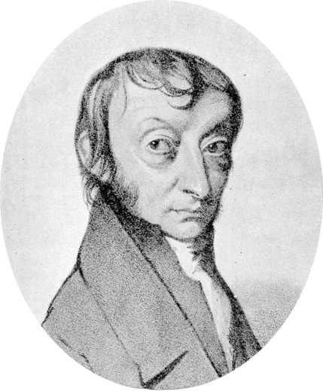
This is the standard scientific unit for measuring large quantities of very small entities such as atoms. What is the number, and who is it named after? 1 mol = 6.02 × 10²³
  The number of atoms determined to be found in 12 grams of carbon-12. Also called Avogadro’s number
1

Slide 52
2
What is the Molar Mass of Carbon Tetrachloride?

Slide 53
2
What is the Molar Mass of Carbon Tetrachloride?

Slide 54
2
What is the Molar Mass of Carbon Tetrachloride? CCl4
Carbon = 12 g/mol
Chlorine = 35.45 g/mol

Slide 55
2
What is the Molar Mass of Carbon Tetrachloride? CCl4
35.45
12
35.45
35.45
35.45
Carbon = 12 g/mol
Chlorine = 35.45 g/mol

Slide 56
2
What is the Molar Mass of Carbon Tetrachloride? CCl4
35.45
35.45 *4 + 12
12
35.45
35.45
35.45
Carbon = 12 g/mol
Chlorine = 35.45 g/mol

Slide 57
2
What is the Molar Mass of Carbon Tetrachloride? CCl4
35.45
35.45 *4 + 12
12
35.45
153.81 g/mol
35.45
35.45
Carbon = 12 g/mol
Chlorine = 35.45 g/mol

Slide 58
To Convert from moles to atoms, multiply the molar amount by Avogadro's number.
To Convert from atoms to moles, divide the atom amount by Avogadro's number
3

Slide 59
To Convert from moles to atoms, multiply the molar amount by Avogadro's number.
To Convert from atoms to moles, divide the atom amount by Avogadro's number
3

Slide 60
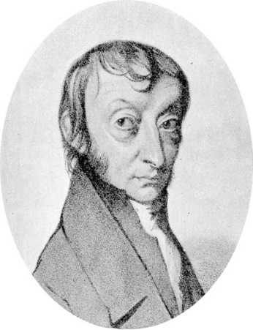

To Convert from moles to atoms, multiply the molar amount by Avogadro's number.
To Convert from atoms to moles, divide the atom amount by Avogadro's number
3

Slide 61
To Convert from moles to atoms, multiply the molar amount by Avogadro's number.
To Convert from atoms to moles, divide the atom amount by Avogadro's number
3

Slide 62

To Convert from moles to atoms, multiply the molar amount by Avogadro's number.
To Convert from atoms to moles, divide the atom amount by Avogadro's number
3

Slide 63
What is the g/mol of Nickel?
Ni = 58.69 g/mol
How many mols are in 10 grams of Copper?
4

Slide 64
What is the g/mol of Nickel?
Ni = 58.69 g/mol
How many mols are in 10 grams of Copper?
          1 mol Cu
10 g Cu x--------------------- = .15 mol Cu 63.54 g Cu
4

Slide 65
What is the g/mol of Nickel?
Ni = 58.69 g/mol
How many mols are in 10 grams of Copper?
          1 mol Cu
10 g Cu x--------------------- = .15 mol Cu 63.54 g Cu
4

Slide 66
What is the g/mol of Nickel?
Ni = 58.69 g/mol
How many mols are in 10 grams of Copper?
          1 mol Cu
10 g Cu x--------------------- = .15 mol Cu 63.54 g Cu
4

Slide 67
What is the g/mol of Nickel?
Ni = 58.69 g/mol
How many mols are in 10 grams of Copper?
          1 mol Cu
10 g Cu x--------------------- = .15 mol Cu 63.54 g Cu
4

Slide 68
What is the g/mol of Nickel?
Ni = 58.69 g/mol
How many mols are in 10 grams of Copper?
          1 mol Cu
10 g Cu x--------------------- = .15 mol Cu 63.54 g Cu
4

Slide 69
Which color is the subscript and which color is the Coefficient?
2 H2 + O2 2 H2O
5

Slide 70
Which color is the subscript and which color is the Coefficient?
2 H2 + O2 2 H2O
Subscript is blue
5

Slide 71
Which color is the subscript and which color is the Coefficient?
2 H2 + O2 2 H2O
Subscript is blue
Coefficient is red
5

Slide 72
Subscripts and Equations Review Game
THE SCRIPT KEEPER | THE MORE YOU KNOW | BALANCING ACT | BLANK STARE | -BONUS- NAME THE COMPOUD
1 | 6 | 11 | 16 | *21
2 | 7 | 12 | 17 | *22
3 | 8 | 13 | 18 | *23
4 | 9 | 14 | 19 | *24
5 | 10 | 15 | 20 | *25
Final Question:________________
Copyright © 2024 SlideSpark .LLC

Slide 73
Subscripts and Equations Review Game
THE SCRIPT KEEPER | THE MORE YOU KNOW | BALANCING ACT | BLANK STARE | -BONUS- NAME THE COMPOUD
1 | 6 | 11 | 16 | *21
2 | 7 | 12 | 17 | *22
3 | 8 | 13 | 18 | *23
4 | 9 | 14 | 19 | *24
5 | 10 | 15 | 20 | *25
Final Question:________________
Copyright © 2024 SlideSpark .LLC

Slide 74
What are the elements found in 4H2SO4, and how many of each element?
4H2SO4
6

Slide 75
What are the elements found in 4H2SO4, and how many of each element?
Answer is 28 Atoms
4H2SO4
6

Slide 76
What are the elements found in 4H2SO4, and how many of each element?
Answer is 28 Atoms
4H2SO4
8 Hydrogen, 4 Sulfur, 16 Oxygen
6

Slide 77
Which one is the correct formula for acetic acid?
A.) C2OH4
B.) 3HCO
C.) CH3COOH
D.) NH4C2O2
E.) 2C(OH)4
7

Slide 78
Which one is the correct formula for acetic acid?
A.) C2OH4
B.) 3HCO
C.) CH3COOH
D.) NH4C2O2
E.) 2C(OH)4
7

Slide 79
Which one is the correct formula for acetic acid?
A.) C2OH4
B.) 3HCO
C.) CH3COOH
D.) NH4C2O2
E.) 2C(OH)4
7

Slide 80
NEW
QUESTION

Slide 81
Which one is the correct formula for carbonic acid?
A.) C2OH2
B.) H2CO3
C.) OOHC
D.) COOOOH
E.) 2C(OH)4
8

Slide 82
Which one is the correct formula for carbonic acid?
A.) C2OH2
B.) H2CO3
C.) OOHC
D.) COOOOH
E.) 2C(OH)4
8

Slide 83
Which one is the correct formula for carbonic acid?
A.) C2OH2
B.) H2CO3
C.) OOHC
D.) COOOOH
E.) 2C(OH)4
8

Slide 84
How many total atoms are in?
Ni(CH3CO2)2
9

Slide 85
How many total atoms are in?
Answer = 15
Ni(CH3CO2)2
9

Slide 86
How many total atoms are in?
Answer = 15
Ni(CH3CO2)2
Nickel= 1 Carbon= 4 Oxygen= 4 Hydrogen= 6
9

Slide 87
What is the empirical formula for glucose?
A.) C6H12O6
B.) 6CH2O3
C.) 3C2OH6
D.) CO(CH)4
E.) Undefined
F.) Defined
10

Slide 88
What is the empirical formula for glucose?
A.) C6H12O6
B.) 6CH2O3
C.) 3C2OH6
D.) CO(CH)4
E.) Undefined
F.) Defined
10

Slide 89
Subscripts and Equations Review Game
THE SCRIPT KEEPER | THE MORE YOU KNOW | BALANCING ACT | BLANK STARE | -BONUS- NAME THE COMPOUD
1 | 6 | 11 | 16 | *21
2 | 7 | 12 | 17 | *22
3 | 8 | 13 | 18 | *23
4 | 9 | 14 | 19 | *24
5 | 10 | 15 | 20 | *25
Final Question:________________
Copyright © 2024 SlideSpark .LLC

Slide 90
Subscripts and Equations Review Game
THE SCRIPT KEEPER | THE MORE YOU KNOW | BALANCING ACT | BLANK STARE | -BONUS- NAME THE COMPOUD
1 | 6 | 11 | 16 | *21
2 | 7 | 12 | 17 | *22
3 | 8 | 13 | 18 | *23
4 | 9 | 14 | 19 | *24
5 | 10 | 15 | 20 | *25
Final Question:________________
Copyright © 2024 SlideSpark .LLC

Slide 91
Balancing Chemical Equations helps describe all of the following except...
  A.) Telling us what happens in a chemical reaction.
  B.) It describes what you started with…and ended with.
  C.) Shows the increasing amount of products compared to reactants.
  D.) It also describes the phases of each (s) (l) (g)
  E.) Describes the amount of each element in reaction.
11

Slide 92
Balancing Chemical Equations helps describe all of the following except...
  A.) Telling us what happens in a chemical reaction.
  B.) It describes what you started with…and ended with.
  C.) Shows the increasing amount of products compared to reactants.
  D.) It also describes the phases of each (s) (l) (g)
  E.) Describes the amount of each element in reaction.
11

Slide 93
Balancing Chemical Equations helps describe all of the following except...
  A.) Telling us what happens in a chemical reaction.
  B.) It describes what you started with…and ended with.
  C.) Shows the increasing amount of products compared to reactants.
  D.) It also describes the phases of each (s) (l) (g)
  E.) Describes the amount of each element in reaction.
11
answer…

Slide 94
Balancing Chemical Equations helps describe all of the following except...
  A.) Telling us what happens in a chemical reaction.
  B.) It describes what you started with…and ended with.
  C.) Shows the increasing amount of products compared to reactants.
  D.) It also describes the phases of each (s) (l) (g)
  E.) Describes the amount of each element in reaction.
11
answer…

Slide 95
Balancing Chemical Equations helps describe all of the following except...
  A.) Telling us what happens in a chemical reaction.
  B.) It describes what you started with…and ended with.
  C.) Shows the increasing amount of products compared to reactants.
  D.) It also describes the phases of each (s) (l) (g)
  E.) Describes the amount of each element in reaction.
11
Remember, in any physical or chemical reaction matter cannot be created or destroyed. Products = Reactants
For our everyday lives and not nuclear
answer…

Slide 96
Which letter is the products and which letter is the reactants?
A
B
12

Slide 97
Which letter is the products and which letter is the reactants?
A
B
12

Slide 98
Which letter is the products and which letter is the reactants?
A
B
Reactants
12

Slide 99
Which letter is the products and which letter is the reactants?
A
B
Reactants
12

Slide 100
Which letter is the products and which letter is the reactants?
A
B
Reactants
Products
12

Slide 101
13
In any physical or chemical change, matter is neither created nor destroyed
  Matter can be changed from one form to another.
=
Copyright © 2024 SlideSpark .LLC

Slide 102

13
In any physical or chemical change, matter is neither created nor destroyed
  Matter can be changed from one form to another.
=
Copyright © 2024 SlideSpark .LLC

Slide 103
13
In any physical or chemical change, matter is neither created nor destroyed
  Matter can be changed from one form to another.
=
Copyright © 2024 SlideSpark .LLC

Slide 104
13
In any physical or chemical change, matter is neither created nor destroyed
  Matter can be changed from one form to another.
=
Copyright © 2024 SlideSpark .LLC

Slide 105
13
In any physical or chemical change, matter is neither created nor destroyed
  Matter can be changed from one form to another.
=
Copyright © 2024 SlideSpark .LLC

Slide 106
13
In any physical or chemical change, matter is neither created nor destroyed.
  Matter can be changed from one form to another.
=
Copyright © 2024 SlideSpark .LLC

Slide 107
13
In any physical or chemical change, matter is neither created nor destroyed.
  Matter can be changed from one form to another.
Reactants = Products
=
Copyright © 2024 SlideSpark .LLC

Slide 108
13
In any physical or chemical change, matter is neither created nor destroyed.
  Matter can be changed from one form to another.
Reactants = Products
=
For our everyday lives and not nuclear forces
Copyright © 2024 SlideSpark .LLC

Slide 109
True or False? It is okay to change the subscript when balancing a chemical equation.
  Example… H2O becomes H3O
14
Copyright © 2024 SlideSpark .LLC

Slide 110
True or False? It is okay to change the subscript when balancing a chemical equation.
  Example… H2O becomes H3O
14
answer…
Copyright © 2024 SlideSpark .LLC

Slide 111
True or False? It is okay to change the subscript when balancing a chemical equation.
  Example… H2O becomes H3O
FALSE
Please do not do!
14
answer…
Copyright © 2024 SlideSpark .LLC

Slide 112
Please balance the equation below.
__As + __ NaOH -> __Na3AsO3 + __H2
15

Slide 113
Please balance the equation below.
__As + __ NaOH -> __Na3AsO3 + __H2
Arsenic reacts with sodium hydroxide to produce sodium ortho arsenate and hydrogen gas.
15

Slide 114
Please balance the equation below.
2
6
2
3
__As + __ NaOH -> __Na3AsO3 + __H2
Arsenic reacts with sodium hydroxide to produce sodium ortho arsenate and hydrogen gas.
15

Slide 115
Subscripts and Equations Review Game
THE SCRIPT KEEPER | THE MORE YOU KNOW | BALANCING ACT | BLANK STARE | -BONUS- NAME THE COMPOUD
1 | 6 | 11 | 16 | *21
2 | 7 | 12 | 17 | *22
3 | 8 | 13 | 18 | *23
4 | 9 | 14 | 19 | *24
5 | 10 | 15 | 20 | *25
Final Question:________________
Copyright © 2024 SlideSpark .LLC

Slide 116
Subscripts and Equations Review Game
THE SCRIPT KEEPER | THE MORE YOU KNOW | BALANCING ACT | BLANK STARE | -BONUS- NAME THE COMPOUD
1 | 6 | 11 | 16 | *21
2 | 7 | 12 | 17 | *22
3 | 8 | 13 | 18 | *23
4 | 9 | 14 | 19 | *24
5 | 10 | 15 | 20 | *25
Final Question:________________
Copyright © 2024 SlideSpark .LLC

Slide 117
Please balance the equation below.
___Fe2O3(s) + __CO(g) → __Fe(l) + ___CO2(g)
16

Slide 118
Please balance the equation below.
___Fe2O3(s) + __CO(g) → __Fe(l) + ___CO2(g)
Ferric Oxide (solid) and Carbon Monoxide (gas) react to form Iron (liquid) and Carbon Dioxide (gas).
16

Slide 119
Please balance the equation below.
3
2
3
___Fe2O3(s) + __CO(g) → __Fe(l) + ___CO2(g)
Ferric Oxide (solid) and Carbon Monoxide (gas) react to form Iron (liquid) and Carbon Dioxide (gas).
16

Slide 120
NEW QUESTION

Slide 121
Please balance the equation below.
__NH4NO3 → __N2 + __O2 + __H2O
17

Slide 122
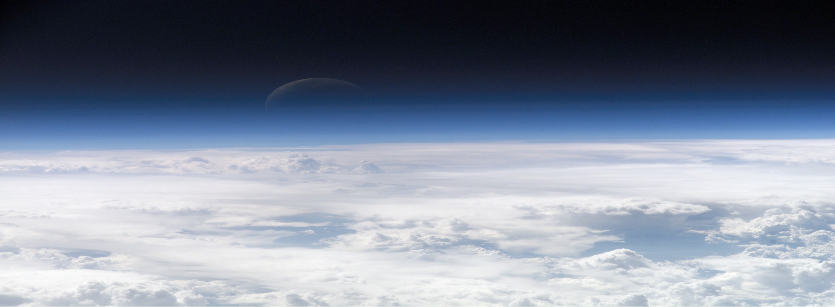
Please balance the equation below.
__NH4NO3 → __N2 + __O2 + __H2O
17
answer is…

Slide 123
Please balance the equation below.
__NH4NO3 → __N2 + __O2 + __H2O
Ammonium Nitrate breaks down to create diatomic nitrogen, oxygen gas, and water.
17
answer is…

Slide 124
Please balance the equation below.
2
2
4
__NH4NO3 → __N2 + __O2 + __H2O
Ammonium Nitrate breaks down to create diatomic nitrogen, oxygen gas, and water.
17
answer is…

Slide 125
NEW
QUESTION

Slide 126
Please balance the equation below.
__SiO2 + __HF → __SiF4 + __H2O
18

Slide 127
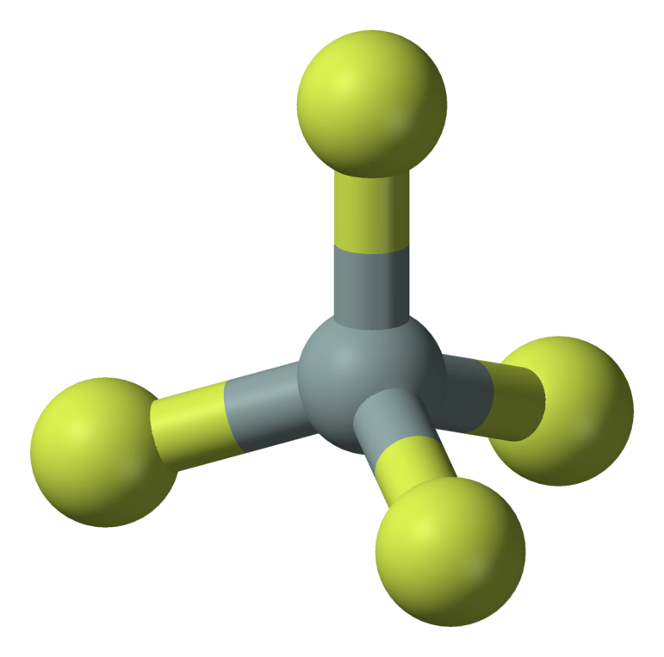
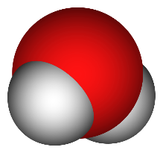


Please balance the equation below.
__SiO2 + __HF → __SiF4 + __H2O
18

Slide 128
Please balance the equation below.
__SiO2 + __HF → __SiF4 + __H2O
Silicon dioxide and Hydrogen Flouride react to produce Silicon tetrafluoride and water.
18

Slide 129
Please balance the equation below.
4
2
__SiO2 + __HF → __SiF4 + __H2O
Silicon dioxide and Hydrogen Flouride react to produce Silicon tetrafluoride and water.
18

Slide 130
NEW
QUESTION

Slide 131
Please balance the equation below.
__H2SO4 +__Pb(OH)4 →__Pb(SO4)2 +__H2O
19
answer is…

Slide 132
Please balance the equation below.
__H2SO4 +__Pb(OH)4 →__Pb(SO4)2 +__H2O
Sulfuric Acid and Lead Hydroxide react to produce Lead Sulfate and Water.
19
answer is…

Slide 133
Please balance the equation below.
2
4
__H2SO4 +__Pb(OH)4 →__Pb(SO4)2 +__H2O
Sulfuric Acid and Lead Hydroxide react to produce Lead Sulfate and Water.
19
answer is…

Slide 134
NEW QUESTION

Slide 135
Please balance the equation below.
__N2(g) + __O2(g) + __H2O →__HNO3 (aq)
20

Slide 136
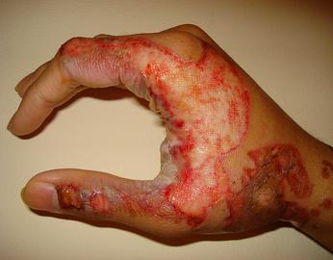
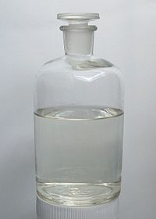
Please balance the equation below.
__N2(g) + __O2(g) + __H2O →__HNO3 (aq)
20

Slide 137
Please balance the equation below.
__N2(g) + __O2(g) + __H2O →__HNO3 (aq)
Diatomic Nitrogen and Oxygen Gas with Water form an Aqueous Nitric Acid.
20

Slide 138
Please balance the equation below.
2
5
2
4
__N2(g) + __O2(g) + __H2O →__HNO3 (aq)
Diatomic Nitrogen and Oxygen Gas with Water form an Aqueous Nitric Acid.
20

Slide 139
Subscripts and Equations Review Game
THE SCRIPT KEEPER | THE MORE YOU KNOW | BALANCING ACT | BLANK STARE | -BONUS- NAME THE COMPOUD
1 | 6 | 11 | 16 | *21
2 | 7 | 12 | 17 | *22
3 | 8 | 13 | 18 | *23
4 | 9 | 14 | 19 | *24
5 | 10 | 15 | 20 | *25
Final Question:________________
Copyright © 2024 SlideSpark .LLC

Slide 140
Subscripts and Equations Review Game
THE SCRIPT KEEPER | THE MORE YOU KNOW | BALANCING ACT | BLANK STARE | -BONUS- NAME THE COMPOUD
1 | 6 | 11 | 16 | *21
2 | 7 | 12 | 17 | *22
3 | 8 | 13 | 18 | *23
4 | 9 | 14 | 19 | *24
5 | 10 | 15 | 20 | *25
Final Question:________________
Copyright © 2024 SlideSpark .LLC

Slide 141
*21
What’s this?

Slide 142

*21
What’s this?

Slide 143
What’s this?
*22

Slide 144

What’s this?
*22

Slide 145
*23
What’s this?

Slide 146
*23
What’s this?

Slide 147
*23
What’s this?

Slide 148
*24

Slide 149
*24

Slide 150
*24

Slide 151
*25
Name the Flavor

Slide 152

*25
Name the Flavor

Slide 153
Subscripts and Equations Review Game
THE SCRIPT KEEPER | THE MORE YOU KNOW | BALANCING ACT | BLANK STARE | -BONUS- NAME THE COMPOUD
1 | 6 | 11 | 16 | *21
2 | 7 | 12 | 17 | *22
3 | 8 | 13 | 18 | *23
4 | 9 | 14 | 19 | *24
5 | 10 | 15 | 20 | *25
Final Question:________________
Copyright © 2024 SlideSpark .LLC

Slide 154
5 Point Wager Question

Slide 155
Please balance the equation below.
__Hg(OH)2 + __H3PO4 →__Hg3(PO4)2 + __H2O
FINAL QUESTION

Slide 156
Please balance the equation below.
__Hg(OH)2 + __H3PO4 →__Hg3(PO4)2 + __H2O
Mercury Hydroxide and Phosphoric Acid react to produce Mercury Phosphate and Water.
FINAL QUESTION

Slide 157
Please balance the equation below.
3
2
6
__Hg(OH)2 + __H3PO4 →__Hg3(PO4)2 + __H2O
Mercury Hydroxide and Phosphoric Acid react to produce Mercury Phosphate and Water.
FINAL QUESTION

Slide 158
Subscripts and Equations Review Game
1-20 = 5 points each
20-25 = Bonus (1 point each)
Final Question = 5 point wager
Find the Owl = 1 point
Answer Key is provided in PowerPoint Form after Final Question
Copyright © 2024 SlideSpark .LLC

Slide 159
Subscripts and Equations
Review Game
2 H2 + O2 2 H2O
Part 4
Lesson 7

Slide 160



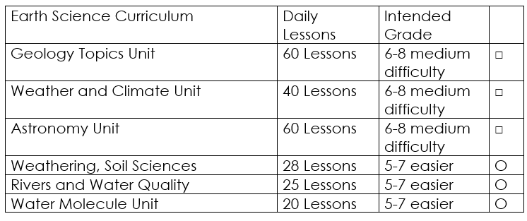

Curriculum Guide
Number of Lessons in each unit (50 min, daily lessons) and difficult rating scale / intended grade level.
=Easier, = More difficult, =Most difficult
Earth Science Units

Slide 161


Life Science Units

Slide 162

Physical Science

Slide 163
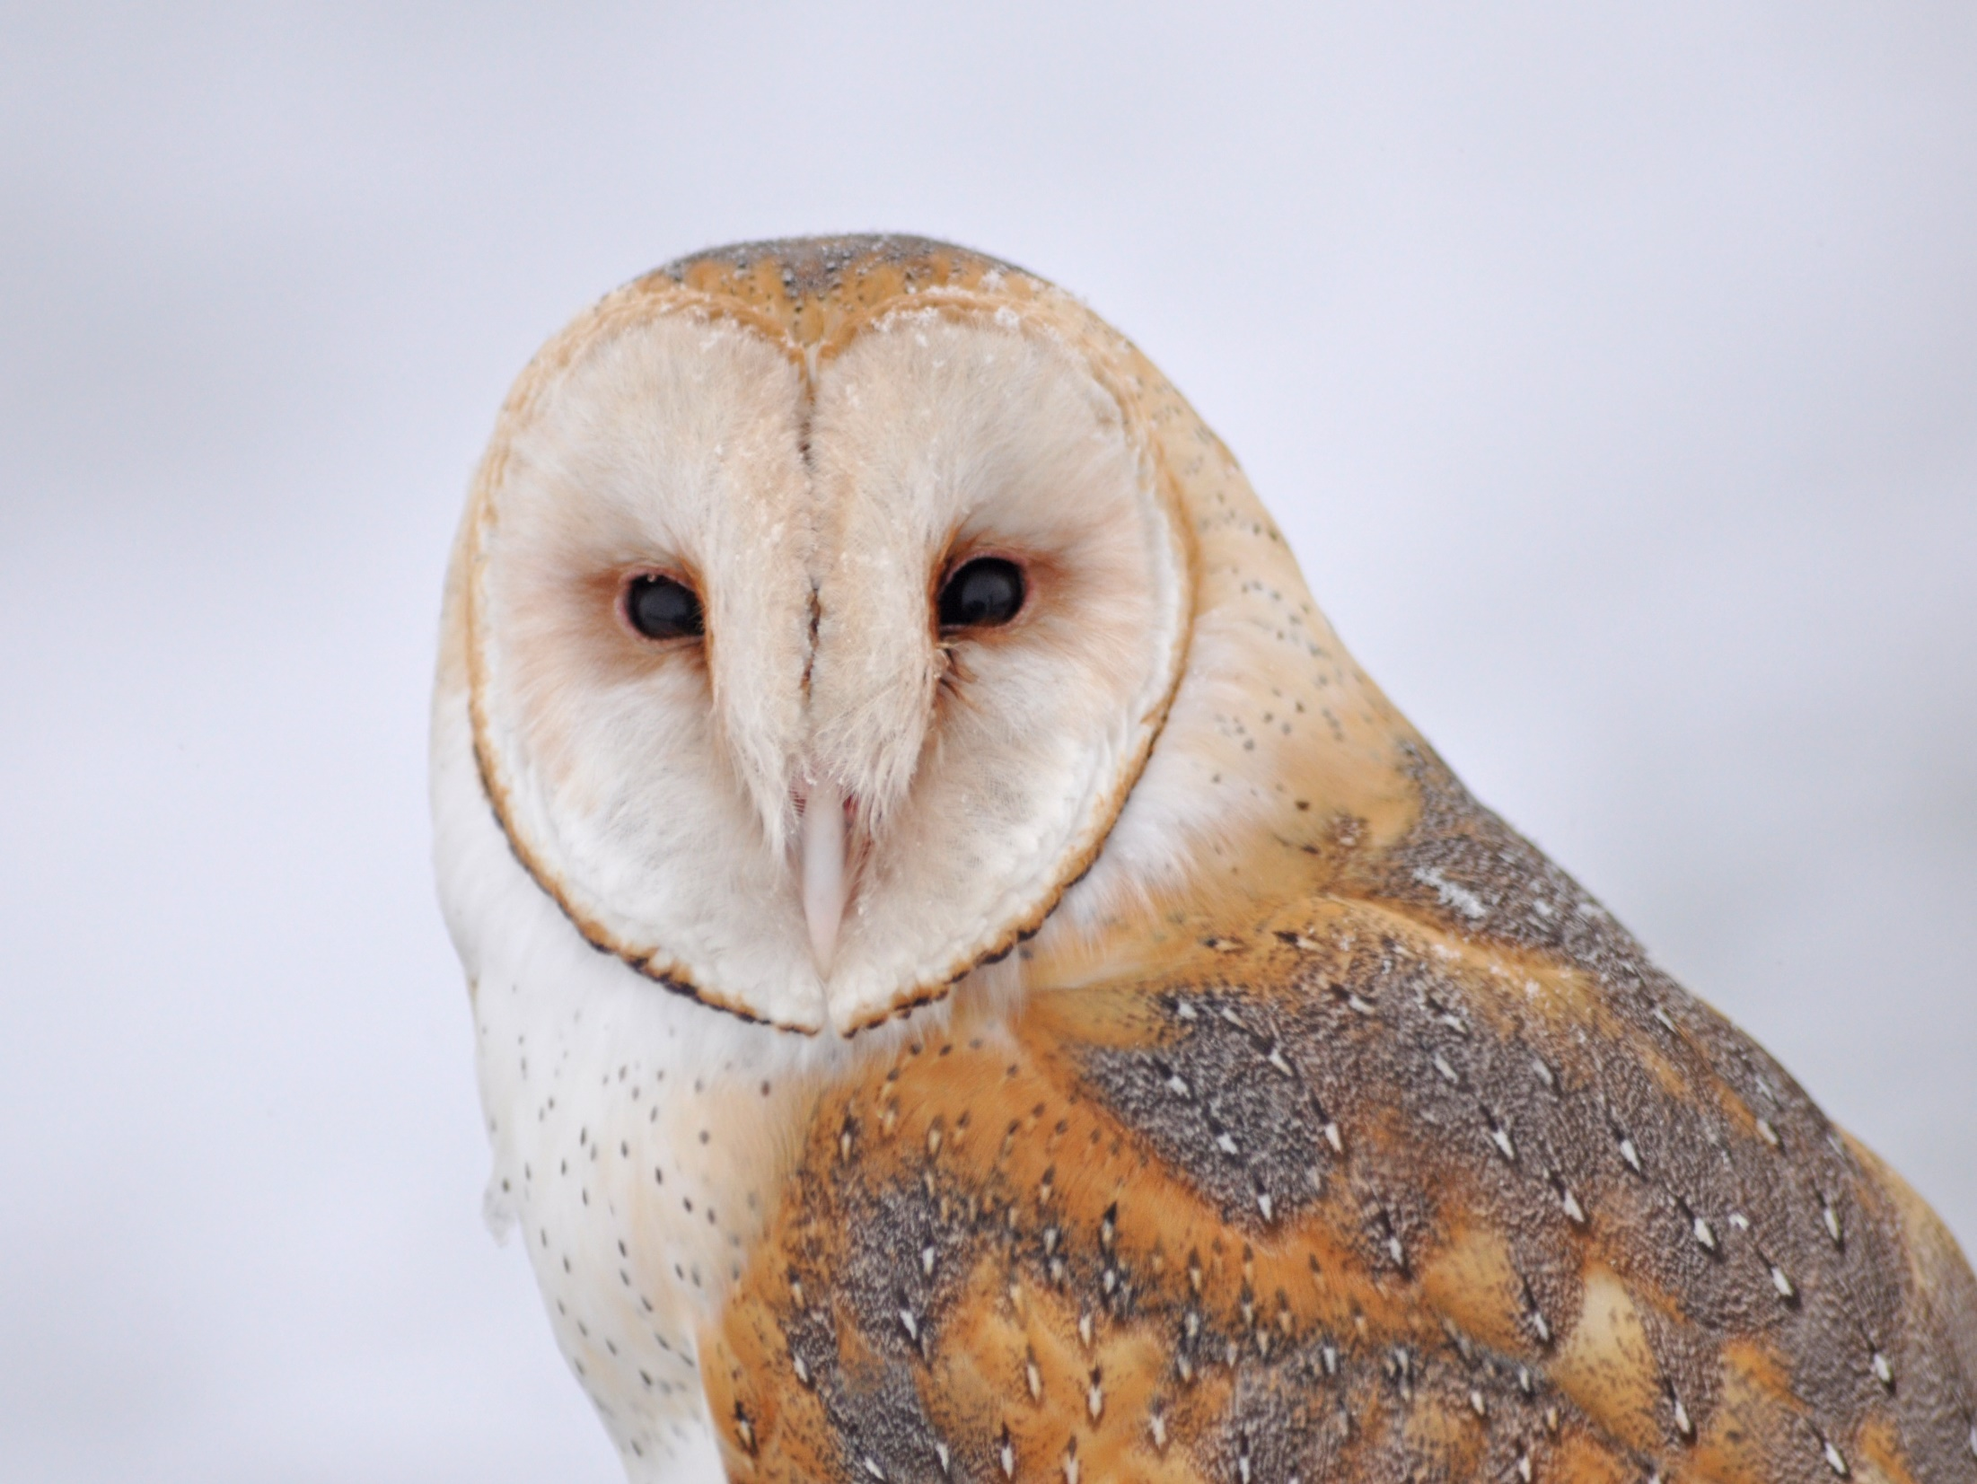
Dear Valued Educator,
Our fully editable .pptx and .doc resources are perfect for educators looking to bring enthusiasm and creativity to their lessons. We encourage you to make changes to fit your needs and style. As science educators, we’re committed to providing students with the tools they need to succeed in the classroom and beyond. Each unit in the curriculum includes a range of resources that have been developed through extensive research and use in a busy classroom. Our teaching approach is designed to make science education engaging and exciting for learners of all ages. We offer a one-of-a-kind science curriculum that will challenge, inspire, and educate students to become tomorrow's scientists and leaders. Join us today and learn more about how our program can help you achieve your classroom goals.
With appreciation,
Support@SlideSpark.net

Slide 164





Thank you for your time and interest in our Science curriculum. We strive to provide students with engaging and informative lessons that will spark their curiosity and encourage scientific exploration. Should you have any questions or concerns, please do not hesitate to contact us. Thank you again for considering our curriculum, and we wish you all the best in your educational journey.
Sincerely,
Support@slidespark.net
SlideSpark Science on TpT

