Slide 1
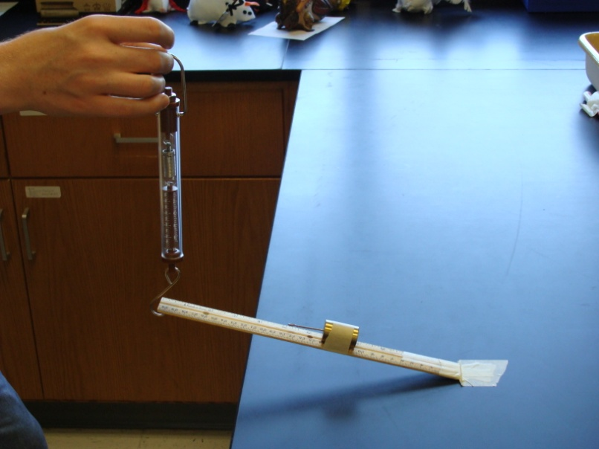

Review Game
Part 4
Lesson 9

Slide 2
Machines Review Game
PULL OVER | ARE YOU CLEVER ENOUGH | ON A JET PLANE | WHEELIN and DEALIN | -BONUS- GREEN MACHINE
1 | 6 | 11 | 16 | *21
2 | 7 | 12 | 17 | *22
3 | 8 | 13 | 18 | *23
4 | 9 | 14 | 19 | *24
5 | 10 | 15 | 20 | *25
Copyright © 2024 SlideSpark .LLC

Slide 3
How to play…
  Don’t play like Jeo_ _ _ _ y.
  Class should be divided into several small groups.
  Groups should use science journal (red slide notes), homework, and other available materials to assist you.
  Groups can communicate quietly with each other but no sharing answers between groups.
    Practice quietly communicating right now?
    Practice Communication Question:
    Your group gets to order one pizza, and you can have two toppings. What does your group want?

Slide 4

Questions 1-20 = 5pts Each
Final Category (Bonus) = 1pt Each
Final Questions = 5 pt wager
If you wager 5 on the last question and get it wrong you lose 5 pts. Wager 5 and get it right you get 5 pts.
Find the Owl =
Secretly write “Owl” in the correct box worth 1pt.
“I’ll be about this big.”

Slide 5
Machines Review Game
PULL OVER | ARE YOU CLEVER ENOUGH | ON A JET PLANE | WHEELIN and DEALIN | -BONUS- GREEN MACHINE
1 | 6 | 11 | 16 | *21
2 | 7 | 12 | 17 | *22
3 | 8 | 13 | 18 | *23
4 | 9 | 14 | 19 | *24
5 | 10 | 15 | 20 | *25
Copyright © 2024 SlideSpark .LLC

Slide 6
Machines Review Game
PULL OVER | ARE YOU CLEVER ENOUGH | ON A JET PLANE | WHEELIN and DEALIN | -BONUS- GREEN MACHINE
1 | 6 | 11 | 16 | *21
2 | 7 | 12 | 17 | *22
3 | 8 | 13 | 18 | *23
4 | 9 | 14 | 19 | *24
5 | 10 | 15 | 20 | *25
Copyright © 2024 SlideSpark .LLC

Slide 7
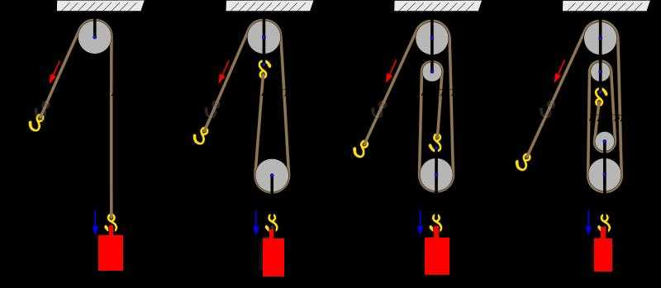
What is the MA of each pulley below?
1
A
B
C
D

Slide 8
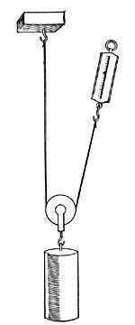
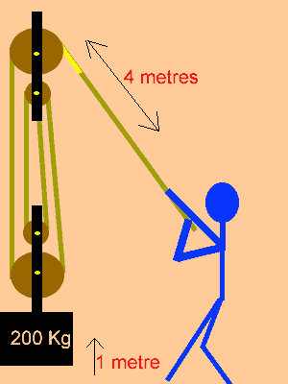
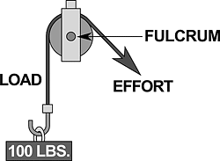
Which is a fixed pulley, movable pulley, and combined pulley? What is the MA of each?
2
A
B
C
Copyright © 2024 SlideSpark .LLC

Slide 9
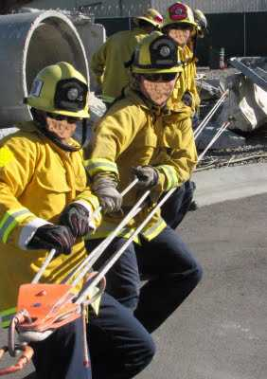
A pulley makes work seem easier, it changes the direction of motion to work with gravity.
  Uses your body weight against the resistance.
3
Copyright © 2024 SlideSpark .LLC

Slide 10

Which two terms are switched?
4
w
÷
newtons
÷
f
d
X
Joules
meters

Slide 11
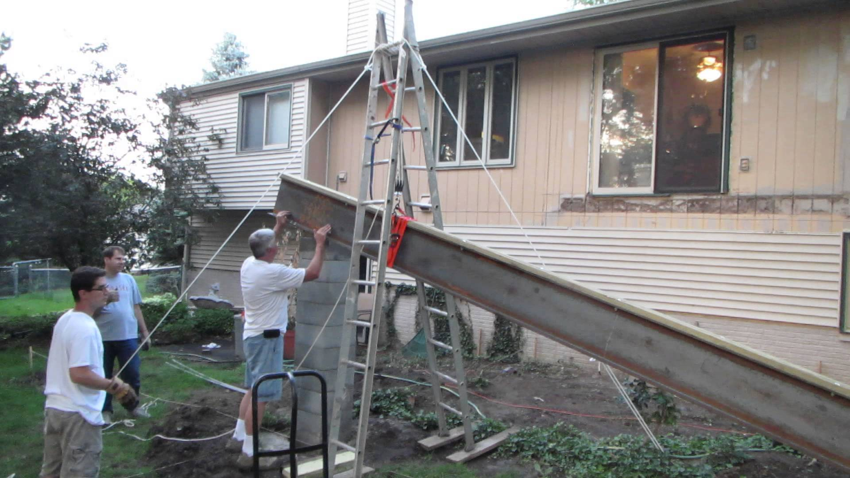
True or False? Simple machines decrease the overall energy needed to do work?
5

Slide 12
Machines Review Game
PULL OVER | ARE YOU CLEVER ENOUGH | ON A JET PLANE | WHEELIN and DEALIN | -BONUS- GREEN MACHINE
1 | 6 | 11 | 16 | *21
2 | 7 | 12 | 17 | *22
3 | 8 | 13 | 18 | *23
4 | 9 | 14 | 19 | *24
5 | 10 | 15 | 20 | *25
Copyright © 2024 SlideSpark .LLC

Slide 13
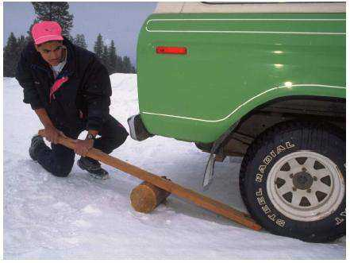
What class of lever is this picture?
6
Copyright © 2024 SlideSpark .LLC

Slide 14
What class of lever is this picture?
Force
6
Load
Fulcrum
Copyright © 2024 SlideSpark .LLC

Slide 15
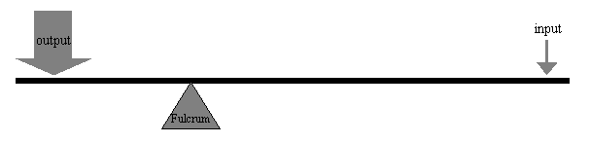
What is the MA of this lever?
  MA = length of effort arm ÷ length of resistance arm.
2 meters
4 meters
7
Copyright © 2024 SlideSpark .LLC

Slide 16
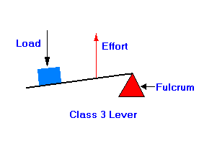
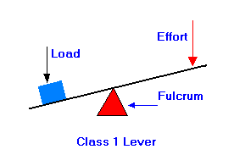
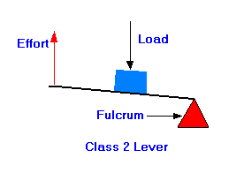
Which is a first, second, and third class lever.?
A
B
C
8

Slide 17
9
and name the class of lever?
B
C
A

Slide 18
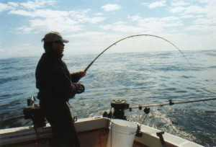
and name the class of lever?
10
C
B
A

Slide 19
Machines Review Game
PULL OVER | ARE YOU CLEVER ENOUGH | ON A JET PLANE | WHEELIN and DEALIN | -BONUS- GREEN MACHINE
1 | 6 | 11 | 16 | *21
2 | 7 | 12 | 17 | *22
3 | 8 | 13 | 18 | *23
4 | 9 | 14 | 19 | *24
5 | 10 | 15 | 20 | *25
Copyright © 2024 SlideSpark .LLC

Slide 20
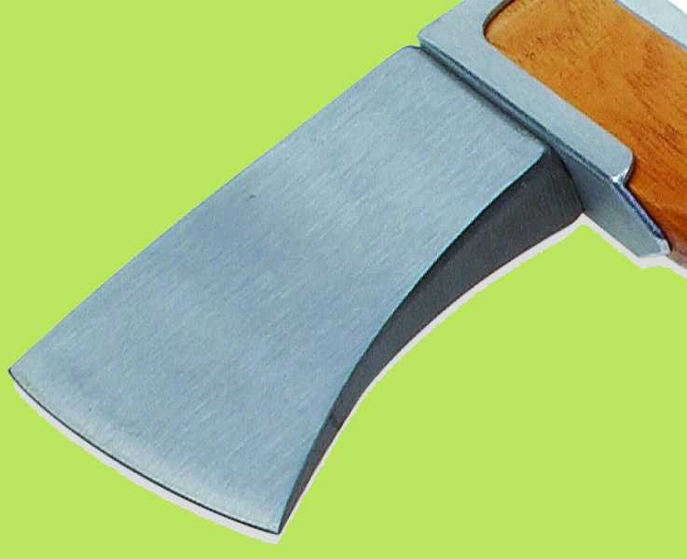
What simple machine is this and what’s the mechanical advantage?
11
15 cm
3 cm

Slide 21
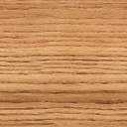



Please find the MA of the shapes below?
12
15
3
5
2
8
8
D
4
4

Slide 22
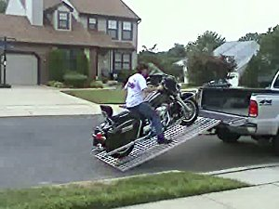
4,000 Joules of Work was used to move a motorcycle up a inclined plane of 2 meters.
  How much did the motorcycle weigh / N?
13

Slide 23
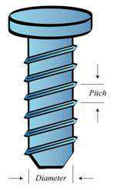
Name this simple machine and find the MA.
Divide circumference by the pitch to get MA.
14
2 cm
6 cm
Copyright © 2024 SlideSpark .LLC

Slide 24
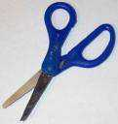
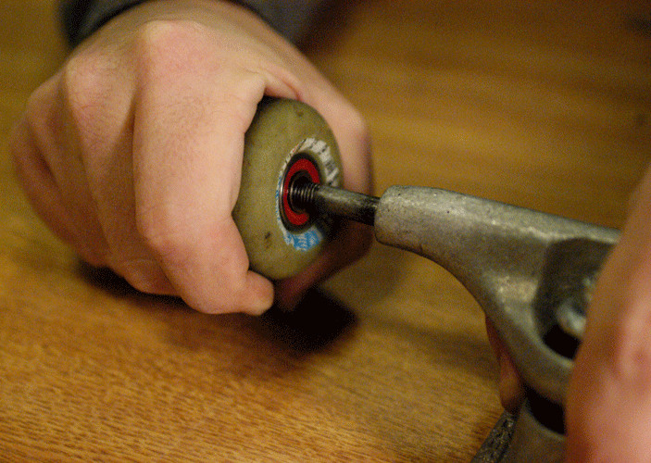
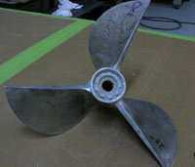
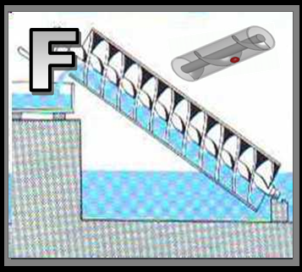
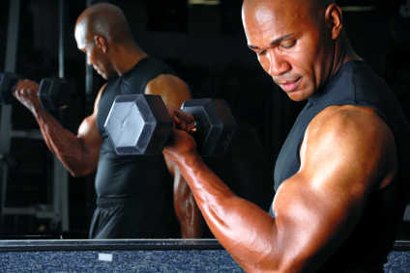
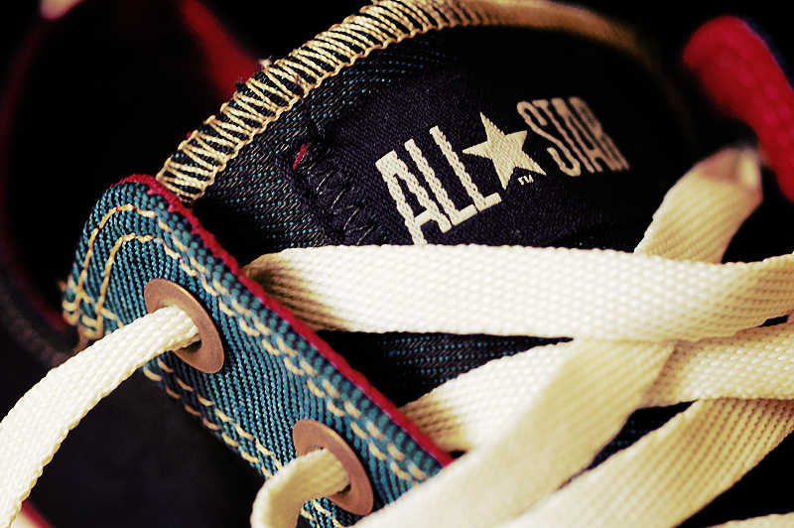
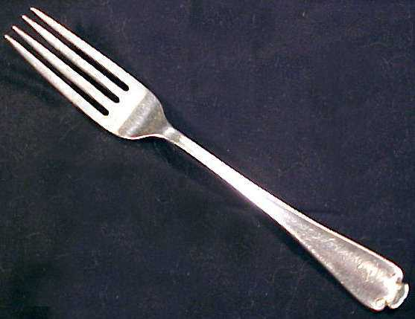
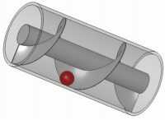
15
Name each simple machine below
A
B
C
Sharp part
D
E
F

Slide 25
Machines Review Game
PULL OVER | ARE YOU CLEVER ENOUGH | ON A JET PLANE | WHEELIN and DEALIN | -BONUS- GREEN MACHINE
1 | 6 | 11 | 16 | *21
2 | 7 | 12 | 17 | *22
3 | 8 | 13 | 18 | *23
4 | 9 | 14 | 19 | *24
5 | 10 | 15 | 20 | *25
Copyright © 2024 SlideSpark .LLC

Slide 26
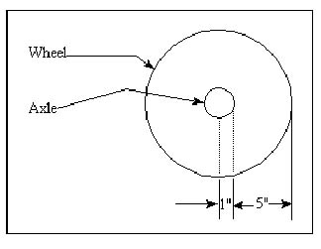
The mechanical advantage of a wheel and axle is the ratio of the radius of the wheel divided by the radius of the axle.
16
What is the MA?
Copyright © 2024 SlideSpark .LLC

Slide 27
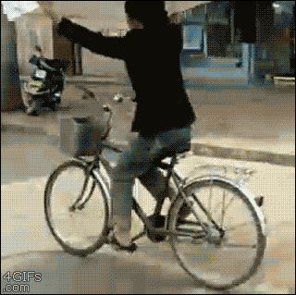
Julie did 20,000 Joules of Work pushing with 200 newtons.
  How far did Julie bike?
17

Slide 28
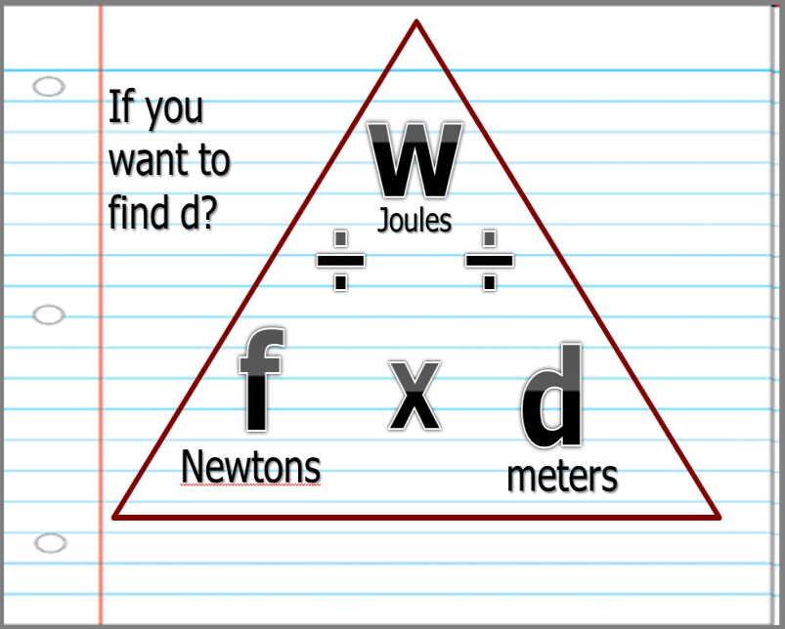
Julie did 20,000 Joules of Work pushing with 200 newtons.
  How far did Julie bike?
17

Slide 29
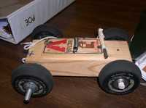
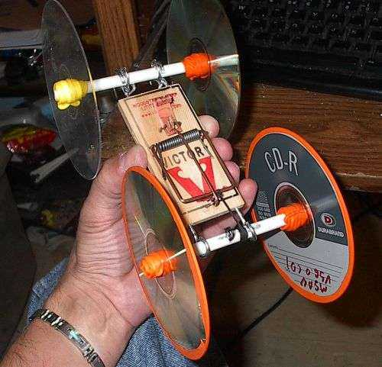
Which wheel and axle will be best for a mouse trap car? Best Mechanical Advantage
18
A
B

Slide 30
Machines…
  A.) Transfer force from one place to another.
  B.) Change direction of a force.
  C.) Increase the magnitude of a force.
  D.) Increase the distance or speed of a force.
19

Slide 31
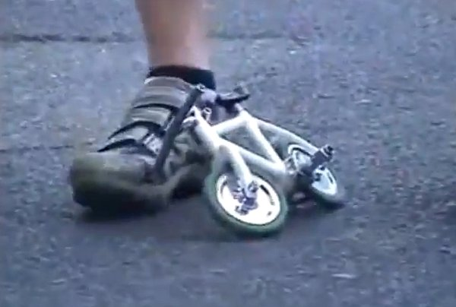
A man puts 300 J of energy into riding a tiny bicycle. The energy transferred to moving forward was 150 J.
  What is the efficiency of the tiny bike?
20

Slide 32
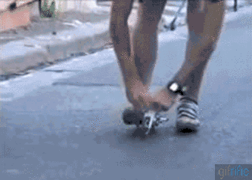
A man puts 300 J of energy into riding a tiny bicycle. The energy transferred to moving forward was 150 J.
  What is the efficiency of the tiny bike?
20

Slide 33
Machines Review Game
PULL OVER | ARE YOU CLEVER ENOUGH | ON A JET PLANE | WHEELIN and DEALIN | -BONUS- GREEN MACHINE
1 | 6 | 11 | 16 | *21
2 | 7 | 12 | 17 | *22
3 | 8 | 13 | 18 | *23
4 | 9 | 14 | 19 | *24
5 | 10 | 15 | 20 | *25
Copyright © 2024 SlideSpark .LLC

Slide 34
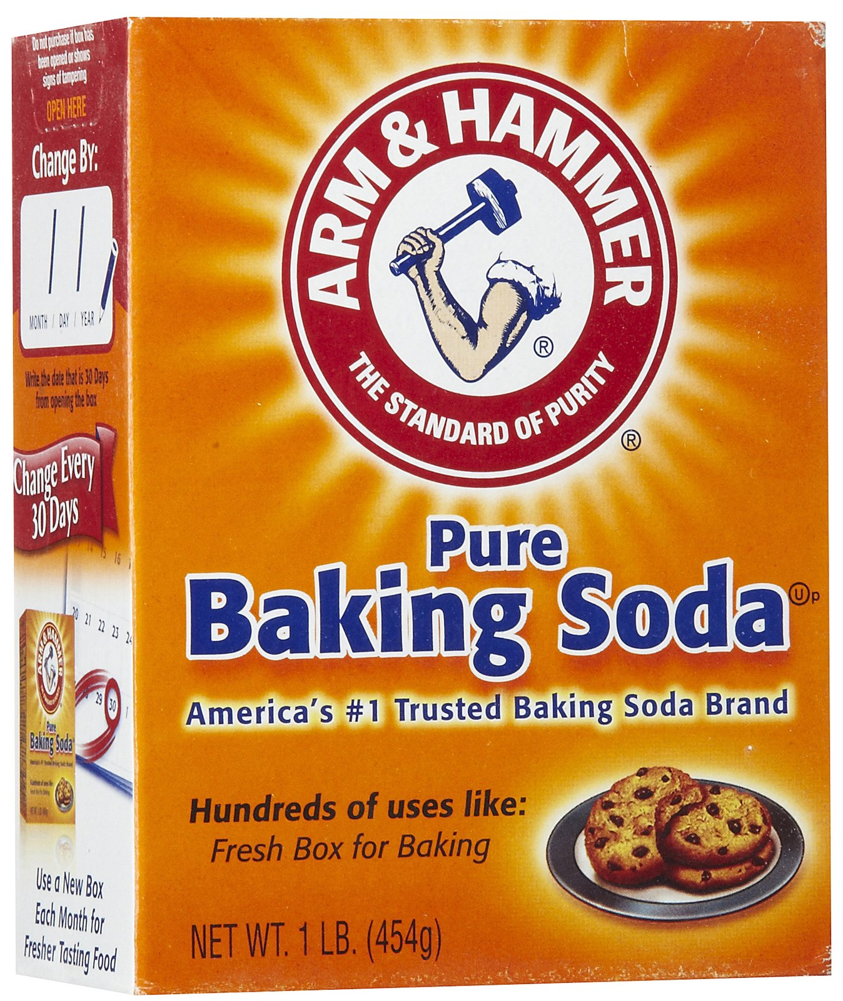
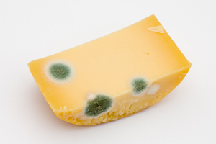
Name this brand of baking soda / lever.
21
Copyright © 2024 SlideSpark .LLC

Slide 35
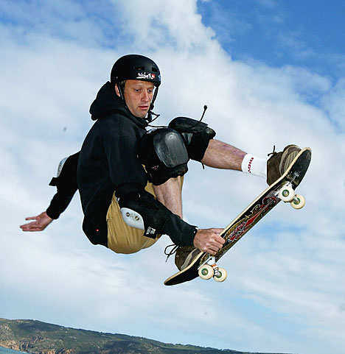
Who is this person and what two machines is he working?
*22
Copyright © 2024 SlideSpark .LLC

Slide 36

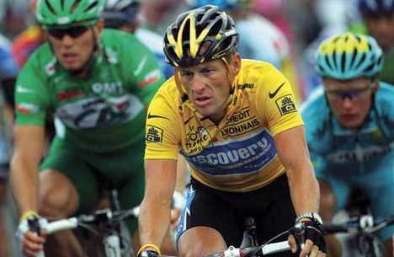
Who am I?
*23
23
Copyright © 2024 SlideSpark .LLC

Slide 37
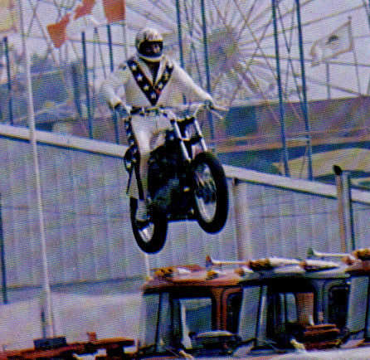
Who is this?
*24

Slide 38
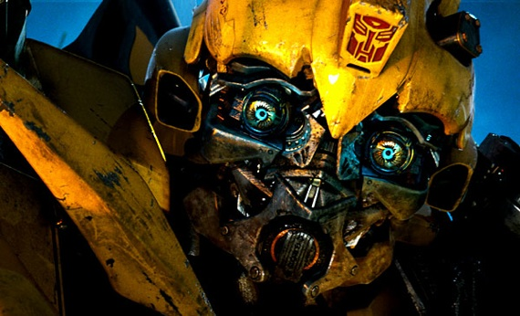
Name this machine?
25

Slide 39
Machines Review Game
PULL OVER | ARE YOU CLEVER ENOUGH | ON A JET PLANE | WHEELIN and DEALIN | -BONUS- GREEN MACHINE
1 | 6 | 11 | 16 | *21
2 | 7 | 12 | 17 | *22
3 | 8 | 13 | 18 | *23
4 | 9 | 14 | 19 | *24
5 | 10 | 15 | 20 | *25
Final Question:_________________
Copyright © 2024 SlideSpark .LLC

Slide 40
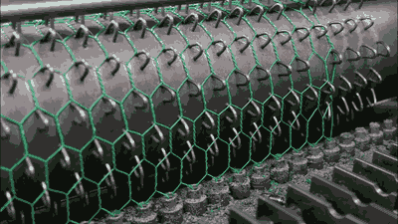
5 point wager question

Slide 41
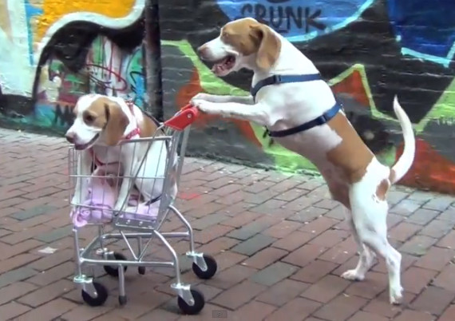
A dog applies a force of 100 newtons to push his buddy down the 60 meters of sidewalk. How much work was done?

Slide 42
Review Game
Part 4
Lesson 9

Slide 43

Review Game
Part 4
Lesson 10

Slide 44
Machines Review Game
PULL OVER | ARE YOU CLEVER ENOUGH | ON A JET PLANE | WHEELIN and DEALIN | -BONUS- GREEN MACHINE
1 | 6 | 11 | 16 | *21
2 | 7 | 12 | 17 | *22
3 | 8 | 13 | 18 | *23
4 | 9 | 14 | 19 | *24
5 | 10 | 15 | 20 | *25
Copyright © 2024 SlideSpark .LLC

Slide 45
How to play…
  Don’t play like Jeo_ _ _ _ y.
  Class should be divided into several small groups.
  Groups should use science journal (red slide notes), homework, and other available materials to assist you.
  Groups can communicate quietly with each other but no sharing answers between groups.
    Practice quietly communicating right now?
    Practice Communication Question:
    Your group gets to order one pizza, and you can have two toppings. What does your group want?

Slide 46
Questions 1-20 = 5pts Each
Final Category (Bonus) = 1pt Each
Final Questions = 5 pt wager
If you wager 5 on the last question and get it wrong you lose 5 pts. Wager 5 and get it right you get 5 pts.
Find the Owl =
Secretly write “Owl” in the correct box worth 1pt.
“I’ll be about this big.”

Slide 47
Machines Review Game
PULL OVER | ARE YOU CLEVER ENOUGH | ON A JET PLANE | WHEELIN and DEALIN | -BONUS- GREEN MACHINE
1 | 6 | 11 | 16 | *21
2 | 7 | 12 | 17 | *22
3 | 8 | 13 | 18 | *23
4 | 9 | 14 | 19 | *24
5 | 10 | 15 | 20 | *25
Copyright © 2024 SlideSpark .LLC

Slide 48
Machines Review Game
PULL OVER | ARE YOU CLEVER ENOUGH | ON A JET PLANE | WHEELIN and DEALIN | -BONUS- GREEN MACHINE
1 | 6 | 11 | 16 | *21
2 | 7 | 12 | 17 | *22
3 | 8 | 13 | 18 | *23
4 | 9 | 14 | 19 | *24
5 | 10 | 15 | 20 | *25
Copyright © 2024 SlideSpark .LLC

Slide 49
What is the MA of each pulley below?
1
A
B
C
D

Slide 50
What is the MA of each pulley below?
1
A
B
C
D

Slide 51
What is the MA of each pulley below?
1
A
1
B
C
D

Slide 52
What is the MA of each pulley below?
1
A
1
B
C
D

Slide 53

What is the MA of each pulley below?
1
A
1
B
C
D

Slide 54
What is the MA of each pulley below?
1
A
1
B
C
D

Slide 55

What is the MA of each pulley below?
1
A
1
B
C
D

Slide 56
What is the MA of each pulley below?
1
A
1
B
C
D

Slide 57

What is the MA of each pulley below?
1
A
1
B
C
D

Slide 58
Which is a fixed pulley, movable pulley, and combined pulley? What is the MA of each?
2
A
B
C
Copyright © 2024 SlideSpark .LLC

Slide 59
Which is a fixed pulley, movable pulley, and combined pulley? What is the MA of each?
2
A
B
C
Copyright © 2024 SlideSpark .LLC

Slide 60
Which is a fixed pulley, movable pulley, and combined pulley? What is the MA of each?
2
Movable
MA=2
A
B
C
Copyright © 2024 SlideSpark .LLC

Slide 61
Which is a fixed pulley, movable pulley, and combined pulley? What is the MA of each?
2
Not great for going up.
Movable
MA=2
A
B
C
Copyright © 2024 SlideSpark .LLC

Slide 62
Which is a fixed pulley, movable pulley, and combined pulley? What is the MA of each?
2
Not great for going up.
Movable
MA=2
A
B
C
Copyright © 2024 SlideSpark .LLC

Slide 63
Which is a fixed pulley, movable pulley, and combined pulley? What is the MA of each?
2
Combined
Pulley
Not great for going up.
Movable
MA=2
MA=4
A
B
C
Copyright © 2024 SlideSpark .LLC

Slide 64
Which is a fixed pulley, movable pulley, and combined pulley? What is the MA of each?
2
Combined
Pulley
Not great for going up.
Movable
MA=2
MA=4
A
B
C
Copyright © 2024 SlideSpark .LLC

Slide 65
Which is a fixed pulley, movable pulley, and combined pulley? What is the MA of each?
2
Combined
Pulley
Not great for going up.
Movable
MA=1
Fixed
Pulley
MA=2
MA=4
A
B
C
Copyright © 2024 SlideSpark .LLC

Slide 66
A pulley makes work seem easier, it changes the direction of motion to work with gravity.
  Uses your body weight against the resistance.
3
Copyright © 2024 SlideSpark .LLC

Slide 67
A pulley makes work seem easier, it changes the direction of motion to work with gravity.
  Uses your body weight against the resistance.
3
Copyright © 2024 SlideSpark .LLC

Slide 68
A pulley makes work seem easier, it changes the direction of motion to work with gravity.
  Uses your body weight against the resistance.
Direction
3
Copyright © 2024 SlideSpark .LLC

Slide 69
Which two terms are switched?
4
w
÷
newtons
÷
f
d
X
Joules
meters

Slide 70
Which two terms are switched?
4
w
÷
newtons
÷
f
d
X
Joules
meters

Slide 71
Which two terms are switched?
force (N) x distance (m) = work (J) Joules
4
w
÷
Joules
÷
f
d
X
newtons
meters

Slide 72
True or False? Simple machines decrease the overall energy needed to do work?
5

Slide 73
True or False? Simple machines decrease the overall energy needed to do work?
5
False

Slide 74
True or False? Simple machines decrease the overall energy needed to do work?
5
False
Simple machines make work easier, they do not decrease the amount of overall work.
Simple machines can actually make more work due to increased friction.
They may decrease the force needed by increasing the distance over which the work is done.

Slide 75
Machines Review Game
PULL OVER | ARE YOU CLEVER ENOUGH | ON A JET PLANE | WHEELIN and DEALIN | -BONUS- GREEN MACHINE
1 | 6 | 11 | 16 | *21
2 | 7 | 12 | 17 | *22
3 | 8 | 13 | 18 | *23
4 | 9 | 14 | 19 | *24
5 | 10 | 15 | 20 | *25
Copyright © 2024 SlideSpark .LLC

Slide 76
What class of levers is this picture?
Force
6
Load
Fulcrum
Copyright © 2024 SlideSpark .LLC

Slide 77
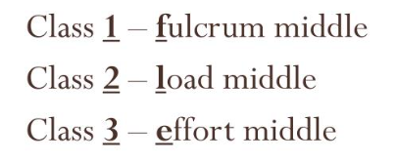
What class of levers is this picture?
FIRST CLASS LEVER
Force
6
Load
Fulcrum
Copyright © 2024 SlideSpark .LLC

Slide 78
What is the MA of this lever?
  MA = length of effort arm ÷ length of resistance arm.
2 meters
4 meters
7
Copyright © 2024 SlideSpark .LLC

Slide 79
What is the MA of this lever?
  MA = length of effort arm ÷ length of resistance arm.
2 meters
4 meters
7
Copyright © 2024 SlideSpark .LLC

Slide 80
What is the MA of this lever?
  MA = length of effort arm ÷ length of resistance arm.
2 meters
4 meters
4 meters / 2 meters =
7
Copyright © 2024 SlideSpark .LLC

Slide 81
What is the MA of this lever?
  MA = length of effort arm ÷ length of resistance arm.
2 meters
4 meters
4 meters / 2 meters = MA 2
7
Copyright © 2024 SlideSpark .LLC

Slide 82
Which is a first, second, and third class lever.?
A
B
C
8

Slide 83
Which is a first, second, and third class lever.?
A
B
C
8

Slide 84
Which is a first, second, and third class lever.?
A
B
C
Third Class
8

Slide 85
Which is a first, second, and third class lever.?
A
B
C
Third Class
8

Slide 86
Which is a first, second, and third class lever.?
A
B
C
Third Class
First Class
8

Slide 87
Which is a first, second, and third class lever.?
A
B
C
Third Class
First Class
8

Slide 88
Which is a first, second, and third class lever.?
A
B
C
Third Class
First Class
Second Class
8

Slide 89
9
and name the class of lever?
B
C
A

Slide 90
9
and name the class of lever?
B
C
A

Slide 91
9
and name the class of lever?
Effort
B
C
A

Slide 92
9
and name the class of lever?
Effort
B
C
A

Slide 93
9
and name the class of lever?
Effort
Load
B
C
A

Slide 94
9
and name the class of lever?
Effort
Load
B
C
A

Slide 95
9
and name the class of lever?
Effort
Load
Fulcrum
B
C
A

Slide 96
9
and name the class of lever?
Effort
Load
Fulcrum
B
C
A

Slide 97
9
Second Class Lever
Effort
Load
Fulcrum
B
C
A

Slide 98
and name the class of lever?
10
C
B
A

Slide 99
and name the class of lever?
10
C
B
A

Slide 100
and name the class of lever?
10
C
B
A
Fulcrum

Slide 101
and name the class of lever?
10
C
B
A
Fulcrum

Slide 102
and name the class of lever?
10
C
Force
B
A
Fulcrum

Slide 103
and name the class of lever?
10
C
Force
B
A
Fulcrum

Slide 104
and name the class of lever?
10
C
Force
B
Load
A
Fulcrum

Slide 105
and name the class of lever?
10
C
Force
B
Load
A
Fulcrum

Slide 106
Third Class Lever
10
C
Force
B
Load
A
Fulcrum

Slide 107
Machines Review Game
PULL OVER | ARE YOU CLEVER ENOUGH | ON A JET PLANE | WHEELIN and DEALIN | -BONUS- GREEN MACHINE
1 | 6 | 11 | 16 | *21
2 | 7 | 12 | 17 | *22
3 | 8 | 13 | 18 | *23
4 | 9 | 14 | 19 | *24
5 | 10 | 15 | 20 | *25
Copyright © 2024 SlideSpark .LLC

Slide 108
What simple machine is this and what’s the mechanical advantage?
11
15 cm
3 cm

Slide 109
What simple machine is this and what’s the mechanical advantage?
11
15 cm
3 cm

Slide 110
What simple machine is this and what’s the mechanical advantage?
11
15 cm
3 cm
Wedge

Slide 111
What simple machine is this and what’s the mechanical advantage?
11
15 cm
3 cm
Wedge

Slide 112
What simple machine is this and what’s the mechanical advantage?
11
15 / 3 =
15 cm
3 cm
Wedge

Slide 113
What simple machine is this and what’s the mechanical advantage?
11
15 / 3 =
5 MA
15 cm
3 cm
Wedge

Slide 114
Please find the MA of the shapes below?
12
15
3
5
2
8
8
D
4
4

Slide 115
Please find the MA of the shapes below?
12
15
3
5
2
8
8
D
4
4

Slide 116
Please find the MA of the shapes below?
12
15
3
5
2
8
8
D
MA = 2
4
4

Slide 117
Please find the MA of the shapes below?
12
15
3
5
2
8
8
D
MA = 2
4
4

Slide 118
Please find the MA of the shapes below?
12
15
3
MA = 5
5
2
8
8
D
MA = 2
4
4

Slide 119
Please find the MA of the shapes below?
12
15
3
MA = 5
5
2
8
8
D
MA = 2
4
4

Slide 120
Please find the MA of the shapes below?
12
15
3
MA = 5
5
2
8
MA = 2.5
8
D
MA = 2
4
4

Slide 121
Please find the MA of the shapes below?
12
15
3
MA = 5
5
2
8
MA = 2.5
8
D
MA = 2
4
4

Slide 122

Please find the MA of the shapes below?
12
15
3
MA = 5
5
2
8
MA = 2.5
8
MA = 2
MA = 2
4
4

Slide 123
4,000 Joules of Work was used to move a motorcycle up an inclined plane of 2 meters.
  How much did the cycle weigh / N?
13

Slide 124
4,000 Joules of Work was used to move a motorcycle up an inclined plane of 2 meters.
  How much did the cycle weigh / N?
13

Slide 125
4,000 Joules of Work was used to move a motorcycle up an inclined plane of 2 meters.
  How much did the cycle weigh / N?
13

Slide 126

4,000 Joules of Work was used to move a motorcycle up an inclined plane of 2 meters.
  How much did the cycle weigh / N?
13

Slide 127
4,000 Joules of Work was used to move a motorcycle up an inclined plane of 2 meters.
  How much did the cycle weigh / N?
13

Slide 128
4,000 Joules of Work was used to move a motorcycle up an inclined plane of 2 meters.
  How much did the cycle weigh / N?
F = w/d
F =
F =
13

Slide 129
4,000 Joules of Work was used to move a motorcycle up an inclined plane of 2 meters.
  How much did the cycle weigh / N?
F = w/d
F = 4000J/2m
F =
13

Slide 130
4,000 Joules of Work was used to move a motorcycle up an inclined plane of 2 meters.
  How much did the cycle weigh / N?
F = w/d
F = 4000J/2m
F = 2,000 N
13

Slide 131
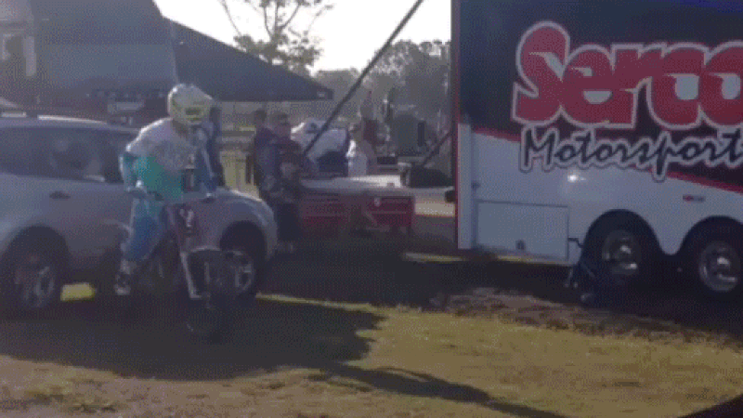

Slide 132
Name this simple machine and find the MA.
Divide circumference by the pitch to get MA.
14
2 cm
6 cm
Copyright © 2024 SlideSpark .LLC

Slide 133
Name this simple machine and find the MA.
Divide circumference by the pitch to get MA.
14
2 cm
6 cm
Copyright © 2024 SlideSpark .LLC

Slide 134
Name this simple machine and find the MA.
Divide circumference by the pitch to get MA.
14
Screw
2 cm
6 cm
Copyright © 2024 SlideSpark .LLC

Slide 135
Name this simple machine and find the MA.
Divide circumference by the pitch to get MA.
14
Screw
2 cm
6 cm
Copyright © 2024 SlideSpark .LLC

Slide 136
Name this simple machine and find the MA.
Divide circumference by the pitch to get MA.
14
Screw
2 cm
6 cm
Copyright © 2024 SlideSpark .LLC

Slide 137

Name this simple machine and find the MA.
Divide circumference by the pitch to get MA.
14
Screw
6 = 18.84
3.14
2 cm
6 cm
Copyright © 2024 SlideSpark .LLC

Slide 138
Name this simple machine and find the MA.
Divide circumference by the pitch to get MA.
14
Screw
6 = 18.84
3.14
2 cm
18.84 / 2 =
6 cm
Copyright © 2024 SlideSpark .LLC

Slide 139
Name this simple machine and find the MA.
Divide circumference by the pitch to get MA.
14
Screw
6 = 18.84
3.14
2 cm
18.84 / 2 =
9.42 MA
6 cm
Copyright © 2024 SlideSpark .LLC

Slide 140
15
Name each simple machine below
A
B
C
D
E
F

Slide 141
15
Name each simple machine below
A
B
C
D
E
F

Slide 142
15
Name each simple machine below
A
B
C
Wedge
D
E
F

Slide 143
15
Name each simple machine below
A
B
C
Wedge
D
E
F

Slide 144
15
Name each simple machine below
A
B
C
Wheel
Screw?
Wedge
Axle
D
E
F

Slide 145
15
Name each simple machine below
A
B
C
Wheel
Wedge
Axle
D
E
F

Slide 146
15
Name each simple machine below
A
B
C
Wheel
Inclined Plane
Wedge
Axle
D
E
F

Slide 147
15
Name each simple machine below
A
B
C
Wheel
Inclined Plane
Wedge
Axle
D
E
F

Slide 148
15
Name each simple machine below
A
B
C
Wheel
Inclined Plane
Wedge
Axle
D
E
F
Lever

Slide 149
15
Name each simple machine below
A
B
C
Wheel
Inclined Plane
Wedge
Axle
D
E
F
Lever

Slide 150
15
Name each simple machine below
A
B
C
Wheel
Inclined Plane
Wedge
Axle
D
E
F
Lever
Pulley

Slide 151
15
Name each simple machine below
A
B
C
Wheel
Inclined Plane
Wedge
Axle
D
E
F
Lever
Pulley

Slide 152
15
Name each simple machine below
A
B
C
Wheel
Inclined Plane
Wedge
Axle
D
E
F
Lever
Pulley
Screw

Slide 153
Machines Review Game
PULL OVER | ARE YOU CLEVER ENOUGH | ON A JET PLANE | WHEELIN and DEALIN | -BONUS- GREEN MACHINE
1 | 6 | 11 | 16 | *21
2 | 7 | 12 | 17 | *22
3 | 8 | 13 | 18 | *23
4 | 9 | 14 | 19 | *24
5 | 10 | 15 | 20 | *25
Copyright © 2024 SlideSpark .LLC

Slide 154
The mechanical advantage of a wheel and axle is the ratio of the radius of the wheel divided by the radius of the axle.
16
What is the MA?
Copyright © 2024 SlideSpark .LLC

Slide 155
The mechanical advantage of a wheel and axle is the ratio of the radius of the wheel divided by the radius of the axle.
16
What is the MA?
Copyright © 2024 SlideSpark .LLC

Slide 156
The mechanical advantage of a wheel and axle is the ratio of the radius of the wheel divided by the radius of the axle.
16
What is the MA?
Copyright © 2024 SlideSpark .LLC

Slide 157
The mechanical advantage of a wheel and axle is the ratio of the radius of the wheel divided by the radius of the axle.
16
What is the MA?
Copyright © 2024 SlideSpark .LLC

Slide 158
The mechanical advantage of a wheel and axle is the ratio of the radius of the wheel divided by the radius of the axle.
16
What is the MA?
Copyright © 2024 SlideSpark .LLC

Slide 159
The mechanical advantage of a wheel and axle is the ratio of the radius of the wheel divided by the radius of the axle.
16
What is the MA?
Copyright © 2024 SlideSpark .LLC

Slide 160
The mechanical advantage of a wheel and axle is the ratio of the radius of the wheel divided by the radius of the axle.
16
What is the MA?
5/1 = 5 MA
Copyright © 2024 SlideSpark .LLC

Slide 161
Julie did 20,000 Joules of Work pushing with 200 newtons.
  How far did Julie bike?
17

Slide 162
Julie did 20,000 Joules of Work pushing with 200 newtons.
  How far did Julie bike?
17

Slide 163
Julie did 20,000 Joules of Work pushing with 200 newtons.
  How far did Julie bike?
17

Slide 164
Julie did 20,000 Joules of Work pushing with 200 newtons.
  How far did Julie bike?
17

Slide 165
Julie did 20,000 Joules of Work pushing with 200 newtons.
  How far did Julie bike?
W / f = d
20,000 J / 200 N = d
100 m = d
17

Slide 166
Julie did 20,000 Joules of Work pushing with 200 newtons.
  How far did Julie bike?
W / f = d
20,000 J / 200 N = d
17

Slide 167
Julie did 20,000 Joules of Work pushing with 200 newtons.
  How far did Julie bike?
W / f = d
20,000 J / 200 N = d
100 m = d
17

Slide 168
Which wheel and axle will be best for a mouse trap car?
18
A
B

Slide 169
Which wheel and axle will be best for a mouse trap car?
18
A
B
Good

Slide 170
Which wheel and axle will be best for a mouse trap car?
18
A
B
Good
Not so good

Slide 171

Which wheel and axle will be best for a mouse trap car? (Owl +1pt)
18
A
B
Good
Not so good

Slide 172
Which wheel and axle will be best for a mouse trap car? (Owl +1pt)
18
A
B
Good
Not so good

Slide 173
Machines…
  A.) Transfer force from one place to another.
  B.) Change direction of a force.
  C.) Increase the magnitude of a force.
  D.) Increase the distance or speed of a force.
19

Slide 174
Machines…
  A.) Transfer force from one place to another.
  B.) Change direction of a force.
  C.) Increase the magnitude of a force.
  D.) Increase the distance or speed of a force.
19

Slide 175
Machines…
  A.) Transfer force from one place to another.
  B.) Change direction of a force.
  C.) Increase the magnitude of a force.
  D.) Increase the distance or speed of a force.
19

Slide 176
Machines…
  A.) Transfer force from one place to another.
  B.) Change direction of a force.
  C.) Increase the magnitude of a force.
  D.) Increase the distance or speed of a force.
19

Slide 177
Machines…
  A.) Transfer force from one place to another.
  B.) Change direction of a force.
  C.) Increase the magnitude of a force.
  D.) Increase the distance or speed of a force.
19

Slide 178
Machines…
  A.) Transfer force from one place to another.
  B.) Change direction of a force.
  C.) Increase the magnitude of a force.
  D.) Increase the distance or speed of a force.
19

Slide 179
Machines…
  A.) Transfer force from one place to another.
  B.) Change direction of a force.
  C.) Increase the magnitude of a force.
  D.) Increase the distance or speed of a force.
19

Slide 180
Machines…
  A.) Transfer force from one place to another.
  B.) Change direction of a force.
  C.) Increase the magnitude of a force.
  D.) Increase the distance or speed of a force.
19

Slide 181
Machines…
  A.) Transfer force from one place to another.
  B.) Change direction of a force.
  C.) Increase the magnitude of a force.
  D.) Increase the distance or speed of a force.
19

Slide 182
Machines…
  A.) Transfer force from one place to another.
  B.) Change direction of a force.
  C.) Increase the magnitude of a force.
  D.) Increase the distance or speed of a force.
19

Slide 183
Machines…
  A.) Transfer force from one place to another.
  B.) Change direction of a force.
  C.) Increase the magnitude of a force.
  D.) Increase the distance or speed of a force.
19

Slide 184

Machines…
  A.) Transfer force from one place to another.
  B.) Change direction of a force.
  C.) Increase the magnitude of a force.
  D.) Increase the distance or speed of a force.
19

Slide 185
A man puts 300 J of energy into riding a tiny bicycle. The energy transferred to moving forward was 150 J.
  What is the efficiency of the tiny bike?
20

Slide 186
A man puts 300 J of energy into riding a tiny bicycle. The energy transferred to moving forward was 150 J.
  What is the efficiency of the tiny bike?
20

Slide 187
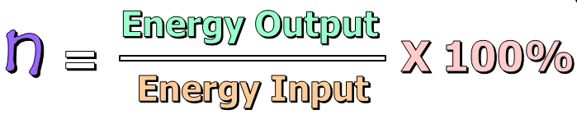
A man puts 300 J of energy into riding a tiny bicycle. The energy transferred to moving forward was 150 J.
  What is the efficiency of the tiny bike?
20

Slide 188
A man puts 300 J of energy into riding a tiny bicycle. The energy transferred to moving forward was 150 J.
  What is the efficiency of the tiny bike?
20

Slide 189
A man puts 300 J of energy into riding a tiny bicycle. The energy transferred to moving forward was 150 J.
  What is the efficiency of the tiny bike?
20
n = 150J/300J x 100%

Slide 190
A man puts 300 J of energy into riding a tiny bicycle. The energy transferred to moving forward was 150 J.
  What is the efficiency of the tiny bike?
20
n = 150J/300J .5 x 100%

Slide 191
A man puts 300 J of energy into riding a tiny bicycle. The energy transferred to moving forward was 150 J.
  What is the efficiency of the tiny bike?
20
n = 150J/300J .5 x 100%
50%

Slide 192
Machines Review Game
PULL OVER | ARE YOU CLEVER ENOUGH | ON A JET PLANE | WHEELIN and DEALIN | -BONUS- GREEN MACHINE
1 | 6 | 11 | 16 | *21
2 | 7 | 12 | 17 | *22
3 | 8 | 13 | 18 | *23
4 | 9 | 14 | 19 | *24
5 | 10 | 15 | 20 | *25
Copyright © 2024 SlideSpark .LLC

Slide 193
Name this brand of baking soda / lever.
21
Copyright © 2024 SlideSpark .LLC

Slide 194
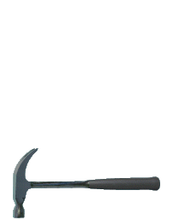
Name this brand of baking soda / lever.
21
Copyright © 2024 SlideSpark .LLC

Slide 195
Who is this person and what two machines is he working?
22
Copyright © 2024 SlideSpark .LLC

Slide 196
Who is this person and what two machines is he working?
Tony Hawk,
22
Copyright © 2024 SlideSpark .LLC

Slide 197
Who is this person and what two machines is he working?
Tony Hawk, Wheel and Axle,
22
Copyright © 2024 SlideSpark .LLC

Slide 198
Who is this person and what two machines is he working?
Tony Hawk, Wheel and Axle, Lever
22
Copyright © 2024 SlideSpark .LLC

Slide 199
Who am I?
*23
23
Copyright © 2024 SlideSpark .LLC

Slide 200
Who am I?
*23
23
The Green Goblin
Copyright © 2024 SlideSpark .LLC

Slide 201
Who is this?
24

Slide 202
Who is this?
24
Evel Knievel

Slide 203
Name this machine?
25

Slide 204
Name this machine?
25

Slide 205
Name this machine?
25

Slide 206
Name this machine?
25

Slide 207
Name this machine?
25

Slide 208
Name this machine?
25
Bumblebee

Slide 209
Machines Review Game
PULL OVER | ARE YOU CLEVER ENOUGH | ON A JET PLANE | WHEELIN and DEALIN | -BONUS- GREEN MACHINE
1 | 6 | 11 | 16 | *21
2 | 7 | 12 | 17 | *22
3 | 8 | 13 | 18 | *23
4 | 9 | 14 | 19 | *24
5 | 10 | 15 | 20 | *25
Final Question:_________________
Copyright © 2024 SlideSpark .LLC

Slide 210
5 point wager question

Slide 211
A dog applies a force of 100 newtons to push his buddy down the 60 meters of sidewalk. How much work was done?

Slide 212

A dog applies a force of 100 newtons to push his buddy down the 60 meters of sidewalk. How much work was done?

Slide 213
A dog applies a force of 100 newtons to push his buddy down the 60 meters of sidewalk. How much work was done?

Slide 214
A dog applies a force of 100 newtons to push his buddy down the 60 meters of sidewalk. How much work was done?
W = f x d
W = 100N x 60m
W =

Slide 215
A dog applies a force of 100 newtons to push his buddy down the 60 meters of sidewalk. How much work was done?
W = f x d
W = 100N x 60m
W =

Slide 216
A dog applies a force of 100 newtons to push his buddy down the 60 meters of sidewalk. How much work was done?
W = f x d
W = 100N x 60m
W = 6,000 Joules
1nm is equal to 1 Joule

Slide 217
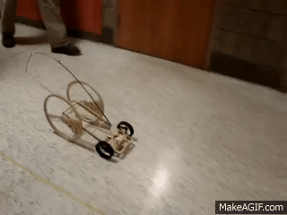
Questions 1-20 = 5pts Each
Final Category (Bonus) = 1pt Each
Final Questions = 5 pt wager
Find the Owl =
Secretly write “Owl” in the correct box worth 1pt.

Slide 218
Review Game
Part 4
Lesson 10

Slide 219



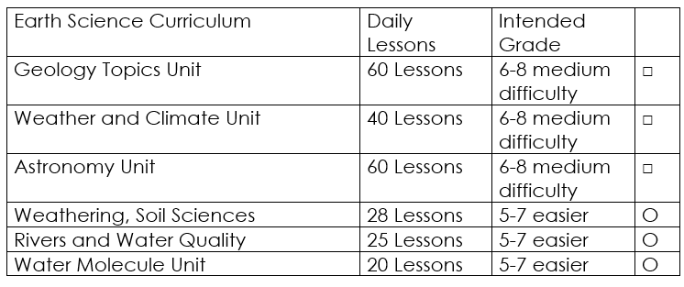

Curriculum Guide
Number of Lessons in each unit (50 min, daily lessons) and difficult rating scale / intended grade level.
=Easier, = More difficult, =Most difficult
Earth Science Units

Slide 220


Life Science Units

Slide 221

Physical Science

Slide 222
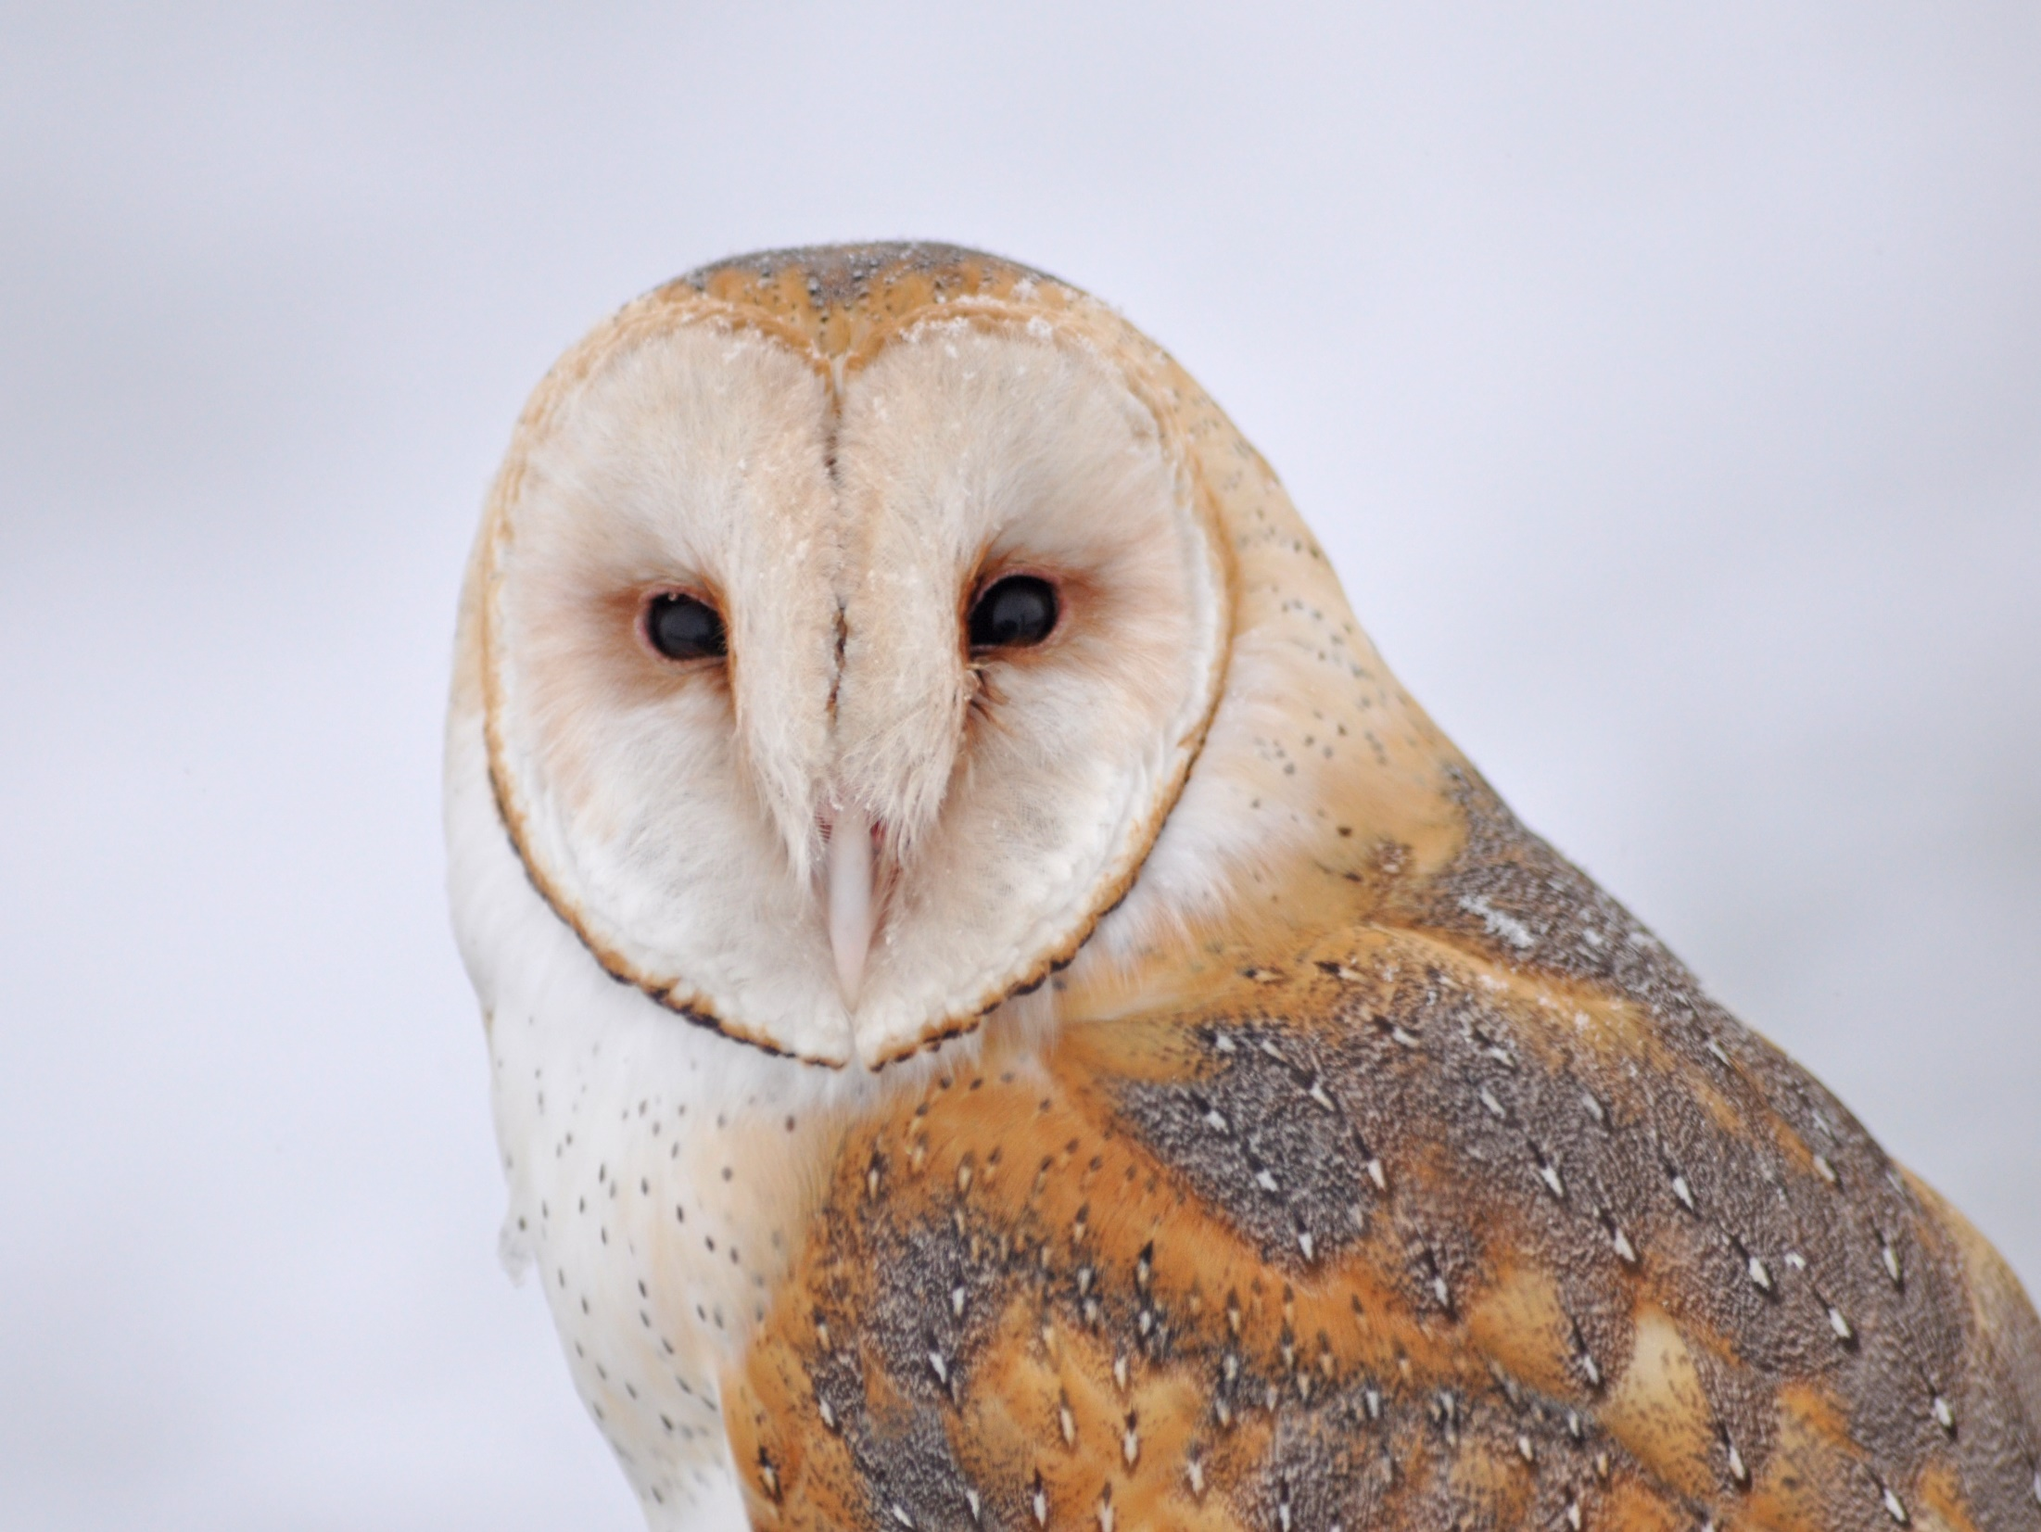
Dear Valued Educator,
Our fully editable .pptx and .doc resources are perfect for educators looking to bring enthusiasm and creativity to their lessons. We encourage you to make changes to fit your needs and style. As science educators, we’re committed to providing students with the tools they need to succeed in the classroom and beyond. Each unit in the curriculum includes a range of resources that have been developed through extensive research and use in a busy classroom. Our teaching approach is designed to make science education engaging and exciting for learners of all ages. We offer a one-of-a-kind science curriculum that will challenge, inspire, and educate students to become tomorrow's scientists and leaders. Join us today and learn more about how our program can help you achieve your classroom goals.
With appreciation,
Support@SlideSpark.net

Slide 223





Thank you for your time and interest in our Science curriculum. We strive to provide students with engaging and informative lessons that will spark their curiosity and encourage scientific exploration. Should you have any questions or concerns, please do not hesitate to contact us. Thank you again for considering our curriculum, and we wish you all the best in your educational journey.
Sincerely,
Support@slidespark.net
SlideSpark Science on TpT

