Slide 1
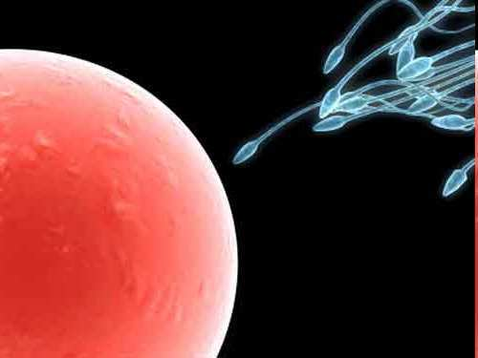
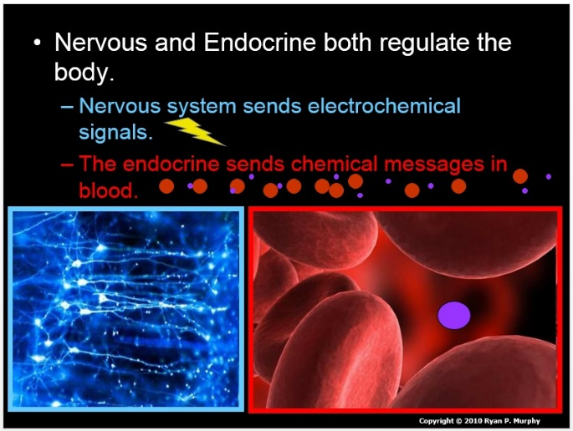

Human Reproductive System and
Endocrine System
Part 10
Lesson 10

Slide 2
Reproductive and Endocrine System Review Game
IT’S UNITED | HANGING TOUGH | MIGHTY APHRODITE | TEST OVER | -BONUS- FAMILY BABIES
1 | 6 | 11 | 16 | *21
2 | 7 | 12 | 17 | *22
3 | 8 | 13 | 18 | *23
4 | 9 | 14 | 19 | *24
5 | 10 | 15 | 20 | *25
Final Question:________________
Copyright © 2024 SlideSpark .LLC

Slide 3
How to play…
  Don’t play like Jeo_ _ _ _ y.
  Class should be divided into several small groups.
  Groups should use science journal (red slide notes), homework, and other available materials to assist you.
  Groups can communicate quietly with each other but no sharing answers between groups.
    Practice quietly communicating right now?
    Practice Communication Question:
    Your group gets to order one pizza, and you can have two toppings. What does your group want?

Slide 4

Questions 1-20 = 5pts Each
Final Category (Bonus) = 1pt Each
Final Questions = 5 pt wager
If you wager 5 on the last question and get it wrong you lose 5 pts. Wager 5 and get it right you get 5 pts.
Find the Owl =
Secretly write “Owl” in the correct box worth 1pt.
“I’ll be about this big.”

Slide 5
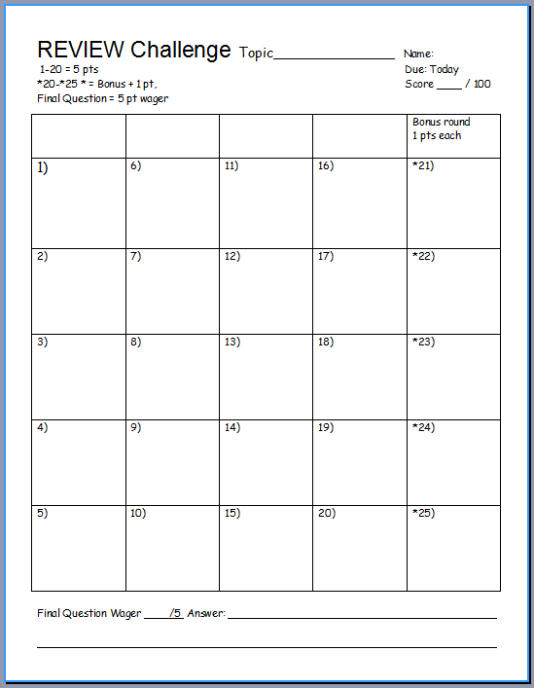
Is your name on the review sheet?
Name

Slide 6
Is your name on the review sheet?
Add the categories
along the top
on the next slide.

Slide 7
Reproductive and Endocrine System Review Game
IT’S UNITED | HANGING TOUGH | MIGHTY APHRODITE | TEST OVER | -BONUS- FAMILY BABIES
1 | 6 | 11 | 16 | *21
2 | 7 | 12 | 17 | *22
3 | 8 | 13 | 18 | *23
4 | 9 | 14 | 19 | *24
5 | 10 | 15 | 20 | *25
Final Question:________________
Copyright © 2024 SlideSpark .LLC

Slide 8
Reproductive and Endocrine System Review Game
IT’S UNITED | HANGING TOUGH | MIGHTY APHRODITE | TEST OVER | -BONUS- FAMILY BABIES
1 | 6 | 11 | 16 | *21
2 | 7 | 12 | 17 | *22
3 | 8 | 13 | 18 | *23
4 | 9 | 14 | 19 | *24
5 | 10 | 15 | 20 | *25
Final Question:________________
Copyright © 2024 SlideSpark .LLC

Slide 9
Which one of the following body systems is not critical to your survival?
A.) Nervous System
B.) Circulatory System
C.) Reproductive System
D.) Digestive System
D.) Endocrine System
E.) Respiratory System
1
Copyright © 2024 SlideSpark .LLC

Slide 10
Which one of the following body systems is not critical to your survival?
A.) Nervous System
B.) Circulatory System
C.) Reproductive System
D.) Digestive System
D.) Endocrine System
E.) Respiratory System
1
Copyright © 2024 SlideSpark .LLC
Copyright © 2024 SlideSpark .LLC

Slide 11
Which one of the following body systems is not critical to your survival?
A.) Nervous System
B.) Circulatory System
C.) Reproductive System
D.) Digestive System
D.) Endocrine System
E.) Respiratory System
1
Copyright © 2024 SlideSpark .LLC
Copyright © 2024 SlideSpark .LLC

Slide 12
Which one of the following body systems is not critical to your survival?
A.) Nervous System
B.) Circulatory System
C.) Reproductive System
D.) Digestive System
D.) Endocrine System
E.) Respiratory System
1
Copyright © 2024 SlideSpark .LLC
Copyright © 2024 SlideSpark .LLC

Slide 13
Which one of the following body systems is not critical to your survival?
A.) Nervous System
B.) Circulatory System
C.) Reproductive System
D.) Digestive System
D.) Endocrine System
E.) Respiratory System
1
Copyright © 2024 SlideSpark .LLC
Copyright © 2024 SlideSpark .LLC

Slide 14
Which one of the following body systems is not critical to your survival?
A.) Nervous System
B.) Circulatory System
C.) Reproductive System
D.) Digestive System
E.) Endocrine System
E.) Respiratory System
1
Copyright © 2024 SlideSpark .LLC
Copyright © 2024 SlideSpark .LLC

Slide 15
Which one of the following body systems is not critical to your survival?
A.) Nervous System
B.) Circulatory System
C.) Reproductive System
D.) Digestive System
E.) Endocrine System
F.) Respiratory System
1
Copyright © 2024 SlideSpark .LLC
Copyright © 2024 SlideSpark .LLC

Slide 16
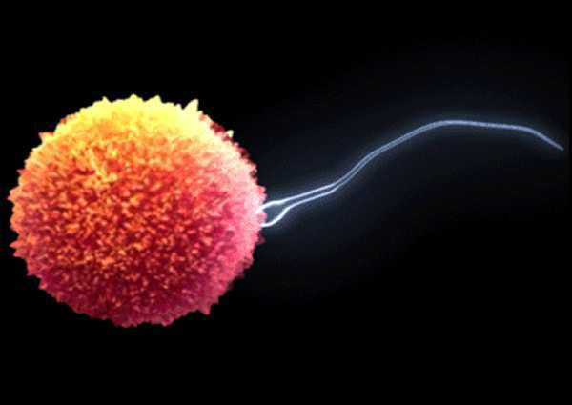
This is the technical term for the joining of the sperm and the egg?
2
Copyright © 2024 SlideSpark .LLC

Slide 17
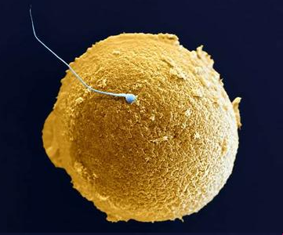
How many chromosomes are found in the sperm and the egg?
3
Copyright © 2024 SlideSpark .LLC

Slide 18
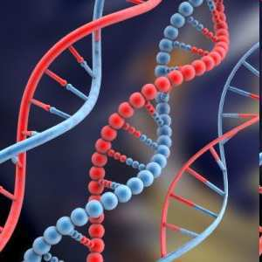
A chromosome is an organized structure of this three letter acronym and protein that is found in cells.
4
Copyright © 2024 SlideSpark .LLC

Slide 19
Sex cells are called…
5
Copyright © 2024 SlideSpark .LLC

Slide 20
Sex cells are called…
A.) Fertilization Cells
5
Copyright © 2024 SlideSpark .LLC

Slide 21
Sex cells are called…
A.) Fertilization Cells
B.) Zygotes
5
Copyright © 2024 SlideSpark .LLC

Slide 22
Sex cells are called…
A.) Fertilization Cells
B.) Zygotes
C.) Diploids
5
Copyright © 2024 SlideSpark .LLC

Slide 23
Sex cells are called…
A.) Fertilization Cells
B.) Zygotes
C.) Diploids
D.) Gametes
5
Copyright © 2024 SlideSpark .LLC

Slide 24
Sex cells are called…
A.) Fertilization Cells
B.) Zygotes
C.) Diploids
D.) Gametes
E.) Genes
5
Copyright © 2024 SlideSpark .LLC

Slide 25
Reproductive and Endocrine System Review Game
IT’S UNITED | HANGING TOUGH | MIGHTY APHRODITE | TEST OVER | -BONUS- FAMILY BABIES
1 | 6 | 11 | 16 | *21
2 | 7 | 12 | 17 | *22
3 | 8 | 13 | 18 | *23
4 | 9 | 14 | 19 | *24
5 | 10 | 15 | 20 | *25
Final Question:________________
Copyright © 2024 SlideSpark .LLC

Slide 26
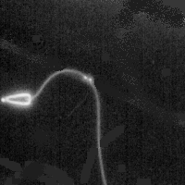
This structure on the male sperm helps to propel the genetic material hopefully toward the egg.
6
Copyright © 2024 SlideSpark .LLC

Slide 27

Name A, B, C, D behind this mystery door?
7
Copyright © 2024 SlideSpark .LLC

Slide 28

7
Bladder
Seminal Vesicle
D
Urethra
Prostrate Gland
Vas deferens
C
Penis
B
Epididymus
A
Testicle
Copyright © 2024 SlideSpark .LLC
Copyright © 2024 SlideSpark .LLC

Slide 29
8
Question: Small tubular glands that are near the prostate. The primary function involves the production of fluid that makes up a significant percentage of semen.
Testicle
Bladder
Epididymus
Prostate Gland
Urethra
Penis
Vas deferens
Seminal vesicle
Copyright © 2024 SlideSpark .LLC
Copyright © 2024 SlideSpark .LLC

Slide 30
Name the part of the male reproductive system.
Question: This is a firm partly muscular chestnut sized gland in males at the neck of the urethra; produces a viscid secretion that is the fluid part of semen.
9
Testicle
Bladder
Epididymus
Prostate Gland
Penis
Urethra
Vas deferens
Seminal vesicle
Copyright © 2024 SlideSpark .LLC
Copyright © 2024 SlideSpark .LLC

Slide 31
Name the part of the male reproductive system.
Question: This is either of the two oval organs that produce sperm in men.
10
Testicle
Bladder
Epididymus
Prostate Gland
Penis
Urethra
Vas deferens
Seminal vesicle
Copyright © 2024 SlideSpark .LLC
Copyright © 2024 SlideSpark .LLC

Slide 32
Reproductive and Endocrine System Review Game
IT’S UNITED | HANGING TOUGH | MIGHTY APHRODITE | TEST OVER | -BONUS- FAMILY BABIES
1 | 6 | 11 | 16 | *21
2 | 7 | 12 | 17 | *22
3 | 8 | 13 | 18 | *23
4 | 9 | 14 | 19 | *24
5 | 10 | 15 | 20 | *25
Final Question:________________
Copyright © 2024 SlideSpark .LLC

Slide 33
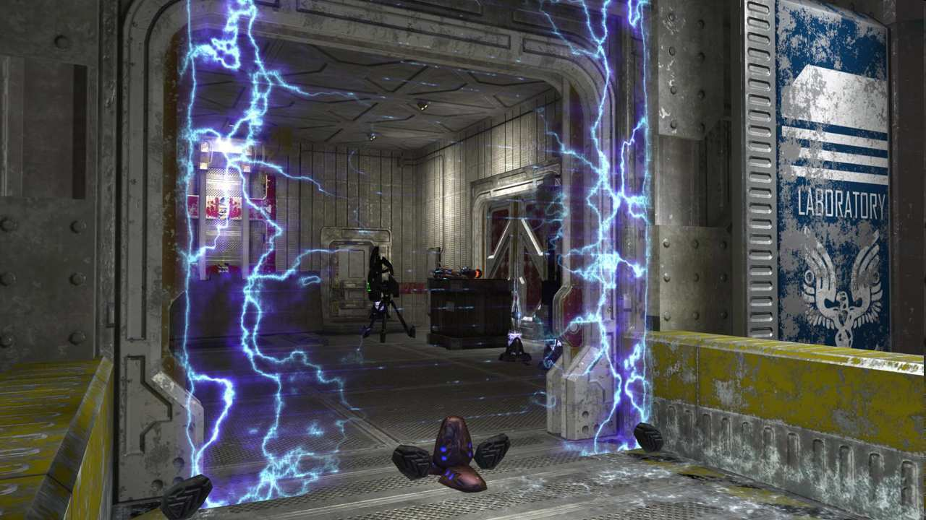
Name A, B, C, D behind this mystery door?
11
Copyright © 2024 SlideSpark .LLC

Slide 34
11
D
Fallopian Tubes
B
C
Womb /
Uterus
Ovary
Endometrium
Cervix
A
Vagina
Copyright © 2024 SlideSpark .LLC

Slide 35
Activity! Name the part of the female reproductive system.
Question: This is the mucous membrane lining the uterus, which thickens during the menstrual cycle in preparation for possible implantation of an embryo.
12
Cervix
Ovary
Vagina
Womb /
Uterus
Endometrium
Fallopian Tubes
Copyright © 2024 SlideSpark .LLC
Copyright © 2024 SlideSpark .LLC

Slide 36
13
Question: These transport the egg from the ovary to the uterus (the womb).
Cervix
Ovary
Vagina
Womb /
Uterus
Endometrium
Fallopian Tubes
Copyright © 2024 SlideSpark .LLC
Copyright © 2024 SlideSpark .LLC

Slide 37
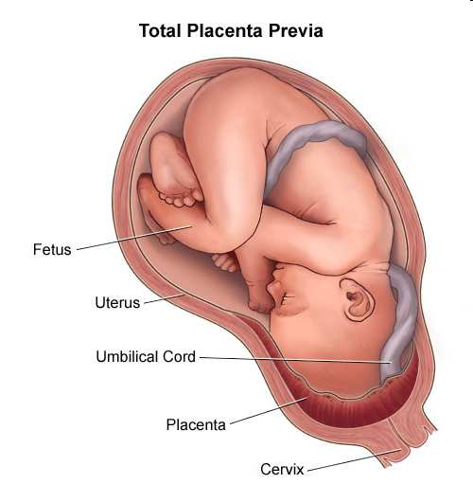
This organ connects the developing fetus to the uterine wall.
  Allows nutrient uptake.
  Eliminates waste.
  Gas exchange via the mother's blood supply.
14
Copyright © 2024 SlideSpark .LLC
Copyright © 2024 SlideSpark .LLC

Slide 38
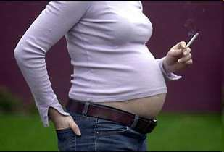


A mother should never ever do these two things while pregnant as the chemicals in them can negatively affect the growing fetus.
15
Copyright © 2024 SlideSpark .LLC

Slide 39
Reproductive and Endocrine System Review Game
IT’S UNITED | HANGING TOUGH | MIGHTY APHRODITE | TEST OVER | -BONUS- FAMILY BABIES
1 | 6 | 11 | 16 | *21
2 | 7 | 12 | 17 | *22
3 | 8 | 13 | 18 | *23
4 | 9 | 14 | 19 | *24
5 | 10 | 15 | 20 | *25
Final Question:________________
Copyright © 2024 SlideSpark .LLC

Slide 40


Slide 41
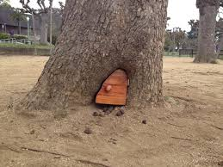
Name A, B, C, and D
Inside this mystery door

Slide 42
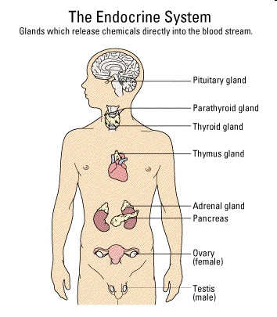




Name these glands of the endocrine system.
16
Copyright © 2024 SlideSpark .LLC

Slide 43

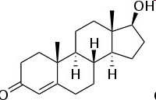
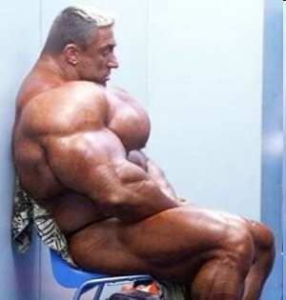
A chemical substance produced in the body that controls and regulates the activity of certain cells or organs is called a hormone.
HGH
Copyright © 2024 SlideSpark .LLC

Slide 44
18
The endocrine system sends….
Copyright © 2024 SlideSpark .LLC

Slide 45
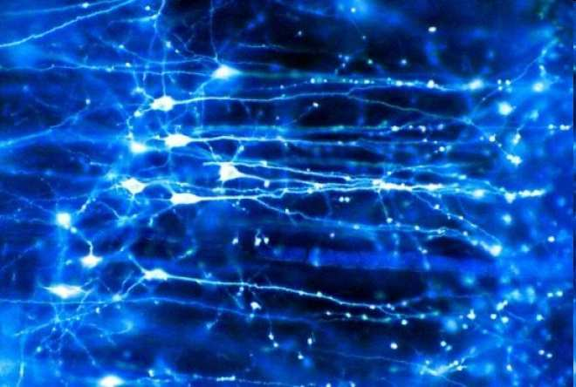
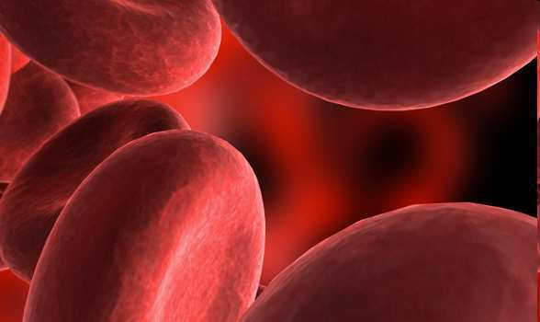
18
The endocrine system sends….
Copyright © 2024 SlideSpark .LLC

Slide 46
18
The endocrine system sends….
  A.) Electrochemical signals through neurons.
Copyright © 2024 SlideSpark .LLC

Slide 47
18
The endocrine system sends….
  A.) Electrochemical signals through neurons.
  B.) Nutrients to the stomach for uptake.
Copyright © 2024 SlideSpark .LLC

Slide 48
18
The endocrine system sends….
  A.) Electrochemical signals through neurons.
  B.) Nutrients to the stomach for uptake.
  C.) Chemical messages to the body via blood
Copyright © 2024 SlideSpark .LLC

Slide 49
18
The endocrine system sends….
  A.) Electrochemical signals through neurons.
  B.) Nutrients to the stomach for uptake.
  C.) Chemical messages to the body via blood
  D.) Sugar directly to the pancreas for processing.
Copyright © 2024 SlideSpark .LLC

Slide 50
18
The endocrine system sends….
  A.) Electrochemical signals through neurons.
  B.) Nutrients to the stomach for uptake.
  C.) Chemical messages to the body via blood
  D.) Sugar directly to the pancreas for processing.
  E.) Nephrons to the brain via neurons.
Copyright © 2024 SlideSpark .LLC

Slide 51
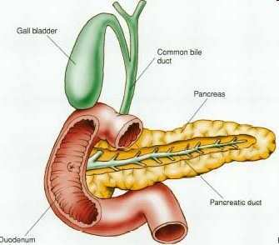
Pancreas: Produces insulin, which keeps sugar (glucose) in blood under control.
  Helps body absorb it and use it for energy.
  Turns excess sugar into a storage molecule called glycogen.
19
Copyright © 2024 SlideSpark .LLC

Slide 52



Slide 53


Slide 55

Name the male and female sex hormones
Female

Slide 56
Reproductive and Endocrine System Review Game
IT’S UNITED | HANGING TOUGH | MIGHTY APHRODITE | TEST OVER | -BONUS- FAMILY BABIES
1 | 6 | 11 | 16 | *21
2 | 7 | 12 | 17 | *22
3 | 8 | 13 | 18 | *23
4 | 9 | 14 | 19 | *24
5 | 10 | 15 | 20 | *25
Final Question:________________
Copyright © 2024 SlideSpark .LLC

Slide 57
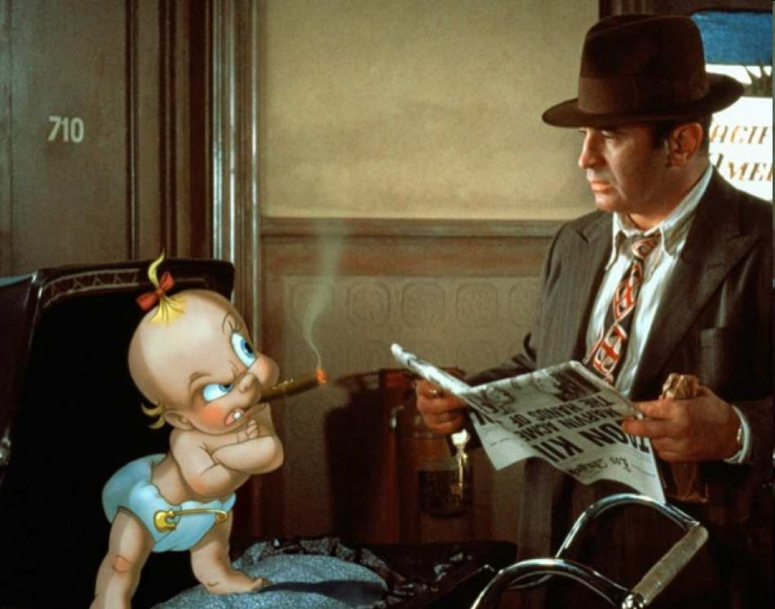
Name the movie with this baby?
*21
Copyright © 2024 SlideSpark .LLC

Slide 58

Nombre del dos cartoon caracteres infra.
*22
Copyright © 2024 SlideSpark .LLC

Slide 59
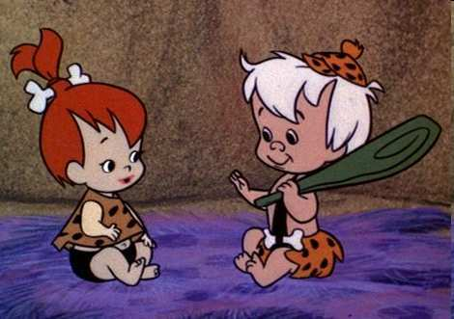
Name these two from the stone age?
*23
Copyright © 2024 SlideSpark .LLC

Slide 60

Name this often controversial T.V. baby?
*24
Copyright © 2024 SlideSpark .LLC

Slide 61
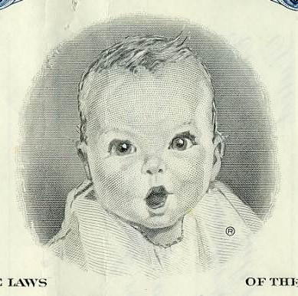
Name this baby?
*25
Copyright © 2024 SlideSpark .LLC

Slide 62
Reproductive and Immune System Review Game
IT’S UNITED | HANGING TOUGH | MIGHTY APHRODITE | WAR OF THE WORLDS | -BONUS- FAMILY BABIES
1 | 6 | 11 | 16 | *21
2 | 7 | 12 | 17 | *22
3 | 8 | 13 | 18 | *23
4 | 9 | 14 | 19 | *24
5 | 10 | 15 | 20 | *25
Final Question:________________
Copyright © 2024 SlideSpark .LLC

Slide 63
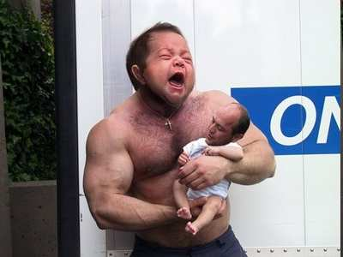

Slide 64
“You may wager up to 5 pts for this final question.” “Please make your wager now.”

Slide 65
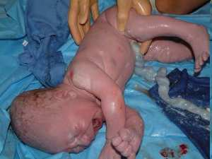
This is the cord that connects from the developing embryo or fetus to the placenta.
Copyright © 2024 SlideSpark .LLC

Slide 66
This is the cord that connects from the developing embryo or fetus to the placenta.
Spelling counts
“Umm…”
Copyright © 2024 SlideSpark .LLC

Slide 67
Human Reproductive System and
Endocrine System
Part 10
Lesson 10

Slide 68

Human Reproductive System and
Endocrine System
Part 10
Lesson 11

Slide 69
Reproductive and Immune System Review Game
IT’S UNITED | HANGING TOUGH | MIGHTY APHRODITE | WAR OF THE WORLDS | -BONUS- FAMILY BABIES
1 | 6 | 11 | 16 | *21
2 | 7 | 12 | 17 | *22
3 | 8 | 13 | 18 | *23
4 | 9 | 14 | 19 | *24
5 | 10 | 15 | 20 | *25
Final Question:________________
Copyright © 2024 SlideSpark .LLC

Slide 70
Which one of the following body systems is not critical to your survival?
A.) Nervous System
B.) Circulatory System
C.) Reproductive System
D.) Digestive System
E.) Endocrine System
F.) Respiratory System
1
Copyright © 2024 SlideSpark .LLC
Copyright © 2024 SlideSpark .LLC

Slide 71
Which one of the following body systems is not critical to your survival? Answer…
A.) Nervous System
B.) Circulatory System
C.) Reproductive System
D.) Digestive System
E.) Endocrine System
F.) Respiratory System
1
Copyright © 2024 SlideSpark .LLC
Copyright © 2024 SlideSpark .LLC

Slide 72
Which one of the following body systems is not critical to your survival? Answer…
A.) Nervous System
B.) Circulatory System
C.) Reproductive System
D.) Digestive System
E.) Endocrine System
F.) Respiratory System
1
Copyright © 2024 SlideSpark .LLC
Copyright © 2024 SlideSpark .LLC

Slide 73
Which one of the following body systems is not critical to your survival? Answer…
A.) Nervous System
B.) Circulatory System
C.) Reproductive System
D.) Digestive System
E.) Endocrine System
F.) Respiratory System
1
Survival of the species
requires a
reproductive system
Copyright © 2024 SlideSpark .LLC
Copyright © 2024 SlideSpark .LLC

Slide 74
This is the technical term for the joining of the sperm and the egg?
2
Copyright © 2024 SlideSpark .LLC

Slide 75
This is the technical term for the joining of the sperm and the egg? Answer…
2
Copyright © 2024 SlideSpark .LLC

Slide 76
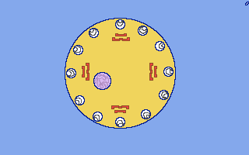
This is the technical term for the joining of the sperm and the egg? Answer…
Fertilization
2
Copyright © 2024 SlideSpark .LLC

Slide 77
How many chromosomes are found in the sperm and the egg?
3
Copyright © 2024 SlideSpark .LLC

Slide 78
How many chromosomes are found in the sperm and the egg?
3
23
23
Copyright © 2024 SlideSpark .LLC

Slide 79
How many chromosomes are found in the sperm and the egg?
3
Haploid
23
23
Haploid
Copyright © 2024 SlideSpark .LLC

Slide 80
How many chromosomes are found in the sperm and the egg?
3
Haploid
23
+
23
Haploid
Copyright © 2024 SlideSpark .LLC

Slide 81
How many chromosomes are found in the sperm and the egg?
3
46
Chromosomes
Diploid Zygote
Copyright © 2024 SlideSpark .LLC

Slide 82
A chromosome is an organized structure of this three letter acronym and protein that is found in cells.
4
Copyright © 2024 SlideSpark .LLC

Slide 83
A chromosome is an organized structure of this three letter acronym and protein that is found in cells. DNA
DNA
4
Copyright © 2024 SlideSpark .LLC

Slide 84
A chromosome is an organized structure of this three letter acronym and protein that is found in cells. DNA = Deoxyribose Nucleic Acid
DNA
4
Copyright © 2024 SlideSpark .LLC

Slide 85
Sex cells are called…
5
Copyright © 2024 SlideSpark .LLC

Slide 86
Sex cells are called…
A.) Fertilization Cells
5
Copyright © 2024 SlideSpark .LLC

Slide 87
Sex cells are called…
A.) Fertilization Cells
B.) Zygotes
5
Copyright © 2024 SlideSpark .LLC

Slide 88
Sex cells are called…
A.) Fertilization Cells
B.) Zygotes
C.) Diploids
5
Copyright © 2024 SlideSpark .LLC

Slide 89
Sex cells are called…
A.) Fertilization Cells
B.) Zygotes
C.) Diploids
D.) Gametes
5
Copyright © 2024 SlideSpark .LLC

Slide 90
Sex cells are called…
A.) Fertilization Cells
B.) Zygotes
C.) Diploids
D.) Gametes
E.) Genes
5
Copyright © 2024 SlideSpark .LLC

Slide 91
Sex cells are called… the answer is…
A.) Fertilization Cells
B.) Zygotes
C.) Diploids
D.) Gametes
E.) Genes
5
Copyright © 2024 SlideSpark .LLC

Slide 92
Sex cells are called…
A.) Fertilization Cells
B.) Zygotes
C.) Diploids
D.) Gametes
E.) Genes
5
Copyright © 2024 SlideSpark .LLC

Slide 93
Reproductive and Immune System Review Game
IT’S UNITED | HANGING TOUGH | MIGHTY APHRODITE | WAR OF THE WORLDS | -BONUS- FAMILY BABIES
1 | 6 | 11 | 16 | *21
2 | 7 | 12 | 17 | *22
3 | 8 | 13 | 18 | *23
4 | 9 | 14 | 19 | *24
5 | 10 | 15 | 20 | *25
Final Question:________________
Copyright © 2024 SlideSpark .LLC

Slide 94
This structure on the male sperm helps to propel the genetic material hopefully toward the egg.
6
Copyright © 2024 SlideSpark .LLC

Slide 95
This structure on the male sperm helps to propel the genetic material hopefully toward the egg.
Flagella
6
Copyright © 2024 SlideSpark .LLC

Slide 96
Name A, B, C, D behind this mystery door?
7
Copyright © 2024 SlideSpark .LLC

Slide 97
7
Bladder
Seminal Vesicle
D
Urethra
Prostrate Gland
Vas deferens
C
Penis
B
Epididymus
A
Testicle
Copyright © 2024 SlideSpark .LLC
Copyright © 2024 SlideSpark .LLC

Slide 98
7
Bladder
Seminal Vesicle
D
Urethra
Prostrate Gland
Vas deferens
C
Penis
B
Epididymus
A
Testicle
Copyright © 2024 SlideSpark .LLC
Copyright © 2024 SlideSpark .LLC

Slide 99
7
Bladder
Seminal Vesicle
D
Urethra
Prostrate Gland
Vas deferens
C
Penis
B
Epididymus
Testicle
Copyright © 2024 SlideSpark .LLC
Copyright © 2024 SlideSpark .LLC

Slide 100
7
Bladder
Seminal Vesicle
D
Urethra
Prostrate Gland
Vas deferens
C
Penis
B
Epididymus
Testicle
Copyright © 2024 SlideSpark .LLC
Copyright © 2024 SlideSpark .LLC

Slide 101
7
Bladder
Seminal Vesicle
D
Urethra
Prostrate Gland
Vas deferens
C
Penis
Epididymus
Testicle
Copyright © 2024 SlideSpark .LLC
Copyright © 2024 SlideSpark .LLC

Slide 102
7
Bladder
Seminal Vesicle
D
Urethra
Prostrate Gland
Vas deferens
C
Penis
Epididymus
Testicle
Copyright © 2024 SlideSpark .LLC
Copyright © 2024 SlideSpark .LLC

Slide 103
7
Bladder
Seminal Vesicle
D
Urethra
Prostrate Gland
Vas deferens
Penis
Epididymus
Testicle
Copyright © 2024 SlideSpark .LLC
Copyright © 2024 SlideSpark .LLC

Slide 104
7
Bladder
Seminal Vesicle
D
Urethra
Prostrate Gland
Vas deferens
Penis
Epididymus
Testicle
Copyright © 2024 SlideSpark .LLC
Copyright © 2024 SlideSpark .LLC

Slide 105
7
Bladder
Seminal Vesicle
Urethra
Prostate Gland
Vas deferens
Penis
Epididymus
Testicle
Copyright © 2024 SlideSpark .LLC
Copyright © 2024 SlideSpark .LLC

Slide 106
8
Question: Small tubular glands that are near the prostate. The primary function involves the production of fluid that makes up a significant percentage of semen.
Testicle
Bladder
Epididymus
Prostate Gland
Urethra
Penis
Vas deferens
Seminal vesicle
Copyright © 2024 SlideSpark .LLC
Copyright © 2024 SlideSpark .LLC

Slide 107
8
Question: Small tubular glands that are near the prostate. The primary function involves the production of fluid that makes up a significant percentage of semen.
Testicle
Bladder
Epididymus
Prostate Gland
Urethra
Penis
Vas deferens
Seminal vesicle
Copyright © 2024 SlideSpark .LLC
Copyright © 2024 SlideSpark .LLC

Slide 108
Name the part of the male reproductive system.
Question: This is a firm partly muscular chestnut sized gland in males at the neck of the urethra; produces a viscid secretion that is the fluid part of semen.
9
Testicle
Bladder
Epididymus
Prostate Gland
Penis
Urethra
Vas deferens
Seminal vesicle
Copyright © 2024 SlideSpark .LLC
Copyright © 2024 SlideSpark .LLC

Slide 109
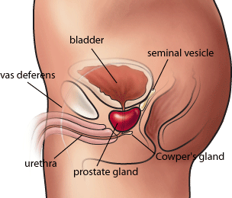
Name the part of the male reproductive system.
Question: This is a firm partly muscular chestnut sized gland in males at the neck of the urethra; produces a viscid secretion that is the fluid part of semen.
9
Testicle
Bladder
Epididymus
Prostate Gland
Penis
Urethra
Vas deferens
Seminal vesicle
Copyright © 2024 SlideSpark .LLC
Copyright © 2024 SlideSpark .LLC

Slide 110
Name the part of the male reproductive system.
Question: This is either of the two oval organs that produce sperm in men.
10
Testicle
Bladder
Epididymus
Prostate Gland
Penis
Urethra
Vas deferens
Seminal vesicle
Copyright © 2024 SlideSpark .LLC
Copyright © 2024 SlideSpark .LLC

Slide 111
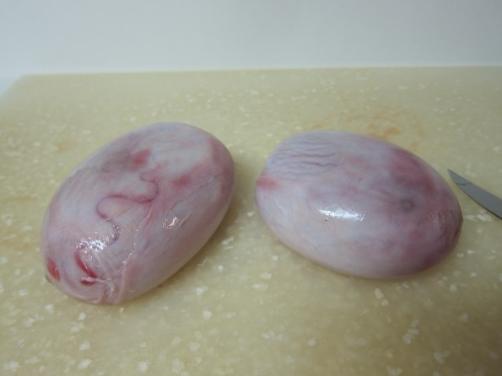
Name the part of the male reproductive system.
Question: This is either of the two oval organs that produce sperm in men.
10
Testicle
Bladder
Epididymus
Prostate Gland
Penis
Urethra
Vas deferens
Seminal vesicle
Copyright © 2024 SlideSpark .LLC
Copyright © 2024 SlideSpark .LLC

Slide 112
Reproductive and Endocrine System Review Game
IT’S UNITED | HANGING TOUGH | MIGHTY APHRODITE | WAR OF THE WORLDS | -BONUS- FAMILY BABIES
1 | 6 | 11 | 16 | *21
2 | 7 | 12 | 17 | *22
3 | 8 | 13 | 18 | *23
4 | 9 | 14 | 19 | *24
5 | 10 | 15 | 20 | *25
Final Question:________________
Copyright © 2024 SlideSpark .LLC

Slide 113
Name A, B, C, D behind this mystery door?
11
Copyright © 2024 SlideSpark .LLC

Slide 114
11
D
Fallopian Tubes
B
C
Womb /
Uterus
C
Ovary
Ovary
Endometrium
Cervix
A
Vagina
Copyright © 2024 SlideSpark .LLC
Copyright © 2024 SlideSpark .LLC

Slide 115
11
D
Fallopian Tubes
B
C
Womb /
Uterus
C
Ovary
Ovary
Endometrium
Cervix
A
Vagina
Copyright © 2024 SlideSpark .LLC
Copyright © 2024 SlideSpark .LLC

Slide 116
11
D
Fallopian Tubes
B
C
Womb /
Uterus
C
Ovary
Ovary
Endometrium
Cervix
A
Vagina
Copyright © 2024 SlideSpark .LLC
Copyright © 2024 SlideSpark .LLC

Slide 117
11
D
Fallopian Tubes
B
C
Womb /
Uterus
C
Ovary
Ovary
Endometrium
Cervix
A
Vagina
Copyright © 2024 SlideSpark .LLC
Copyright © 2024 SlideSpark .LLC

Slide 118
11
D
Fallopian Tubes
B
C
Womb /
Uterus
C
Ovary
Ovary
Endometrium
Cervix
A
Vagina
Copyright © 2024 SlideSpark .LLC
Copyright © 2024 SlideSpark .LLC

Slide 119
11
D
Fallopian Tubes
B
C
Womb /
Uterus
C
Ovary
Ovary
Endometrium
Cervix
A
Vagina
Copyright © 2024 SlideSpark .LLC
Copyright © 2024 SlideSpark .LLC

Slide 120
11
D
Fallopian Tubes
B
C
Womb /
Uterus
C
Ovary
Ovary
Endometrium
Cervix
A
Vagina
Copyright © 2024 SlideSpark .LLC
Copyright © 2024 SlideSpark .LLC

Slide 121
11
D
Fallopian Tubes
B
C
Womb /
Uterus
C
Ovary
Ovary
Endometrium
Cervix
A
Vagina
Copyright © 2024 SlideSpark .LLC
Copyright © 2024 SlideSpark .LLC

Slide 122
D
11
Fallopian Tubes
B
C
Womb /
Uterus
C
Ovary
Ovary
Endometrium
Cervix
A
Vagina
Copyright © 2024 SlideSpark .LLC
Copyright © 2024 SlideSpark .LLC

Slide 123
Activity! Name the part of the female reproductive system.
Question: This is the mucous membrane lining the uterus, which thickens during the menstrual cycle in preparation for possible implantation of an embryo.
12
Cervix
Ovary
Vagina
Womb /
Uterus
Endometrium
Fallopian Tubes
Copyright © 2024 SlideSpark .LLC
Copyright © 2024 SlideSpark .LLC

Slide 124
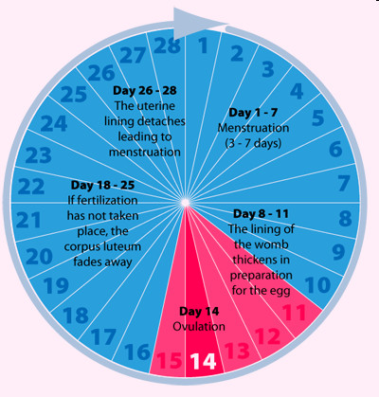
Activity! Name the part of the female reproductive system.
Question: This is the mucous membrane lining the uterus, which thickens during the menstrual cycle in preparation for possible implantation of an embryo.
12
Cervix
Ovary
Vagina
Womb /
Uterus
Endometrium
Fallopian Tubes
Copyright © 2024 SlideSpark .LLC
Copyright © 2024 SlideSpark .LLC

Slide 125
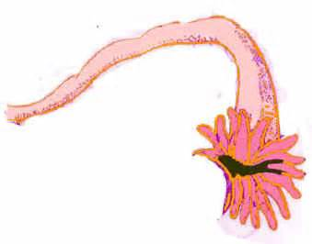
13
Question: These transport the egg from the ovary to the uterus (the womb).
Cervix
Ovary
Vagina
Womb /
Uterus
Endometrium
Fallopian Tubes
Copyright © 2024 SlideSpark .LLC
Copyright © 2024 SlideSpark .LLC

Slide 126
13
Question: These transport the egg from the ovary to the uterus (the womb).
Cervix
Ovary
Vagina
Womb /
Uterus
Endometrium
Fallopian Tubes
Copyright © 2024 SlideSpark .LLC
Copyright © 2024 SlideSpark .LLC

Slide 127
This organ connects the developing fetus to the uterine wall.
  Allows nutrient uptake.
  Eliminates waste.
  Gas exchange via the mother's blood supply.
14
Copyright © 2024 SlideSpark .LLC
Copyright © 2024 SlideSpark .LLC

Slide 128
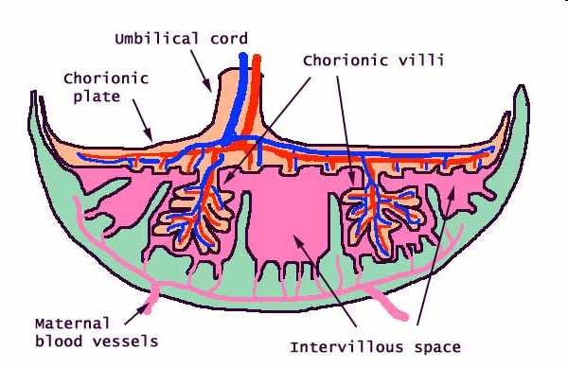
This organ connects the developing fetus to the uterine wall.
  Allows nutrient uptake.
  Eliminates waste.
  Gas exchange via the mother's blood supply.
The Placenta
14
Copyright © 2024 SlideSpark .LLC
Copyright © 2024 SlideSpark .LLC

Slide 129

A mother should never ever do these two things while pregnant as the chemicals in them can negatively affect the growing fetus.
15
Copyright © 2024 SlideSpark .LLC

Slide 130
A mother should never ever do these two things while pregnant as the chemicals in them can negatively affect the growing fetus.
Smoking
Alcohol
15
Copyright © 2024 SlideSpark .LLC

Slide 131

A mother should never ever do these two things while pregnant as the chemicals in them can negatively affect the growing fetus.
Smoking
Alcohol
15
Copyright © 2024 SlideSpark .LLC

Slide 132
A mother should never ever do these two things while pregnant as the chemicals in them can negatively affect the growing fetus.
Smoking
Alcohol
15
Copyright © 2024 SlideSpark .LLC

Slide 133
Reproductive and Endocrine System Review Game
IT’S UNITED | HANGING TOUGH | MIGHTY APHRODITE | TEST OVER | -BONUS- FAMILY BABIES
1 | 6 | 11 | 16 | *21
2 | 7 | 12 | 17 | *22
3 | 8 | 13 | 18 | *23
4 | 9 | 14 | 19 | *24
5 | 10 | 15 | 20 | *25
Final Question:________________
Copyright © 2024 SlideSpark .LLC

Slide 134


Slide 135
Name A, B, C, and D
Inside this mystery door

Slide 136
Name these glands of the endocrine system.
16
Copyright © 2024 SlideSpark .LLC

Slide 137
Name these glands of the endocrine system.
16
Copyright © 2024 SlideSpark .LLC

Slide 138
Name these glands of the endocrine system.
16
Copyright © 2024 SlideSpark .LLC

Slide 139
Name these glands of the endocrine system.
16
Copyright © 2024 SlideSpark .LLC

Slide 140
Name these glands of the endocrine system.
16
Copyright © 2024 SlideSpark .LLC

Slide 141
Name these glands of the endocrine system.
16
Copyright © 2024 SlideSpark .LLC

Slide 142
Name these glands of the endocrine system.
16
Copyright © 2024 SlideSpark .LLC

Slide 143
Name these glands of the endocrine system.
16
Copyright © 2024 SlideSpark .LLC

Slide 144
Name these glands of the endocrine system.
16
Copyright © 2024 SlideSpark .LLC

Slide 145
A chemical substance produced in the body that controls and regulates the activity of certain cells or organs is called a hormone.
HGH
Copyright © 2024 SlideSpark .LLC

Slide 146
A chemical substance produced in the body that controls and regulates the activity of certain cells or organs is called a hormone.
HGH
Copyright © 2024 SlideSpark .LLC

Slide 147
A chemical substance produced in the body that controls and regulates the activity of certain cells or organs is called a hormone.
HGH
Hormone
Copyright © 2024 SlideSpark .LLC

Slide 148
18
The endocrine system sends….
Copyright © 2024 SlideSpark .LLC

Slide 149
18
The endocrine system sends….
Copyright © 2024 SlideSpark .LLC

Slide 150
18
The endocrine system sends….
  A.) Electrochemical signals through neurons.
Copyright © 2024 SlideSpark .LLC

Slide 151
18
The endocrine system sends….
  A.) Electrochemical signals through neurons.
  B.) Nutrients to the stomach for uptake.
Copyright © 2024 SlideSpark .LLC

Slide 152
18
The endocrine system sends….
  A.) Electrochemical signals through neurons.
  B.) Nutrients to the stomach for uptake.
  C.) Chemical messages to the body via blood
Copyright © 2024 SlideSpark .LLC

Slide 153
18
The endocrine system sends….
  A.) Electrochemical signals through neurons.
  B.) Nutrients to the stomach for uptake.
  C.) Chemical messages to the body via blood
  D.) Sugar directly to the pancreas for processing.
Copyright © 2024 SlideSpark .LLC

Slide 154
18
The endocrine system sends….
  A.) Electrochemical signals through neurons.
  B.) Nutrients to the stomach for uptake.
  C.) Chemical messages to the body via blood
  D.) Sugar directly to the pancreas for processing.
  E.) Nephrons to the brain via neurons.
Copyright © 2024 SlideSpark .LLC

Slide 155

18
The endocrine system sends….
  A.) Electrochemical signals through neurons.
  B.) Nutrients to the stomach for uptake.
  C.) Chemical messages to the body via blood
  D.) Sugar directly to the pancreas for processing.
  E.) Nephrons to the brain via neurons.
Copyright © 2024 SlideSpark .LLC

Slide 156
18
The endocrine system sends….
  A.) Electrochemical signals through neurons.
  B.) Nutrients to the stomach for uptake.
  C.) Chemical messages to the body via blood
  D.) Sugar directly to the pancreas for processing.
Copyright © 2024 SlideSpark .LLC

Slide 157
18
The endocrine system sends….
  A.) Electrochemical signals through neurons.
  B.) Nutrients to the stomach for uptake.
  C.) Chemical messages to the body via blood
  D.) Sugar directly to the pancreas for processing.
Copyright © 2024 SlideSpark .LLC

Slide 158
Pancreas: Produces insulin, which keeps sugar (glucose) in blood under control.
  Helps body absorb it and use it for energy.
  Turns excess sugar into a storage molecule called glycogen.
19
Copyright © 2024 SlideSpark .LLC

Slide 159
Pancreas: Produces insulin, which keeps sugar (glucose) in blood under control.
  Helps body absorb it and use it for energy.
  Turns excess sugar into a storage molecule called glycogen.
19
Copyright © 2024 SlideSpark .LLC

Slide 160
Pancreas: Produces insulin, which keeps sugar (glucose) in blood under control.
  Helps body absorb it and use it for energy.
  Turns excess sugar into a storage molecule called glycogen.
19
Copyright © 2024 SlideSpark .LLC

Slide 161
Pancreas: Produces insulin, which keeps sugar (glucose) in blood under control.
  Helps body absorb it and use it for energy.
  Turns excess sugar into a storage molecule called glycogen.
Maintains…
Homeostasis
19
Copyright © 2024 SlideSpark .LLC

Slide 162
Pancreas: Produces insulin, which keeps sugar (glucose) in blood under control.
  Helps body absorb it and use it for energy.
  Turns excess sugar into a storage molecule called glycogen.
Maintains…
Homeostasis
19
Copyright © 2024 SlideSpark .LLC

Slide 163
Pancreas: Produces insulin, which keeps sugar (glucose) in blood under control.
  Helps body absorb it and use it for energy.
  Turns excess sugar into a storage molecule called glycogen.
Maintains…
Homeostasis
19
Copyright © 2024 SlideSpark .LLC

Slide 167
Name the male and female sex hormones
Female

Slide 168

Name the male and female sex hormones
Female

Slide 169


Name the male and female sex hormones
Female

Slide 170

Name the male and female sex hormones

Slide 171

Name the male and female sex hormones
Female

Slide 172
Reproductive and Endocrine System Review Game
IT’S UNITED | HANGING TOUGH | MIGHTY APHRODITE | TEST OVER | -BONUS- FAMILY BABIES
1 | 6 | 11 | 16 | *21
2 | 7 | 12 | 17 | *22
3 | 8 | 13 | 18 | *23
4 | 9 | 14 | 19 | *24
5 | 10 | 15 | 20 | *25
Final Question:________________
Copyright © 2024 SlideSpark .LLC

Slide 173
Name the movie with this baby?
*21
Copyright © 2024 SlideSpark .LLC

Slide 174

*21
Copyright © 2024 SlideSpark .LLC

Slide 175
Nombre del dos cartoon caracteres infra.
*22
Copyright © 2024 SlideSpark .LLC

Slide 176
Nombre del dos cartoon caracteres infra?
Name the two cartoon characters below?
*22
Copyright © 2024 SlideSpark .LLC

Slide 177
Nombre del dos cartoon caracteres infra?
Name the two cartoon characters below?
*22
Dora
Boots
Copyright © 2024 SlideSpark .LLC

Slide 178
Name these two from the stone age?
*23
Copyright © 2024 SlideSpark .LLC

Slide 179
Name these two from the stone age?
*23
Pebbles
Copyright © 2024 SlideSpark .LLC

Slide 180
Name these two from the stone age?
*23
Bamm Bamm
Pebbles
Copyright © 2024 SlideSpark .LLC

Slide 181
Name this often controversial T.V. baby?
*24
Copyright © 2024 SlideSpark .LLC

Slide 182
Name this often controversial T.V. baby?
*24
Stewart Gilligan Griffin
“Stewie”
Copyright © 2024 SlideSpark .LLC

Slide 183
Name this baby?
*25
Copyright © 2024 SlideSpark .LLC

Slide 184

Name this baby? Gerber
*25
Copyright © 2024 SlideSpark .LLC

Slide 185
Reproductive and Endocrine System Review Game
IT’S UNITED | HANGING TOUGH | MIGHTY APHRODITE | TEST OVER | -BONUS- FAMILY BABIES
1 | 6 | 11 | 16 | *21
2 | 7 | 12 | 17 | *22
3 | 8 | 13 | 18 | *23
4 | 9 | 14 | 19 | *24
5 | 10 | 15 | 20 | *25
Final Question:________________
Copyright © 2024 SlideSpark .LLC

Slide 186
“This was a 5 pt wager question.”

Slide 187
This is the cord that connects from the developing embryo or fetus to the placenta.
Copyright © 2024 SlideSpark .LLC

Slide 188
This is the cord that connects from the developing embryo or fetus to the placenta.
Spelling counts
“Umm…”
Copyright © 2024 SlideSpark .LLC

Slide 189
This is the cord that connects from the developing embryo or fetus to the placenta.
umbilical cord
Copyright © 2024 SlideSpark .LLC

Slide 190
Reproductive and Endocrine PowerPoint
Review Game
1-20 = 5 points each
20-25 = Bonus (1 point each)
Final Question = 5 point wager
Find the Owl = 1 point
Copyright © 2024 SlideSpark .LLC

Slide 191
Human Reproductive System and
Endocrine System
Part 10
Lesson 11

Slide 192



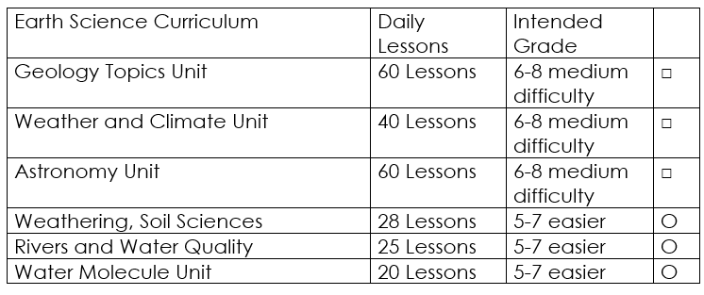

Curriculum Guide
Number of Lessons in each unit (50 min, daily lessons) and difficult rating scale / intended grade level.
=Easier, = More difficult, =Most difficult
Earth Science Units

Slide 193


Life Science Units

Slide 194

Physical Science

Slide 195

Dear Valued Educator,
Our fully editable .pptx and .doc resources are perfect for educators looking to bring enthusiasm and creativity to their lessons. We encourage you to make changes to fit your needs and style. As science educators, we’re committed to providing students with the tools they need to succeed in the classroom and beyond. Each unit in the curriculum includes a range of resources that have been developed through extensive research and use in a busy classroom. Our teaching approach is designed to make science education engaging and exciting for learners of all ages. We offer a one-of-a-kind science curriculum that will challenge, inspire, and educate students to become tomorrow's scientists and leaders. Join us today and learn more about how our program can help you achieve your classroom goals.
With appreciation,
Support@SlideSpark.net

Slide 196





Thank you for your time and interest in our Science curriculum. We strive to provide students with engaging and informative lessons that will spark their curiosity and encourage scientific exploration. Should you have any questions or concerns, please do not hesitate to contact us. Thank you again for considering our curriculum, and we wish you all the best in your educational journey.
Sincerely,
Support@slidespark.net
SlideSpark Science on TpT

