Slide 1
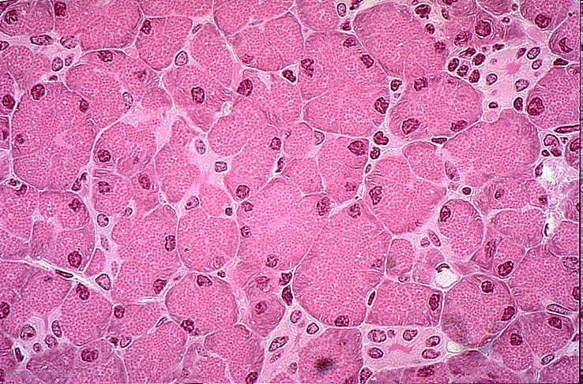

Review Game
Part 1
Lesson 8

Slide 2
Cellular Biology Review Game
IT CAME FROM THE SEWER | IT’S ALIVE | LEVEL UP | SCHLEID ON TIME | CELL BLOCK -BONUS-
1 | 6 | 11 | 16 | *21
2 | 7 | 12 | 17 | *22
3 | 8 | 13 | 18 | *23
4 | 9 | 14 | 19 | *24
5 | 10 | 15 | 20 | *25
Copyright © 2024 SlideSpark .LLC

Slide 3
How to play…
  Don’t play like Jeo_ _ _ _ y.
  Class should be divided into several small groups.
  Groups should use science journal (red slide notes), homework, and other available materials to assist you.
  Groups can communicate quietly with each other but no sharing answers between groups.
    Practice quietly communicating right now?
    Practice Communication Question:
    Your group gets to order one pizza and you can have two toppings. What does your group want?

Slide 4

Questions 1-20 = 5pts Each
Final Category (Bonus) = 1pt Each
Final Questions = 5 pt wager
If you wager 5 on the last question and get it wrong you lose 5 pts. Wager 5 and get it right you get 5 pts.
Find the Owl =
Secretly write “Owl” in the correct box worth 1pt.
“I’ll be about this big.”

Slide 5
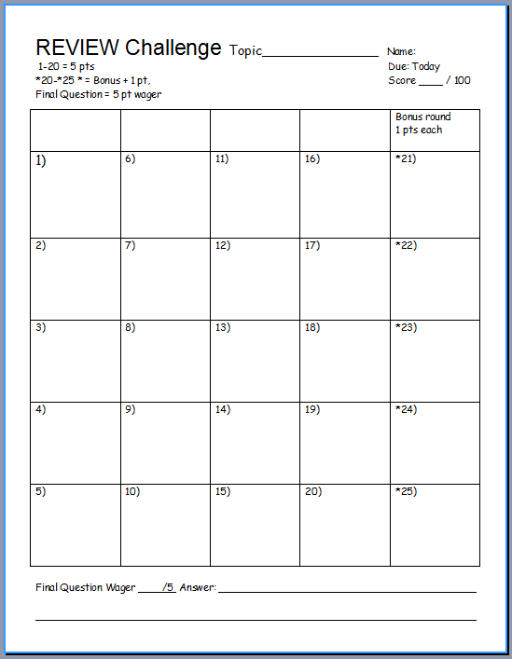
Is your name on the review sheet?
Name

Slide 6
Is your name on the review sheet?
Add the categories
along the top
on the next slide.

Slide 7
Cellular Biology Review Game
IT CAME FROM THE SEWER | IT’S ALIVE | LEVEL UP | SCHLEID ON TIME | CELL BLOCK -BONUS-
1 | 6 | 11 | 16 | *21
2 | 7 | 12 | 17 | *22
3 | 8 | 13 | 18 | *23
4 | 9 | 14 | 19 | *24
5 | 10 | 15 | 20 | *25
Copyright © 2024 SlideSpark .LLC

Slide 8
Cellular Biology Review Game
IT CAME FROM THE SEWER | IT’S ALIVE | LEVEL UP | SCHLEID ON TIME | CELL BLOCK -BONUS-
1 | 6 | 11 | 16 | *21
2 | 7 | 12 | 17 | *22
3 | 8 | 13 | 18 | *23
4 | 9 | 14 | 19 | *24
5 | 10 | 15 | 20 | *25
Copyright © 2024 SlideSpark .LLC

Slide 9
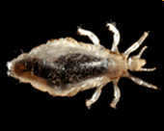

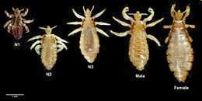
All of the following are characteristics of living things Except…
  A.) Made of SPONCH Elements
  B.) Made of Cells
  C.) Moves
  D.) Responds to a Stimulus
  E.) Can Survive without Energy
  F.) Adjusts to Changes
    Maintains Homeostasis
  G.) Reproduces
  H.) Grows and Develops
  I.) Adapts to Changes
  J.) Has a Life Span
1
Copyright © 2024 SlideSpark .LLC

Slide 10
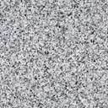
This SPONCH element is considered by many to be the duct tape of life
  It holds everything together and makes up about 18.5% of animals.
2

Slide 11

Life comes from pre existing life. Except…
3
Copyright © 2024 SlideSpark .LLC

Slide 12
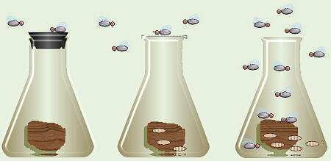
Are you Ready?
4
Copyright © 2024 SlideSpark .LLC

Slide 13
Ready, Set, Go…
4
Copyright © 2024 SlideSpark .LLC

Slide 14
This experiment was created in 1668 by Francesco Redi that helped disprove spontaneous origin.
4
Copyright © 2024 SlideSpark .LLC

Slide 15
This experiment was created in 1668 by Francesco Redi that helped disprove spontaneous origin.
  People believed flies spontaneously came from meat.
  He covered one flask, left one open to air.
  Observed flies laying eggs on meat.
  Flies come from flies. Life comes from life.
4
Copyright © 2024 SlideSpark .LLC

Slide 16
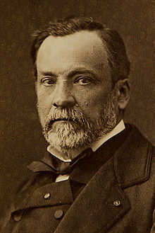
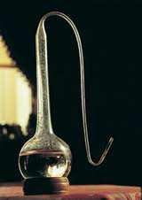
Louis Pasteur's experiments (1860' s) showed that micro-organisms are even carried in the air.
Both flasks boiled to sterilize Micro-organisms trapped in swan
Open to air (broth spoils). and broth does not spoil.
5
Copyright © 2024 SlideSpark .LLC

Slide 17
Cellular Biology Review Game
IT CAME FROM THE SEWER | IT’S ALIVE | LEVEL UP | SCHLEID ON TIME | CELL BLOCK -BONUS-
1 | 6 | 11 | 16 | *21
2 | 7 | 12 | 17 | *22
3 | 8 | 13 | 18 | *23
4 | 9 | 14 | 19 | *24
5 | 10 | 15 | 20 | *25
Copyright © 2024 SlideSpark .LLC

Slide 18
Cellular Biology Review Game
IT CAME FROM THE SEWER | IT’S ALIVE | LEVEL UP | SCHLEID ON TIME | CELL BLOCK -BONUS-
1 | 6 | 11 | 16 | *21
2 | 7 | 12 | 17 | *22
3 | 8 | 13 | 18 | *23
4 | 9 | 14 | 19 | *24
5 | 10 | 15 | 20 | *25
Copyright © 2024 SlideSpark .LLC

Slide 19
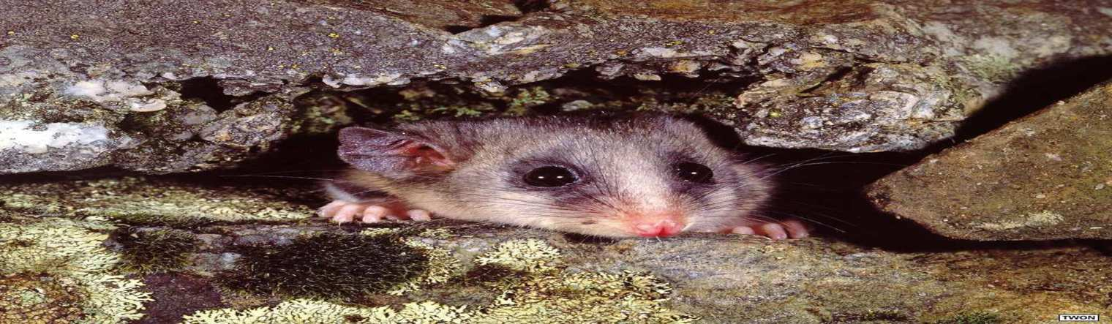
Living things need…
  Energy – Supplied by the sun (most of the time) and stored in food.
6
Copyright © 2024 SlideSpark .LLC

Slide 20
Living things need…
  Energy – Supplied by the sun (most of the time) and stored in food.
6
Copyright © 2024 SlideSpark .LLC

Slide 21
Living things need…
  Energy – Supplied by the sun (most of the time) and stored in food.
  Oxygen – To burn the food in cells. (Respiration)
  Water – To keep things moving in and out of cells. (Universal Solvent)
  Minerals- For proper chemical balance.
6
Copyright © 2024 SlideSpark .LLC

Slide 22
Living things need…
  Energy – Supplied by the sun (most of the time) and stored in food.
  Oxygen – To burn the food in cells. (Respiration)
  Water – To keep things moving in and out of cells. (Universal Solvent)
  Minerals- For proper chemical balance.
6
Copyright © 2024 SlideSpark .LLC

Slide 23
Living things need…
  Energy – Supplied by the sun (most of the time) and stored in food.
  Oxygen – To burn the food in cells. (Respiration)
  Water – To keep things moving in and out of cells. (Universal Solvent)
  Minerals- For proper chemical balance.
6
Copyright © 2024 SlideSpark .LLC

Slide 24


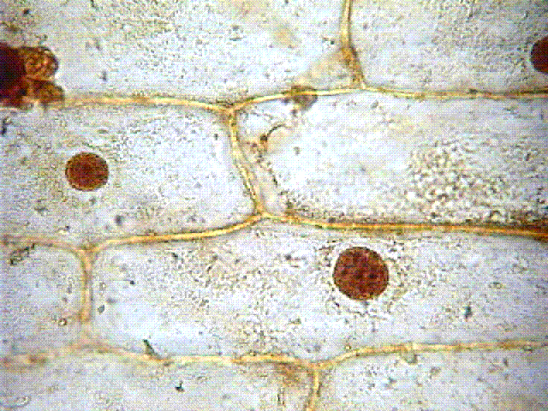
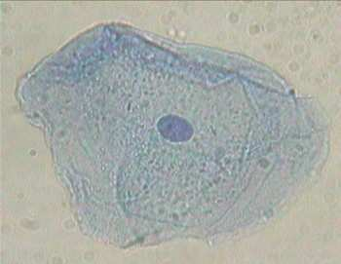

Which is a cheek cell, and which is an onion cell?
Copyright © 2024 SlideSpark .LLC

Slide 25
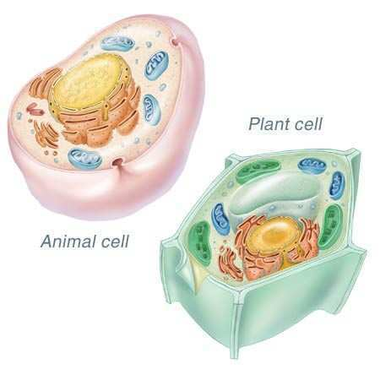
Plant and animal cells both have all of the following except…
  A.) Nucleus to hold DNA
  B.) Cytoplasm as fluid.
  C.) Cell Membrane to keep materials in.
  D.) Chloroplast to make sugar from light.
8
Copyright © 2024 SlideSpark .LLC

Slide 26
Plant and animal cells both have all of the following except…
  A.) Nucleus to hold DNA
  B.) Cytoplasm as fluid.
  C.) Cell Membrane to keep materials in.
  D.) Chloroplast to make sugar from light.
8
Copyright © 2024 SlideSpark .LLC

Slide 27
Plant and animal cells both have all of the following except…
  A.) Nucleus to hold DNA
  B.) Cytoplasm as fluid.
  C.) Cell Membrane to keep materials in.
  D.) Chloroplast to make sugar from light.
8
Copyright © 2024 SlideSpark .LLC

Slide 28
Plant and animal cells both have all of the following except…
  A.) Nucleus to hold DNA
  B.) Cytoplasm as fluid.
  C.) Cell Membrane to keep materials in.
  D.) Chloroplast to make sugar from light.
8
Copyright © 2024 SlideSpark .LLC

Slide 29
Plant and animal cells both have all of the following except…
  A.) Nucleus to hold DNA
  B.) Cytoplasm as fluid.
  C.) Cell Membrane to keep materials in.
  D.) Chloroplast to make sugar from light.
8
Copyright © 2024 SlideSpark .LLC

Slide 30
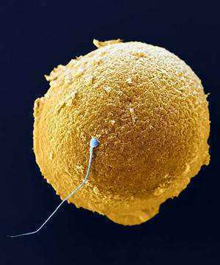
Life comes from life. Name these two sex cells?
9
Copyright © 2024 SlideSpark .LLC

Slide 31

Humans have some…
  A.) 7,000 Cells
  B.) 1 Million total cells
  C.) 50-75 Trillion cells.
  D.) 876 Quintillion cells
  E.) We are not made of true cells.
Copyright © 2024 SlideSpark .LLC

Slide 32
Humans have some…
  A.) 7,000 Cells
  B.) 1 Million total cells
  C.) 50-75 Trillion cells.
  D.) 876 Quintillion cells
  E.) We are not made of true cells.
Copyright © 2024 SlideSpark .LLC

Slide 33
Humans have some…
  A.) 7,000 Cells
  B.) 1 Million total cells
  C.) 50-75 Trillion cells.
  D.) 876 Quintillion cells
  E.) We are not made of true cells.
Copyright © 2024 SlideSpark .LLC

Slide 34
Humans have some…
  A.) 7,000 Cells
  B.) 1 Million total cells
  C.) 30-37 Trillion cells.
  D.) 876 Quintillion cells
  E.) We are not made of true cells.
Copyright © 2024 SlideSpark .LLC

Slide 35
Humans have some…
  A.) 7,000 Cells
  B.) 1 Million total cells
  C.) 30-37 Trillion cells.
  D.) 876 Quintillion cells
  E.) We are not made of true cells.
Copyright © 2024 SlideSpark .LLC

Slide 36
Humans have some…
  A.) 7,000 Cells
  B.) 1 Million total cells
  C.) 30-37 Trillion cells.
  D.) 876 Quintillion cells
  E.) We are not made of true cells.
Copyright © 2024 SlideSpark .LLC

Slide 37
Cellular Biology Review Game
IT CAME FROM THE SEWER | IT’S ALIVE | LEVEL UP | SCHLEID ON TIME | CELL BLOCK -BONUS-
1 | 6 | 11 | 16 | *21
2 | 7 | 12 | 17 | *22
3 | 8 | 13 | 18 | *23
4 | 9 | 14 | 19 | *24
5 | 10 | 15 | 20 | *25
Copyright © 2024 SlideSpark .LLC

Slide 38
Cellular Biology Review Game
IT CAME FROM THE SEWER | IT’S ALIVE | LEVEL UP | SCHLEID ON TIME | CELL BLOCK -BONUS-
1 | 6 | 11 | 16 | *21
2 | 7 | 12 | 17 | *22
3 | 8 | 13 | 18 | *23
4 | 9 | 14 | 19 | *24
5 | 10 | 15 | 20 | *25
Copyright © 2024 SlideSpark .LLC

Slide 39

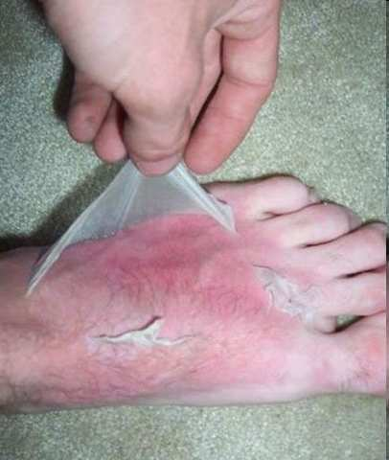
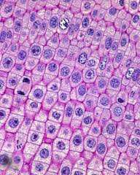
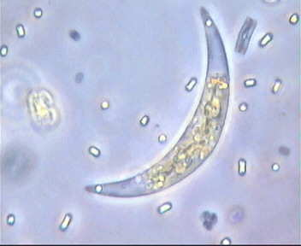
Use the terms from class to describe A and B.
  It has to do with how many cells it has.
A
B
Copyright © 2024 SlideSpark .LLC

Slide 40

Cells are the structural and functional units of all living organisms.
12
Fun
For
Frank
Copyright © 2024 SlideSpark .LLC

Slide 41
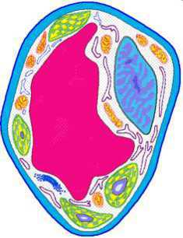
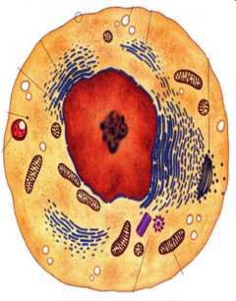
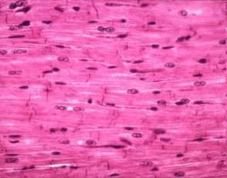

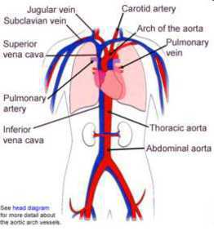
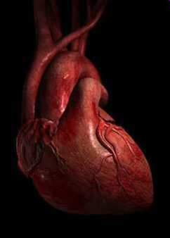
Name, A, B, C, and D?
A
Cell
Atom
Molecule
Cell Organelle
B
Tissue
Organism
Organ System
Organ
Cell
C
13
D
Copyright © 2024 SlideSpark .LLC

Slide 42
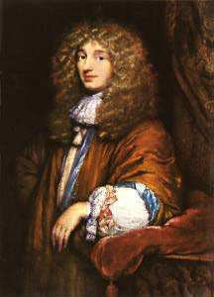
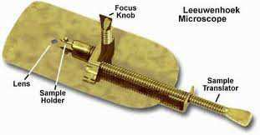
Anton van Leeuwenhoek
  Looked at the first living cells.
  Advanced early microscopes and work.
14
Copyright © 2024 SlideSpark .LLC

Slide 43
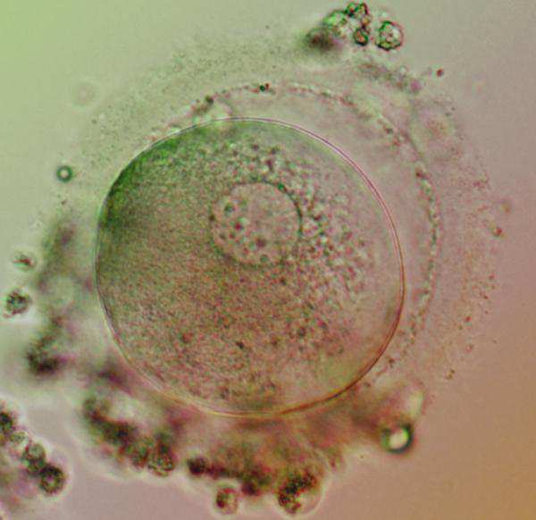
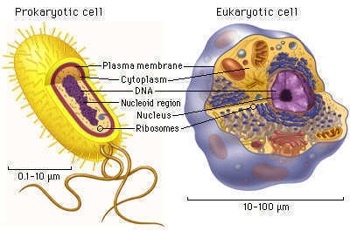
There are two main groups of cells.
  A.) Prokaryotic
  B.) Eukaryotic
19
Prokaryotic
Eukaryotic
B
A
Copyright © 2024 SlideSpark .LLC

Slide 44
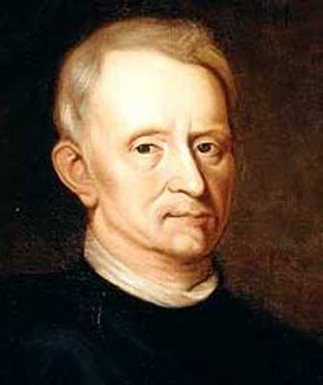
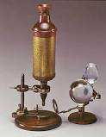
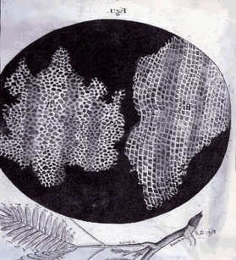
15
Robert Hooke
  Named cells.
  Advanced early microscopes and work.
Did not get along with
Sir Isaac Newton
Copyright © 2024 SlideSpark .LLC

Slide 45
Cellular Biology Review Game
IT CAME FROM THE SEWER | IT’S ALIVE | LEVEL UP | SCHLEID ON TIME | CELL BLOCK -BONUS-
1 | 6 | 11 | 16 | *21
2 | 7 | 12 | 17 | *22
3 | 8 | 13 | 18 | *23
4 | 9 | 14 | 19 | *24
5 | 10 | 15 | 20 | *25
Copyright © 2024 SlideSpark .LLC

Slide 46
Cellular Biology Review Game
IT CAME FROM THE SEWER | IT’S ALIVE | LEVEL UP | SCHLEID ON TIME | CELL BLOCK -BONUS-
1 | 6 | 11 | 16 | *21
2 | 7 | 12 | 17 | *22
3 | 8 | 13 | 18 | *23
4 | 9 | 14 | 19 | *24
5 | 10 | 15 | 20 | *25
Copyright © 2024 SlideSpark .LLC

Slide 47
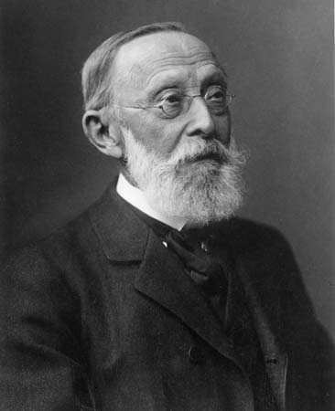
Rudolf Virchow (1900) came up with an early cell theory.
  All cells come from pre-existing cells.
16
Copyright © 2024 SlideSpark .LLC

Slide 48
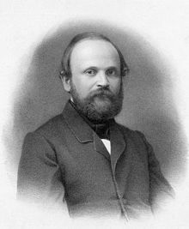
Rudolf Virchow (1900) came up with an early cell theory.
  All cells come from pre-existing cells.
16
Bonus 1pt
Stole / may
have taken from…
Copyright © 2024 SlideSpark .LLC

Slide 49
Rudolf Virchow (1900) came up with an early cell theory.
  All cells come from pre-existing cells.
16
Bonus 1pt
Stole / may
have taken from…
Copyright © 2024 SlideSpark .LLC

Slide 50
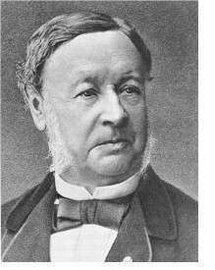
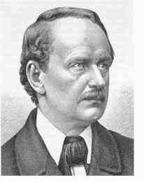
Name A and B that helped create the modern cell theory.
17
A
B
Copyright © 2024 SlideSpark .LLC

Slide 51
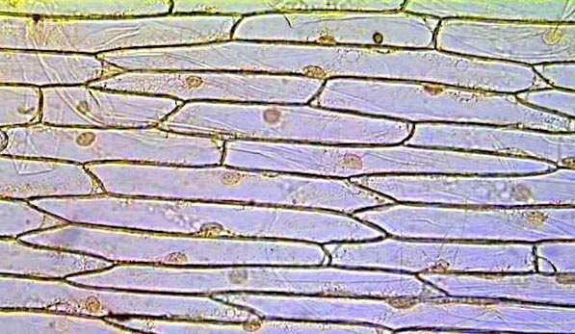
All of the following are part of the modern cell theory except?
  A.) -Living things are made of cells.
  B.) -All cells come from pre-existing cells.
  C.) -Cells contain genetic information.
  D.) -All cells are different in composition.
  E.) -Energy flow of life occurs in cells.
18
Copyright © 2024 SlideSpark .LLC

Slide 52
All of the following are part of the modern cell theory except?
  A.) -Living things are made of cells.
  B.) -All cells come from pre-existing cells.
  C.) -Cells contain genetic information.
  D.) -All cells are different in composition.
  E.) -Energy flow of life occurs in cells.
18
Copyright © 2024 SlideSpark .LLC

Slide 53
All of the following are part of the modern cell theory except?
  A.) -Living things are made of cells.
  B.) -All cells come from pre-existing cells.
  C.) -Cells contain genetic information.
  D.) -All cells are different in composition.
  E.) -Energy flow of life occurs in cells.
18
Copyright © 2024 SlideSpark .LLC

Slide 54
All of the following are part of the modern cell theory except?
  A.) -Living things are made of cells.
  B.) -All cells come from pre-existing cells.
  C.) -Cells contain genetic information.
  D.) -All cells are different in composition.
  E.) -Energy flow of life occurs in cells.
18
Copyright © 2024 SlideSpark .LLC

Slide 55
All of the following are part of the modern cell theory except?
  A.) -Living things are made of cells.
  B.) -All cells come from pre-existing cells.
  C.) -Cells contain genetic information.
  D.) -All cells are different in composition.
  E.) -Energy flow of life occurs in cells.
18
Copyright © 2024 SlideSpark .LLC

Slide 56
All of the following are part of the modern cell theory except?
  A.) -Living things are made of cells.
  B.) -All cells come from pre-existing cells.
  C.) -Cells contain genetic information.
  D.) -All cells are different in composition.
  E.) -Energy flow of life occurs in cells.
18
Copyright © 2024 SlideSpark .LLC

Slide 57
There are two main groups of cells.
  A.) Prokaryotic
  B.) Eukaryotic
19
B
A
Copyright © 2024 SlideSpark .LLC

Slide 58
There are two main groups of cells.
  A.) Prokaryotic
  B.) Eukaryotic
19
Prokaryotic
Eukaryotic
B
A
Copyright © 2024 SlideSpark .LLC

Slide 59
Which one is older (evolved)? Can you provide a reference of time.
  A.) Prokaryotic (appeared about 3.8 billion years ago.)
  B.) Eukaryotic (Appeared approx. 2.2 billion years ago.)
20
A
B
Copyright © 2024 SlideSpark .LLC

Slide 60
Cellular Biology Review Game
IT CAME FROM THE SEWER | IT’S ALIVE | LEVEL UP | SCHLEID ON TIME | CELL BLOCK -BONUS-
1 | 6 | 11 | 16 | *21
2 | 7 | 12 | 17 | *22
3 | 8 | 13 | 18 | *23
4 | 9 | 14 | 19 | *24
5 | 10 | 15 | 20 | *25
Copyright © 2024 SlideSpark .LLC

Slide 61
Cellular Biology Review Game
IT CAME FROM THE SEWER | IT’S ALIVE | LEVEL UP | SCHLEID ON TIME | CELL BLOCK -BONUS-
1 | 6 | 11 | 16 | *21
2 | 7 | 12 | 17 | *22
3 | 8 | 13 | 18 | *23
4 | 9 | 14 | 19 | *24
5 | 10 | 15 | 20 | *25
Copyright © 2024 SlideSpark .LLC

Slide 62

This Character doesn’t appear to be behind bars?
  A.) Prokaryotic (appeared about 3.8 billion years ago.)
  B.) Eukaryotic (Appeared approx. 2.2 billion years ago.)
*21
Copyright © 2024 SlideSpark .LLC

Slide 63
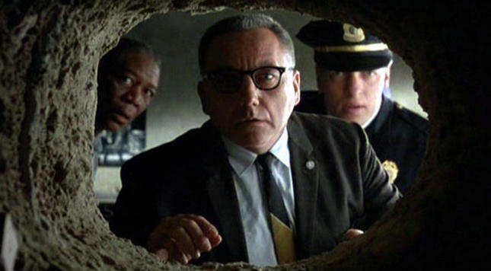
This is the cell from what movie?
  A.) Prokaryotic (appeared about 3.8 billion years ago.)
  B.) Eukaryotic (Appeared approx. 2.2 billion years ago.)
*22
*21
Copyright © 2024 SlideSpark .LLC

Slide 64
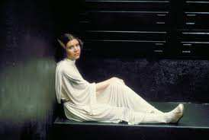
Where is this scene taking place?
  A.) Prokaryotic (appeared about 3.8 billion years ago.)
  B.) Eukaryotic (Appeared approx. 2.2 billion years ago.)
*23
Copyright © 2024 SlideSpark .LLC

Slide 65
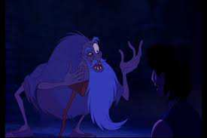
This is the prison cell from what movie?
  A.) Prokaryotic (appeared about 3.8 billion years ago.)
  B.) Eukaryotic (Appeared approx. 2.2 billion years ago.)
*24
Copyright © 2024 SlideSpark .LLC

Slide 66
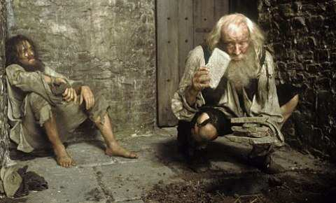
This is the soon to be Count of Monte Cristo
*25
Copyright © 2024 SlideSpark .LLC

Slide 67
Cellular Biology Review Game
IT CAME FROM THE SEWER | IT’S ALIVE | LEVEL UP | SCHLEID ON TIME | CELL BLOCK -BONUS-
1 | 6 | 11 | 16 | *21
2 | 7 | 12 | 17 | *22
3 | 8 | 13 | 18 | *23
4 | 9 | 14 | 19 | *24
5 | 10 | 15 | 20 | *25
Final Question
Copyright © 2024 SlideSpark .LLC

Slide 68

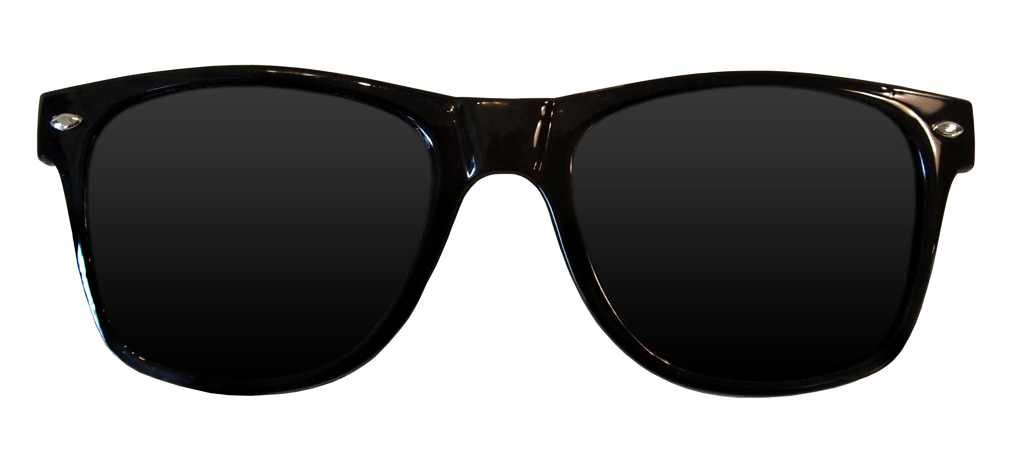
Final Question

Slide 69
Final Question
“You may wager up to 5 pts .”

Slide 70
Name A, B, and C?
C
A
B
Final Wager Question
Copyright © 2024 SlideSpark .LLC

Slide 71
Review Game
Part 1 Lesson 8

Slide 72
Review Game
Part 1
Lesson 8

Slide 73

Cellular Biology
Review Game
Answer Version
Part 1
Lesson 9

Slide 74
Questions 1-20 = 5pts Each
Final Category (Bonus) = 1pt Each
Final Questions = 5 pt wager
If you wager 5 on the last question and get it wrong you lose 5 pts. Wager 5 and get it right you get 5 pts.
Find the Owl =
Secretly write “Owl” in the correct box worth 1pt.
“I’ll be about this big.”

Slide 75
Cellular Biology Review Game
IT CAME FROM THE SEWER | IT’S ALIVE | LEVEL UP | SCHLEID ON TIME | CELL BLOCK -BONUS-
1 | 6 | 11 | 16 | *21
2 | 7 | 12 | 17 | *22
3 | 8 | 13 | 18 | *23
4 | 9 | 14 | 19 | *24
5 | 10 | 15 | 20 | *25
Copyright © 2024 SlideSpark .LLC

Slide 76
Cellular Biology Review Game
IT CAME FROM THE SEWER | IT’S ALIVE | LEVEL UP | SCHLEID ON TIME | CELL BLOCK -BONUS-
1 | 6 | 11 | 16 | *21
2 | 7 | 12 | 17 | *22
3 | 8 | 13 | 18 | *23
4 | 9 | 14 | 19 | *24
5 | 10 | 15 | 20 | *25
Copyright © 2024 SlideSpark .LLC

Slide 77
All of the following are characteristics of living things Except…
  A.) Made of SPONCH Elements
  B.) Made of Cells
  C.) Moves
  D.) Responds to a Stimulus
  E.) Can Survive without Energy
  F.) Adjusts to Changes
    Maintains Homeostasis
  G.) Reproduces
  H.) Grows and Develops
  I.) Adapts to Changes
  J.) Has a Life Span
1
Copyright © 2024 SlideSpark .LLC

Slide 78
All of the following are characteristics of living things Except…
  A.) Made of SPONCH Elements
  B.) Made of Cells
  C.) Moves
  D.) Responds to a Stimulus
  E.) Can Survive without Energy
  F.) Adjusts to Changes
    Maintains Homeostasis
  G.) Reproduces
  H.) Grows and Develops
  I.) Adapts to Changes
  J.) Has a Life Span
1
and the answer is…
Copyright © 2024 SlideSpark .LLC

Slide 79
All of the following are characteristics of living things Except…
  A.) Made of SPONCH Elements
  B.) Made of Cells
  C.) Moves
  D.) Responds to a Stimulus
  E.) Can Survive without Energy
  F.) Adjusts to Changes
    Maintains Homeostasis
  G.) Reproduces
  H.) Grows and Develops
  I.) Adapts to Changes
  J.) Has a Life Span
1
and the answer is…
Copyright © 2024 SlideSpark .LLC

Slide 80
All of the following are characteristics of living things Except…
  A.) Made of SPONCH Elements
  B.) Made of Cells
  C.) Moves
  D.) Responds to a Stimulus
  E.) Can Survive without Energy
  F.) Adjusts to Changes
    Maintains Homeostasis
  G.) Reproduces
  H.) Grows and Develops
  I.) Adapts to Changes
  J.) Has a Life Span
1
Should be…
Copyright © 2024 SlideSpark .LLC

Slide 81
All of the following are characteristics of living things Except…
  A.) Made of SPONCH Elements
  B.) Made of Cells
  C.) Moves
  D.) Responds to a Stimulus
  E.) Requires Energy
  F.) Adjusts to Changes
    Maintains Homeostasis
  G.) Reproduces
  H.) Grows and Develops
  I.) Adapts to Changes
  J.) Has a Life Span
1
Should be…
Copyright © 2024 SlideSpark .LLC

Slide 82
This SPONCH element is considered by many to be the duct tape of life
  It holds everything together and makes up about 18.5% of animals.
2

Slide 83
This SPONCH element is considered by many to be the duct tape of life
  It holds everything together and makes up about 18.5% of animals.
C
2

Slide 84
This SPONCH element is considered by many to be the duct tape of life
  It holds everything together and makes up about 18.5% of animals.
CARBON
C
2

Slide 85
Life comes from pre existing life.
3
Copyright © 2024 SlideSpark .LLC

Slide 86
Life comes from pre existing life. Except…
3
Abiogenesis
Copyright © 2024 SlideSpark .LLC

Slide 87
Life comes from pre existing life. Except…
3
Abiogenesis
Copyright © 2024 SlideSpark .LLC

Slide 88
Life comes from pre existing life. Except…
Abiogenesis: The first life came from non-living materials.
3
Abiogenesis
Copyright © 2024 SlideSpark .LLC

Slide 89
Ready, Set, Go…
4
Copyright © 2024 SlideSpark .LLC

Slide 90
Are you Ready?
4
Copyright © 2024 SlideSpark .LLC

Slide 91
Are you Redi?
4
Copyright © 2024 SlideSpark .LLC

Slide 92
This experiment was created in 1668 by Francesco Redi that helped disprove spontaneous origin.
4
Copyright © 2024 SlideSpark .LLC

Slide 93
This experiment was created in 1668 by Francesco Redi that helped disprove spontaneous origin.
  People believed flies spontaneously came from meat.
  He covered one flask, left one open to air.
  Observed flies laying eggs on meat.
  Flies come from flies. Life comes from life.
4
Copyright © 2024 SlideSpark .LLC

Slide 94
This experiment was created in 1668 by Francesco Redi that helped disprove spontaneous origin.
  People believed flies spontaneously came from meat.
  He covered one flask, left one open to air.
  Observed flies laying eggs on meat.
  Flies come from flies. Life comes from life.
4
and the answer is…
Copyright © 2024 SlideSpark .LLC

Slide 95
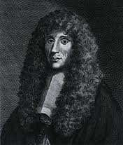
This experiment was created in 1668 by Francesco Redi that helped disprove spontaneous origin.
  People believed flies spontaneously came from meat.
  He covered one flask, left one open to air.
  Observed flies laying eggs on meat.
  Flies come from flies. Life comes from life.
4
Francesco
Redi
and the answer is…
Copyright © 2024 SlideSpark .LLC

Slide 96
Louis Pasteur's experiments (1860' s) showed that micro-organisms are even carried in the air.
Both flasks boiled to sterilize Micro-organisms trapped in swan
Open to air (broth spoils). and broth does not spoil.
5
Copyright © 2024 SlideSpark .LLC

Slide 97
Louis Pasteur's experiments (1860' s) showed that micro-organisms are even carried in the air.
Both flasks boiled to sterilize Micro-organisms trapped in swan
Open to air (broth spoils). and broth does not spoil.
5
and the answer is…
Copyright © 2024 SlideSpark .LLC

Slide 98
Louis Pasteur's experiments (1860' s) showed that micro-organisms are even carried in the air.
Both flasks boiled to sterilize Micro-organisms trapped in swan
Open to air (broth spoils). and broth does not spoil.
5
and the answer is…
Copyright © 2024 SlideSpark .LLC

Slide 99
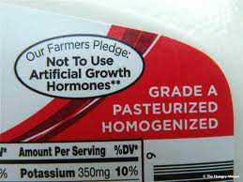
Louis Pasteur's experiments (1860' s) showed that micro-organisms are even carried in the air.
Both flasks boiled to sterilize Micro-organisms trapped in swan
Open to air (broth spoils). and broth does not spoil.
5
and the answer is…
Copyright © 2024 SlideSpark .LLC

Slide 100
Louis Pasteur's experiments (1860' s) showed that micro-organisms are even carried in the air.
Both flasks boiled to sterilize Micro-organisms trapped in swan
Open to air (broth spoils). and broth does not spoil.
5
Pasteurization: Partial sterilization of a substance and especially a liquid (as milk) at a temperature and for a period of exposure that destroys objectionable organisms. Makes Safer.
and the answer is…
Copyright © 2024 SlideSpark .LLC

Slide 101
Cellular Biology Review Game
IT CAME FROM THE SEWER | IT’S ALIVE | LEVEL UP | SCHLEID ON TIME | CELL BLOCK -BONUS-
1 | 6 | 11 | 16 | *21
2 | 7 | 12 | 17 | *22
3 | 8 | 13 | 18 | *23
4 | 9 | 14 | 19 | *24
5 | 10 | 15 | 20 | *25
Copyright © 2024 SlideSpark .LLC

Slide 102
Cellular Biology Review Game
IT CAME FROM THE SEWER | IT’S ALIVE | LEVEL UP | SCHLEID ON TIME | CELL BLOCK -BONUS-
1 | 6 | 11 | 16 | *21
2 | 7 | 12 | 17 | *22
3 | 8 | 13 | 18 | *23
4 | 9 | 14 | 19 | *24
5 | 10 | 15 | 20 | *25
Copyright © 2024 SlideSpark .LLC

Slide 103
Living things need…
  Energy – Supplied by the sun (most of the time) and stored in food.
  Oxygen – To burn the food in cells. (Respiration)
  Water – To keep things moving in and out of cells. (Universal Solvent)
  Minerals- For proper chemical balance.
6
Copyright © 2024 SlideSpark .LLC

Slide 104
Living things need…
  Energy – Supplied by the sun (most of the time) and stored in food.
  Oxygen – To burn the food in cells. (Respiration)
  Water – To keep things moving in and out of cells. (Universal Solvent)
  Minerals- For proper chemical balance.
6
Copyright © 2024 SlideSpark .LLC

Slide 105
Living things need…
  Energy – Supplied by the sun (most of the time) and stored in food.
  Oxygen – To burn the food in cells. (Respiration)
  Water – To keep things moving in and out of cells. (Universal Solvent)
  Minerals- For proper chemical balance.
6
Copyright © 2024 SlideSpark .LLC

Slide 106
Living things need…
  Energy – Supplied by the sun (most of the time) and stored in food.
  Oxygen – To burn the food in cells. (Respiration)
  Water – To keep things moving in and out of cells. (Universal Solvent)
  Minerals- For proper chemical balance.
6
Copyright © 2024 SlideSpark .LLC

Slide 107
Living things need…
  Energy – Supplied by the sun (most of the time) and stored in food.
  Oxygen – To burn the food in cells. (Respiration)
  Water – To keep things moving in and out of cells. (Universal Solvent)
  Minerals- For proper chemical balance.
6
Copyright © 2024 SlideSpark .LLC

Slide 108
Living things need…
  Energy – Supplied by the sun (most of the time) and stored in food.
  Oxygen – To burn the food in cells. (Respiration)
  Water – To keep things moving in and out of cells. (Universal Solvent)
  Minerals- For proper chemical balance.
6
Copyright © 2024 SlideSpark .LLC

Slide 109
Living things need…
  Energy – Supplied by the sun (most of the time) and stored in food.
  Oxygen – To burn the food in cells. (Respiration)
  Water – To keep things moving in and out of cells. (Universal Solvent)
  Minerals- For proper chemical balance.
6
Copyright © 2024 SlideSpark .LLC

Slide 110
Living things need…
  Energy – Supplied by the sun (most of the time) and stored in food.
  Oxygen – To burn the food in cells. (Respiration)
  Water – To keep things moving in and out of cells. (Universal Solvent)
  Minerals- For proper chemical balance.
6
Copyright © 2024 SlideSpark .LLC

Slide 111
Living things need…
  Energy – Supplied by the sun (most of the time) and stored in food.
  Oxygen – To burn the food in cells. (Respiration)
  Water – To keep things moving in and out of cells. (Universal Solvent)
  Minerals- For proper chemical balance.
6
Copyright © 2024 SlideSpark .LLC

Slide 112
Which is a cheek cell, and which is an onion cell?
Copyright © 2024 SlideSpark .LLC

Slide 113
Which is a cheek cell, and which is an onion cell?
Copyright © 2024 SlideSpark .LLC

Slide 114

Which is a cheek cell, and which is an onion cell?
Copyright © 2024 SlideSpark .LLC

Slide 115
Which is a cheek cell, and which is an onion cell?
Copyright © 2024 SlideSpark .LLC

Slide 116



Which is a cheek cell, and which is an onion cell?
Copyright © 2024 SlideSpark .LLC

Slide 117

Which is a cheek cell, and which is an onion cell?
Copyright © 2024 SlideSpark .LLC

Slide 118

Which is a cheek cell, and which is an onion cell?
Copyright © 2024 SlideSpark .LLC

Slide 119
Plant and animal cells both have all of the following except…
  A.) Nucleus to hold DNA
  B.) Cytoplasm as fluid.
  C.) Cell Membrane to keep materials in.
  D.) Chloroplast to make sugar from light.
8
Copyright © 2024 SlideSpark .LLC

Slide 120
Plant and animal cells both have all of the following except…
  A.) Nucleus to hold DNA
  B.) Cytoplasm as fluid.
  C.) Cell Membrane to keep materials in.
  D.) Chloroplast to make sugar from light.
8
and the answer is…
Copyright © 2024 SlideSpark .LLC

Slide 121
Plant and animal cells both have all of the following except…
  A.) Nucleus to hold DNA
  B.) Cytoplasm as fluid.
  C.) Cell Membrane to keep materials in.
  D.) Chloroplast to make sugar from light.
8
and the answer is…
Copyright © 2024 SlideSpark .LLC

Slide 122
Plant and animal cells both have all of the following except…
  A.) Nucleus to hold DNA
  B.) Cytoplasm as fluid.
  C.) Cell Membrane to keep materials in.
  D.) Chloroplast to make sugar from light.
8
??????
and CELL WALLS
and the answer is…
Copyright © 2024 SlideSpark .LLC

Slide 123
Plant and animal cells both have all of the following except…
  A.) Nucleus to hold DNA
  B.) Cytoplasm as fluid.
  C.) Cell Membrane to keep materials in.
  D.) Chloroplast to make sugar from light.
8
and CELL WALLS
and the answer is…
Copyright © 2024 SlideSpark .LLC

Slide 124
Life comes from life. Name these two sex cells?
9
Copyright © 2024 SlideSpark .LLC

Slide 125
Life comes from life. Name these two sex cells?
9
and the answer is…
Copyright © 2024 SlideSpark .LLC

Slide 126
Life comes from life. Name these two sex cells?
9
and the answer is…
Copyright © 2024 SlideSpark .LLC

Slide 127
Life comes from life. Name these two sex cells?
9
Sperm
and the answer is…
Copyright © 2024 SlideSpark .LLC

Slide 128
Life comes from life. Name these two sex cells?
9
Sperm
and the answer is…
Copyright © 2024 SlideSpark .LLC

Slide 129
Life comes from life. Name these two sex cells?
9
Egg
Sperm
and the answer is…
Copyright © 2024 SlideSpark .LLC

Slide 130
Humans have some…
  A.) 7,000 Cells
  B.) 1 Million total cells
  C.) 50-75 Trillion cells.
  D.) 876 Quintillion cells
  E.) We are not made of true cells.
Copyright © 2024 SlideSpark .LLC

Slide 131
Humans have some…
  A.) 7,000 Cells
  B.) 1 Million total cells
  C.) 50-75 Trillion cells.
  D.) 876 Quintillion cells
  E.) We are not made of true cells.
Copyright © 2024 SlideSpark .LLC

Slide 132
Humans have some…
  A.) 7,000 Cells
  B.) 1 Million total cells
  C.) 50-75 Trillion cells.
  D.) 876 Quintillion cells
  E.) We are not made of true cells.
Copyright © 2024 SlideSpark .LLC

Slide 133
Humans have some…
  A.) 7,000 Cells
  B.) 1 Million total cells
  C.) 30-37 Trillion cells.
  D.) 876 Quintillion cells
  E.) We are not made of true cells.
Copyright © 2024 SlideSpark .LLC

Slide 134
Humans have some…
  A.) 7,000 Cells
  B.) 1 Million total cells
  C.) 30-37 Trillion cells.
  D.) 876 Quintillion cells
  E.) We are not made of true cells.
Copyright © 2024 SlideSpark .LLC

Slide 135
Humans have some…
  A.) 7,000 Cells
  B.) 1 Million total cells
  C.) 30-37 Trillion cells.
  D.) 876 Quintillion cells
  E.) We are not made of true cells.
Copyright © 2024 SlideSpark .LLC

Slide 136
Humans have some…
  A.) 7,000 Cells
  B.) 1 Million total cells
  C.) 30-37 Trillion cells.
  D.) 876 Quintillion cells
  E.) We are not made of true cells.
and the answer is…
Copyright © 2024 SlideSpark .LLC

Slide 137

Humans have some…
  A.) 7,000 Cells
  B.) 1 Million total cells
  C.) 30-37 Trillion cells.
  D.) 876 Quintillion cells
  E.) We are not made of true cells.
and the answer is…
Copyright © 2024 SlideSpark .LLC

Slide 138
Cellular Biology Review Game
IT CAME FROM THE SEWER | IT’S ALIVE | LEVEL UP | SCHLEID ON TIME | CELL BLOCK -BONUS-
1 | 6 | 11 | 16 | *21
2 | 7 | 12 | 17 | *22
3 | 8 | 13 | 18 | *23
4 | 9 | 14 | 19 | *24
5 | 10 | 15 | 20 | *25
Copyright © 2024 SlideSpark .LLC

Slide 139
Cellular Biology Review Game
IT CAME FROM THE SEWER | IT’S ALIVE | LEVEL UP | SCHLEID ON TIME | CELL BLOCK -BONUS-
1 | 6 | 11 | 16 | *21
2 | 7 | 12 | 17 | *22
3 | 8 | 13 | 18 | *23
4 | 9 | 14 | 19 | *24
5 | 10 | 15 | 20 | *25
Copyright © 2024 SlideSpark .LLC

Slide 140
Use the terms from class to describe A and B.
  It has to do with how many cells it has.
A
B
Copyright © 2024 SlideSpark .LLC

Slide 141
Use the terms from class to describe A and B.
  It has to do with how many cells it has.
A
B
Copyright © 2024 SlideSpark .LLC

Slide 142
Use the terms from class to describe A and B.
  It has to do with how many cells it has.
A
B
Multi-cellular
Copyright © 2024 SlideSpark .LLC

Slide 143
Use the terms from class to describe A and B.
  It has to do with how many cells it has.
A
B
Multi-cellular
Many celled
Copyright © 2024 SlideSpark .LLC

Slide 144
Use the terms from class to describe A and B.
  It has to do with how many cells it has.
A
B
Multi-cellular
Many celled
Copyright © 2024 SlideSpark .LLC

Slide 145
Use the terms from class to describe A and B.
  It has to do with how many cells it has.
A
B
Unicellular
Multi-cellular
Many celled
Copyright © 2024 SlideSpark .LLC

Slide 146
Use the terms from class to describe A and B.
  It has to do with how many cells it has.
A
B
Unicellular
Multi-cellular
Single celled
Many celled
Copyright © 2024 SlideSpark .LLC

Slide 147
Cells are the structural and functional units of all living organisms.
12
Fun
For
Frank
Copyright © 2024 SlideSpark .LLC

Slide 148
Cells are the structural and functional units of all living organisms.
12
Fun
For
Frank
Copyright © 2024 SlideSpark .LLC

Slide 149
Cells are the structural and functional units of all living organisms.
12
Fun
For
Frank
Copyright © 2024 SlideSpark .LLC

Slide 150
Cells are the structural and functional units of all living organisms.
12
Fun
For
Frank
Copyright © 2024 SlideSpark .LLC

Slide 151
Cells are the structural and functional units of all living organisms.
12
Fun
For
Frank
Copyright © 2024 SlideSpark .LLC

Slide 152
Cells are the structural and functional units of all living organisms.
12
Oops.
Copyright © 2024 SlideSpark .LLC

Slide 153
Cells are the structural and functional units of all living organisms.
12
F
F
F
Copyright © 2024 SlideSpark .LLC

Slide 154
Cells are the structural and functional units of all living organisms.
12
Form
F
F
Copyright © 2024 SlideSpark .LLC

Slide 155
Cells are the structural and functional units of all living organisms.
12
Form
Follows
F
Copyright © 2024 SlideSpark .LLC

Slide 156
Cells are the structural and functional units of all living organisms.
12
Form
Follows
Function
Copyright © 2024 SlideSpark .LLC

Slide 157
Name, A, B, C, and D?
A
Cell
Atom
Molecule
Cell Organelle
B
Tissue
Organism
Organ System
Organ
Cell
C
13
D
Copyright © 2024 SlideSpark .LLC

Slide 158
Name, A, B, C, and D?
A
Cell
Atom
Molecule
Cell Organelle
B
Tissue
Organism
Organ System
Organ
Cell
C
13
D
Copyright © 2024 SlideSpark .LLC

Slide 159
Name, A, B, C, and D?
A
Cell
Atom
Molecule
Cell Organelle
B
Tissue
Organism
Organ System
Organ
Cell
C
13
D
Copyright © 2024 SlideSpark .LLC

Slide 160
Name, A, B, C, and D?
A
Cell
Atom
Molecule
Cell Organelle
B
Tissue
Organism
Organ System
Organ
Cell
C
13
D
Copyright © 2024 SlideSpark .LLC

Slide 161
Name, A, B, C, and D?
A
Cell
Atom
Molecule
Cell Organelle
B
Tissue
Organism
Organ System
Organ
Cell
C
13
D
Copyright © 2024 SlideSpark .LLC

Slide 162
Name, A, B, C, and D?
A
Cell
Atom
Molecule
Cell Organelle
B
Tissue
Organism
Organ System
Organ
Cell
C
13
D
Copyright © 2024 SlideSpark .LLC

Slide 163
Name, A, B, C, and D?
A
Cell
Atom
Molecule
Cell Organelle
B
Tissue
Organism
Organ System
Organ
Cell
C
13
D
Copyright © 2024 SlideSpark .LLC

Slide 164
Name, A, B, C, and D?
A
Cell
Atom
Molecule
Cell Organelle
B
Tissue
Organism
Organ System
Organ
Cell
C
13
D
Copyright © 2024 SlideSpark .LLC

Slide 165
Name, A, B, C, and D?
A
Cell
Atom
Molecule
Cell Organelle
B
Tissue
Organism
Organ System
Organ
Cell
C
13
D
Copyright © 2024 SlideSpark .LLC

Slide 166
Anton van Leeuwenhoek
  Looked at the first living cells.
  Advanced early microscopes and work.
14
Copyright © 2024 SlideSpark .LLC

Slide 167
Anton van Leeuwenhoek
  Looked at the first living cells.
  Advanced early microscopes and work.
14
Copyright © 2024 SlideSpark .LLC

Slide 168
Anton van Leeuwenhoek
  Looked at the first living cells.
  Advanced early microscopes and work.
14
Copyright © 2024 SlideSpark .LLC

Slide 169
Anton van Leeuwenhoek
  Looked at the first living cells.
  Advanced early microscopes and work.
14
Copyright © 2024 SlideSpark .LLC

Slide 170
Anton van Leeuwenhoek
  Looked at the first living cells.
  Advanced early microscopes and work.
14
Copyright © 2024 SlideSpark .LLC

Slide 171
Anton van Leeuwenhoek
  Looked at the first living cells.
  Advanced early microscopes and work.
14
Copyright © 2024 SlideSpark .LLC

Slide 172

Anton van Leeuwenhoek
  Looked at the first living cells.
  Advanced early microscopes and work.
14
Copyright © 2024 SlideSpark .LLC

Slide 173
Anton van Leeuwenhoek
  Looked at the first living cells.
  Advanced early microscopes and work.
14
Copyright © 2024 SlideSpark .LLC

Slide 174
15
Robert Hooke
  Named first cells.
  Advanced early microscopes and work.
Copyright © 2024 SlideSpark .LLC

Slide 175
15
Robert Hooke
  Named first cells.
  Advanced early microscopes and work.
Copyright © 2024 SlideSpark .LLC

Slide 176
15
Robert Hooke
  Named first cells.
  Advanced early microscopes and work.
Copyright © 2024 SlideSpark .LLC

Slide 177
15
Robert Hooke
  Named first cells.
  Advanced early microscopes and work.
Copyright © 2024 SlideSpark .LLC

Slide 178
15
Robert Hooke
  Named first cells.
  Advanced early microscopes and work.
Copyright © 2024 SlideSpark .LLC

Slide 179
Cellular Biology Review Game
IT CAME FROM THE SEWER | IT’S ALIVE | LEVEL UP | SCHLEID ON TIME | CELL BLOCK -BONUS-
1 | 6 | 11 | 16 | *21
2 | 7 | 12 | 17 | *22
3 | 8 | 13 | 18 | *23
4 | 9 | 14 | 19 | *24
5 | 10 | 15 | 20 | *25
Copyright © 2024 SlideSpark .LLC

Slide 180
Cellular Biology Review Game
IT CAME FROM THE SEWER | IT’S ALIVE | LEVEL UP | SCHLEID ON TIME | CELL BLOCK -BONUS-
1 | 6 | 11 | 16 | *21
2 | 7 | 12 | 17 | *22
3 | 8 | 13 | 18 | *23
4 | 9 | 14 | 19 | *24
5 | 10 | 15 | 20 | *25
Copyright © 2024 SlideSpark .LLC

Slide 181
Rudolf Virchow (1900) came up with an early cell theory.
  All cells come from pre-existing cells.
16
Copyright © 2024 SlideSpark .LLC

Slide 182
Rudolf Virchow (1900) came up with an early cell theory.
  All cells come from pre-existing cells.
16
Copyright © 2024 SlideSpark .LLC

Slide 183
Rudolf Virchow (1900) came up with an early cell theory.
  All cells come from pre-existing cells.
16
Copyright © 2024 SlideSpark .LLC

Slide 184
Rudolf Virchow (1900) came up with an early cell theory.
  All cells come from pre-existing cells.
16
Copyright © 2024 SlideSpark .LLC

Slide 185
Rudolf Virchow (1900) came up with an early cell theory.
  All cells come from pre-existing cells.
16
Copyright © 2024 SlideSpark .LLC

Slide 186
Rudolf Virchow (1900) came up with an early cell theory.
  All cells come from pre-existing cells.
16
Bonus 1pt
Virchow may
have taken from…
Copyright © 2024 SlideSpark .LLC

Slide 187
Rudolf Virchow (1900) came up with an early cell theory.
  All cells come from pre-existing cells.
16
Bonus 1pt
Robert Remak
Virchow may
have taken from…
Copyright © 2024 SlideSpark .LLC

Slide 188
Name A and B that helped create the modern cell theory.
17
A
B
Copyright © 2024 SlideSpark .LLC

Slide 189
Name A and B that helped create the modern cell theory.
17
A
B
Copyright © 2024 SlideSpark .LLC

Slide 190
Name A and B that helped create the modern cell theory.
17
A
B
Schwann
(Theodore)
Copyright © 2024 SlideSpark .LLC

Slide 191
Name A and B that helped create the modern cell theory.
17
A
B
Schwann
(Theodore)
Copyright © 2024 SlideSpark .LLC

Slide 192
Name A and B that helped create the modern cell theory.
17
A
B
Schwann
(Theodore)
Schleiden
(Matthias)
Copyright © 2024 SlideSpark .LLC

Slide 193
All of the following are part of the modern cell theory except?
  A.) -Living things are made of cells.
  B.) -All cells come from pre-existing cells.
  C.) -Cells contain genetic information.
  D.) -All cells are different in composition.
  E.) -Energy flow of life occurs in cells.
18
Copyright © 2024 SlideSpark .LLC

Slide 194
All of the following are part of the modern cell theory except?
  A.) -Living things are made of cells.
  B.) -All cells come from pre-existing cells.
  C.) -Cells contain genetic information.
  D.) -All cells are different in composition.
  E.) -Energy flow of life occurs in cells.
18
Copyright © 2024 SlideSpark .LLC

Slide 195
All of the following are part of the modern cell theory except?
  A.) -Living things are made of cells.
  B.) -All cells come from pre-existing cells.
  C.) -Cells contain genetic information.
  D.) -All cells are different in composition.
  E.) -Energy flow of life occurs in cells.
18
Copyright © 2024 SlideSpark .LLC

Slide 196
All of the following are part of the modern cell theory except?
  A.) -Living things are made of cells.
  B.) -All cells come from pre-existing cells.
  C.) -Cells contain genetic information.
  D.) -All cells are different in composition.
  E.) -Energy flow of life occurs in cells.
18
Copyright © 2024 SlideSpark .LLC

Slide 197
All of the following are part of the modern cell theory except?
  A.) -Living things are made of cells.
  B.) -All cells come from pre-existing cells.
  C.) -Cells contain genetic information.
  D.) -All cells are different in composition.
  E.) -Energy flow of life occurs in cells.
18
Copyright © 2024 SlideSpark .LLC

Slide 198
All of the following are part of the modern cell theory except?
  A.) -Living things are made of cells.
  B.) -All cells come from pre-existing cells.
  C.) -Cells contain genetic information.
  D.) -All cells are different in composition.
  E.) -Energy flow of life occurs in cells.
18
Copyright © 2024 SlideSpark .LLC

Slide 199
All of the following are part of the modern cell theory except?
  A.) -Living things are made of cells.
  B.) -All cells come from pre-existing cells.
  C.) -Cells contain genetic information.
  D.) -All cells are different in composition.
  E.) -Energy flow of life occurs in cells.
18
and the answer is…
Copyright © 2024 SlideSpark .LLC

Slide 200
All of the following are part of the modern cell theory except?
  A.) -Living things are made of cells.
  B.) -All cells come from pre-existing cells.
  C.) -Cells contain genetic information.
  D.) -All cells are different in composition.
  E.) -Energy flow of life occurs in cells.
18
and the answer is…
Copyright © 2024 SlideSpark .LLC

Slide 201
All of the following are part of the modern cell theory except?
  A.) -Living things are made of cells.
  B.) -All cells come from pre-existing cells.
  C.) -Cells contain genetic information.
  D.) -All cells are similar in composition.
  E.) -Energy flow of life occurs in cells.
18
It should be…
Copyright © 2024 SlideSpark .LLC

Slide 202
There are two main groups of cells.
  A.) Prokaryotic
  B.) Eukaryotic
19
B
A
Copyright © 2024 SlideSpark .LLC

Slide 203
There are two main groups of cells.
  A.) Prokaryotic
  B.) Eukaryotic
19
B
A
Copyright © 2024 SlideSpark .LLC

Slide 204
There are two main groups of cells.
  A.) Prokaryotic
  B.) Eukaryotic
19
Prokaryotic
B
A
Copyright © 2024 SlideSpark .LLC

Slide 205
There are two main groups of cells.
  A.) Prokaryotic
  B.) Eukaryotic
19
Prokaryotic
B
A
Copyright © 2024 SlideSpark .LLC

Slide 206
There are two main groups of cells.
  A.) Prokaryotic
  B.) Eukaryotic
19
Prokaryotic
B
A
Eukaryotic
Copyright © 2024 SlideSpark .LLC

Slide 207
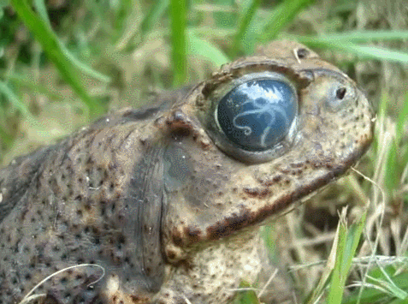
There are two main groups of cells.
  A.) Prokaryotic
  B.) Eukaryotic
19
Prokaryotic
Eukaryotic
B
A
Copyright © 2024 SlideSpark .LLC

Slide 208
Which one is older (evolved)? Can you provide a reference of time.
  A.) Prokaryotic (appeared about 3.8 billion years ago.)
  B.) Eukaryotic (Appeared approx. 2.2 billion years ago.)
20
A
B
Copyright © 2024 SlideSpark .LLC

Slide 209
Which one is older (evolved)? Can you provide a reference of time. and the answer is…
20
A
B
Copyright © 2024 SlideSpark .LLC

Slide 210
Which one is older (evolved)? Can you provide a reference of time.
  A.) Prokaryotic (appeared about 3.8 billion years ago.)
  B.) Eukaryotic (Appeared approx. 2.2 billion years ago.)
20
A
B
Older
Prokaryotic
Copyright © 2024 SlideSpark .LLC

Slide 211
Which one is older (evolved)? Can you provide a reference of time.
  A.) Prokaryotic (appeared about 3.8 billion years ago.)
  B.) Eukaryotic (Appeared approx. 2.2 billion years ago.)
20
A
B
Older
Younger
Prokaryotic
Eukaryotic
Copyright © 2024 SlideSpark .LLC

Slide 212
Cellular Biology Review Game
IT CAME FROM THE SEWER | IT’S ALIVE | LEVEL UP | SCHLEID ON TIME | CELL BLOCK -BONUS-
1 | 6 | 11 | 16 | *21
2 | 7 | 12 | 17 | *22
3 | 8 | 13 | 18 | *23
4 | 9 | 14 | 19 | *24
5 | 10 | 15 | 20 | *25
Copyright © 2024 SlideSpark .LLC

Slide 213
Cellular Biology Review Game
IT CAME FROM THE SEWER | IT’S ALIVE | LEVEL UP | SCHLEID ON TIME | CELL BLOCK -BONUS-
1 | 6 | 11 | 16 | *21
2 | 7 | 12 | 17 | *22
3 | 8 | 13 | 18 | *23
4 | 9 | 14 | 19 | *24
5 | 10 | 15 | 20 | *25
Copyright © 2024 SlideSpark .LLC

Slide 214
This Character doesn’t appear to be behind bars?
  A.) Prokaryotic (appeared about 3.8 billion years ago.)
  B.) Eukaryotic (Appeared approx. 2.2 billion years ago.)
*21
Copyright © 2024 SlideSpark .LLC

Slide 215
This Character doesn’t appear to be behind bars?
  A.) Prokaryotic (appeared about 3.8 billion years ago.)
  B.) Eukaryotic (Appeared approx. 2.2 billion years ago.)
*21
Wolverine
Copyright © 2024 SlideSpark .LLC

Slide 216
This is the cell from what movie?
  A.) Prokaryotic (appeared about 3.8 billion years ago.)
  B.) Eukaryotic (Appeared approx. 2.2 billion years ago.)
*22
*21
Copyright © 2024 SlideSpark .LLC

Slide 217

This is the cell from what movie?
  A.) Prokaryotic (appeared about 3.8 billion years ago.)
  B.) Eukaryotic (Appeared approx. 2.2 billion years ago.)
*22
*21
Copyright © 2024 SlideSpark .LLC

Slide 218
Where is this scene taking place?
  A.) Prokaryotic (appeared about 3.8 billion years ago.)
  B.) Eukaryotic (Appeared approx. 2.2 billion years ago.)
*23
Copyright © 2024 SlideSpark .LLC

Slide 219
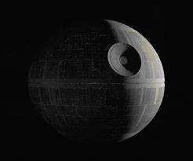
Where is this scene taking place?
  A.) Prokaryotic (appeared about 3.8 billion years ago.)
  B.) Eukaryotic (Appeared approx. 2.2 billion years ago.)
*23
Death Star
Copyright © 2024 SlideSpark .LLC

Slide 220
Where is this scene taking place?
  A.) Prokaryotic (appeared about 3.8 billion years ago.)
  B.) Eukaryotic (Appeared approx. 2.2 billion years ago.)
*23
Death Star
Cell Block??
Copyright © 2024 SlideSpark .LLC

Slide 221
This is the prison cell from what movie?
  A.) Prokaryotic (appeared about 3.8 billion years ago.)
  B.) Eukaryotic (Appeared approx. 2.2 billion years ago.)
*24
Copyright © 2024 SlideSpark .LLC

Slide 222
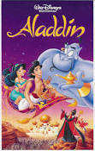
This is the prison cell from what movie?
  A.) Prokaryotic (appeared about 3.8 billion years ago.)
  B.) Eukaryotic (Appeared approx. 2.2 billion years ago.)
*24
Copyright © 2024 SlideSpark .LLC

Slide 223
This is the soon to be Count of Monte Cristo
*25
Copyright © 2024 SlideSpark .LLC

Slide 224

This is the soon to be Count of Monte Cristo
*25
Copyright © 2024 SlideSpark .LLC

Slide 225
Cellular Biology Review Game
IT CAME FROM THE SEWER | IT’S ALIVE | LEVEL UP | SCHLEID ON TIME | CELL BLOCK -BONUS-
1 | 6 | 11 | 16 | *21
2 | 7 | 12 | 17 | *22
3 | 8 | 13 | 18 | *23
4 | 9 | 14 | 19 | *24
5 | 10 | 15 | 20 | *25
Final Question
Copyright © 2024 SlideSpark .LLC

Slide 226
Final Question

Slide 227
Final Question
“You may wager up to 5 pts .”

Slide 228
Name A, B, and C?
C
A
B
Final Wager Question
Copyright © 2024 SlideSpark .LLC

Slide 229
Name A, B, and C?
C
A
B
Final Wager Question
Copyright © 2024 SlideSpark .LLC

Slide 230
Name A, B, and C?
C
A
B
Nucleus
Final Wager Question
Copyright © 2024 SlideSpark .LLC

Slide 231
Name A, B, and C?
C
A
B
Nucleus
Final Wager Question
Copyright © 2024 SlideSpark .LLC

Slide 232
Name A, B, and C?
C
A
B
Nucleus
Cytoplasm
Final Wager Question
Copyright © 2024 SlideSpark .LLC

Slide 233
Name A, B, and C?
C
A
B
Nucleus
Cytoplasm
Final Wager Question
Copyright © 2024 SlideSpark .LLC

Slide 234
Name A, B, and C?
Plasma Membrane
C
(or cell membrane)
No Cell Wall (Animal)
A
B
Nucleus
Cytoplasm
Final Wager Question
Copyright © 2024 SlideSpark .LLC

Slide 235


Questions 1-20 = 5pts Each
Final Category (Bonus) = 1pt Each
Final Questions = 5 pt wager
Find the Owl =
Secretly write “Owl” in the correct box worth 1pt.

Slide 236
Cellular Biology
Review Game
Answer Version
Part 1
Lesson 9

Slide 237



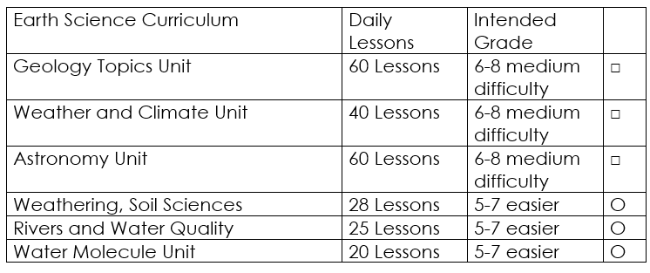

Curriculum Guide
Number of Lessons in each unit (50 min, daily lessons) and difficult rating scale / intended grade level.
=Easier, = More difficult, =Most difficult
Earth Science Units

Slide 238


Life Science Units

Slide 239
Physical Science

Slide 240
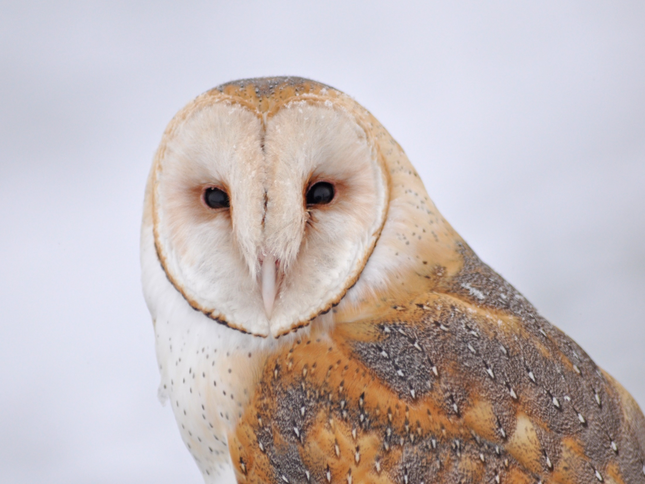
Dear Valued Educator,
Our fully editable .pptx and .doc resources are perfect for educators looking to bring enthusiasm and creativity to their lessons. We encourage you to make changes to fit your needs and style. As science educators, we’re committed to providing students with the tools they need to succeed in the classroom and beyond. Each unit in the curriculum includes a range of resources that have been developed through extensive research and use in a busy classroom. Our teaching approach is designed to make science education engaging and exciting for learners of all ages. We offer a one-of-a-kind science curriculum that will challenge, inspire, and educate students to become tomorrow's scientists and leaders. Join us today and learn more about how our program can help you achieve your classroom goals.
With appreciation,
Support@SlideSpark.net

Slide 241





Thank you for your time and interest in our Science curriculum. We strive to provide students with engaging and informative lessons that will spark their curiosity and encourage scientific exploration. Should you have any questions or concerns, please do not hesitate to contact us. Thank you again for considering our curriculum, and we wish you all the best in your educational journey.
Sincerely,
Support@slidespark.net
SlideSpark Science on TpT

